Slide 1

“Bringing Ideas to Life”
Community Partnership Annual Forum
3rd March 2023

Slide 2
6 minutes to Start
Siren working with East Suffolk Council young apprentices in 2022 - YouTube

Slide 3
Steve Gallant, Chair
Community Partnership Board
Welcome
Notes:
Good morning everyone, and welcome to this year’s East Suffolk Community Partnership Forum.
I am Cllr Steve Gallant, Leader of East Suffolk Council, and I also Chair the Community Partnership Board.
Housekeeping:
There are no emergency evacuation tests scheduled for today so if the alarms sound please leave whatever room you are in via the marked exits and walk to the assembly point by the car park at the front of the Conference Centre.
Please be aware that photos will be taken at this event and may be used for promotional purposes. If you do not consent to your photo being taken, please speak to a member of staff at reception.

Slide 4

Our Net Zero Partner
Notes:
As you all know, climate change is a big topic facing our district and indeed the country. Reducing our carbon emissions and restoring our environment is an crucial way of tackling this challenge.
East Suffolk Council has set a goal of reaching net zero emissions by 2030. We also support Suffolk’s goal to hit this target by 2030 as well, and are very actively working with partners across all sectors to achieve this.
At East Suffolk Council we take our role as leading by example very seriously. We’ve worked hard in the lead up to this event to reduce the use of materials, cut down our food miles and encourage use of public transport and car sharing.
Because we can’t eliminate all of our emissions yet, this event still has a carbon footprint. Therefore, I’m delighted that the Sizewell C team are our very first ‘net zero’ conference partner.
The Sizewell C team are helping us offset our remaining carbon footprint by sponsoring the investment in projects in this county that will store and capture equivalent emissions generated by this conference. Thanks to their support we are able to run a net zero conference for the first time!
Extra thanks also to those of you that has taken up the sustainable travel options to get here today, plus the venue and exhibitors that have worked to reduce our environmental footprint.

Slide 5
“Bringing Ideas to Life”
Annual Forum 2023: Programme
9:30-9:40 | Introduction and update on Community Partnerships
9:40-10:10 | Keynote: “Moving forwards after Covid-19 changed the world”
10:25-11:25 | Workshops and seminars: Session 1
11:25-12:00 | Refreshments and Marketplace
12:00-1:00 | Workshops and seminars: Session 2
1:00-2:00 | Lunch and Marketplace
Notes:
Now, on to business.
There are over 200 of us here today and many more people who wanted to attend but we did not have room!
I would like to welcome every single one of you for taking time out of your busy schedules to be here – and I look forward to us all sharing the incredible wealth of knowledge and skills assembled here in this room.
We are here to explore some of the most critical issues for our residents, communities and business – so I thank you all for accepting your invitation to come along and help make East Suffolk an even better place to live, work and visit in.
The event is scheduled to run until 2 pm for those that are staying for lunch.
We now have a morning packed with 12 separate workshops and seminars – all focussing on the priorities identified by our Community Partnerships here in East Suffolk.
There are a host of people from 19 different organisations here today who I want to thank for stepping up to organise and facilitate these session – your support is invaluable.
And I’m sure we all appreciate the work of the Event Team from East Suffolk Council, EELGA and Trinity Park Events, who have pulled the whole show together.

Slide 6
Community Partnership Ambitions
Embed the Community Partnerships as the place to do place-based partnership work
Establish a programme of activity to address the data-led priorities identified at East Suffolk and individual CP level
Establish the Community Partnership Board as a strategic forum to effectively and collaboratively problem solve key challenges for East Suffolk
Evidence high impact investment of both Community Partnership and Board funding
Hold a successful Partnership Forum annually to share good practice and lessons learned
Notes:
We have invested heavily in the Community Partnerships and I think it is important we take a moment to reflect on what we aim to achieve by doing this before briefly reviewing progress.
This is a major investment - Total DELIVERY budget across all eight Community Partnerships and the Community Partnership Board has been £1,730,000 To tackle priority issues that have been identified as important to our people and places in East Suffolk.
We wanted Community Partnerships to be something fresh that utilise the incredible knowledge, experience and enthusiasm contained right across the wide range of organisations and communities in East Suffolk.
Through a process of data analysis, stakeholder engagement and collaborative working the Community Partnerships have collectively identified priorities for action and are busy delivering on them.
Each year we also hosts this conference for representatives from our communities, voluntary organisations, public services and local businesses. This important event gives us all the opportunity to share our knowledge and expertise and work together to benefit our communities and businesses in East Suffolk.

Slide 7
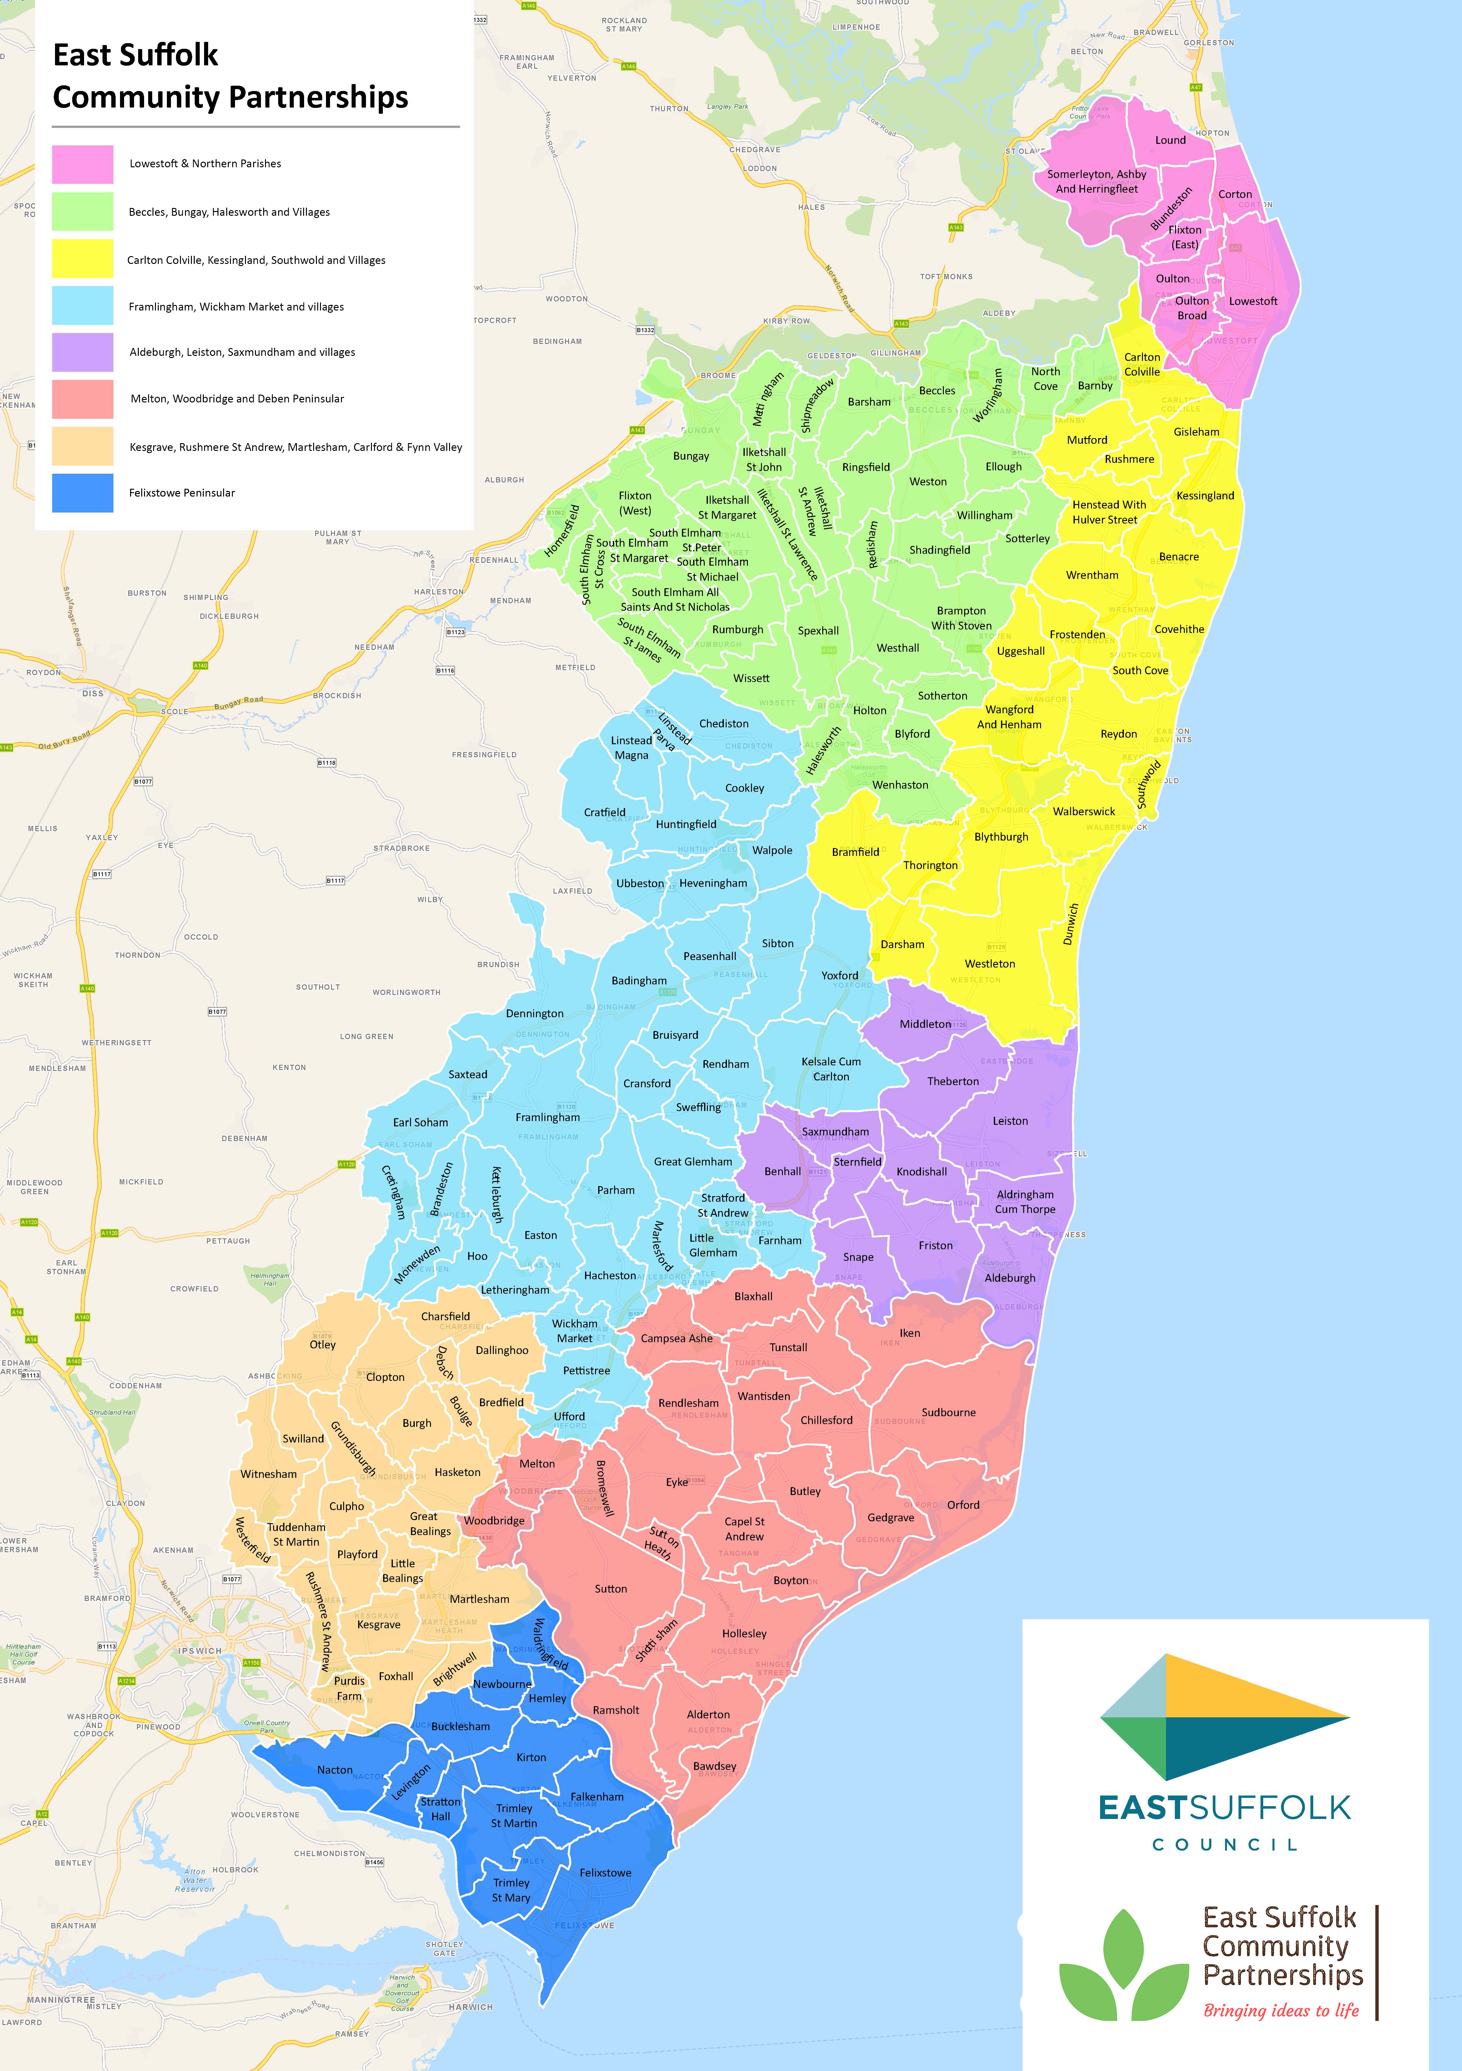
Community Partnerships - a Recap
Eight Community Partnerships
Wide range of members: Town, Parish, District and County Councillors, Voluntary organisations, Community groups, Health (CCG’s), Police, Youth Groups and more….
Annual budget of £25k per partnership
Community Partnership Board with an annual budget of £300k
Notes:
I quick recap on our 8 Community Partnerships.
The Community Partnerships are based on natural groupings of communities and using the East Suffolk Council ward boundaries as the ‘building blocks’.
These partnerships are informal bodies with a solution-focussed workshop style, giving them the opportunity to work collaboratively to solve problems and deliver solutions to them.
I’m also pleased to say that each Community Partnership is evolving it’s own character and style to reflect the local distinctiveness of their area and their own priorities. I would like to thank the Chairs, Vice-chairs and members of each of our eight Community Partnerships for their tremendous efforts to deliver a wide range of initiatives that are making a real difference on the ground in their communities.
The Chairs of the partnership also sit alongside a range of other partners on the Community Partnership Board to tackle issue that are best addressed at a more strategic level.
As Chair, I would like to thank all of the members of the Board for their generous support and investment of time. We have been tackling some challenging and important issues and we could not do it without you.
There are a good number of Board members here to day. They are easily identified by their green badges, so if you would like to know more about our work please do introduce yourself to one of us.

Slide 8
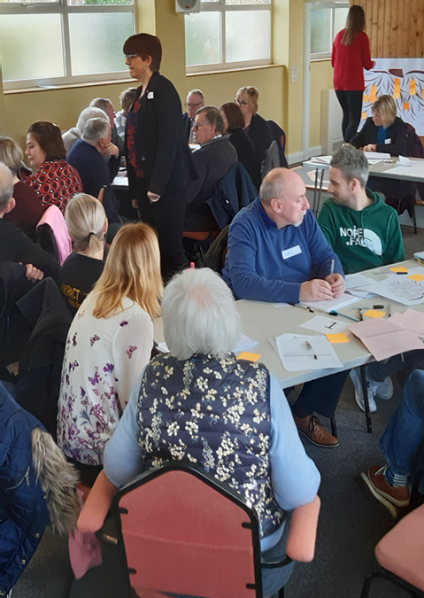
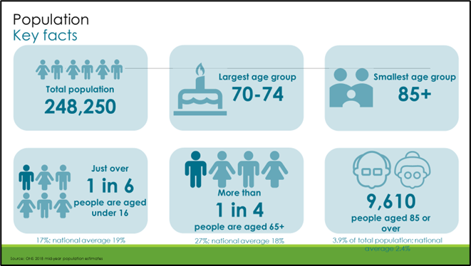
Focus on:
What we know (data)
What local people know (insight)
Notes:
Data is important. We want our partnerships to have the best available data on which to base their activity.
New data packs produced in 2022 for each of the eight community partnerships
There is now a new online “East Suffolk Profile”
Work undertaken by East Suffolk Council and Suffolk County Council knowledge & Information Team
Used as a focal point for a wider discussion at community partnership workshops. As a result, priorities are identified for each CP area and reviewed annually.

Slide 9
Community Partnership Board Priorities
Isolation & Loneliness
Transport & Travel
Mental Health & Wellbeing – focus on young people
Inequalities - focus on Financial Inequality
Notes:
The Community Partnership Board.
The Board is currently delivering on four priorities identified both from East Suffolk wide data and intelligence, as well as by picking up issues that are priorities across the majority of the individual Community Partnership.
For the Board (All years to date):
Total initiatives funded – 19
Total funding allocated - £916,978.89
2 For the eight CP’s combined (all years to date):
196 projects funded (including the separate projects funded through small grants)
Total amount of funding allocated = £521,527.79

Slide 10
Going forward
East Suffolk Council committed to Community Partnerships
Funding allocated for at least the next two years
Build engagement locally – across sectors
Further embed our enabling approach – not doing ‘to’ or ‘for’
Increase impact and demonstrate that impact
Notes:
So, to conclude, there has been some real progress this year.
Despite the obvious challenges presented initially by Covid, and now by the impact of the cost of living rises on individuals, families, businesses and voluntary sector organisations, our Community Partnerships have managed to put themselves at the heart of the action and delivered tangible benefits for their communities.
Indeed having Community Partnerships in place has enhanced our ability to mobilise support for the most vulnerable in our communities who were disproportionately affected by Covid , lockdown and now financial insecurity.
The Board is in a good position to deal with more strategic issues affecting East Suffolk, and has built a track record in delivering results.
And finally, as you would expect with the roll out of a major programme like this - it’s not all been plain sailing but it has definitely proving to be worth it.

Slide 11
Anna Crispe
Consultant in Public Health, Assistant Director,
Knowledge, Intelligence & Evidence,
Suffolk County Council
Notes:
I’ll be back later to introduce the rest of the programme but first I am extremely pleased to introduce Anna Crispe, who is going to speak to us on “Moving forwards after Covid-19 changed the world”.
Point to come back on by Steve here:
I think the presentation from Anna has shone a light on some of the challenges for East Suffolk residents and businesses, but also on some opportunities to do more in partnership, particularly through an increased emphasis on inclusive growth – growth that benefits everyone within our communities – joint working with the two new Integrated Care Systems that cover East Suffolk and the importance of the voluntary, community, faith and social enterprise sectors
It also, for me, reinforces our focus on areas of activity such as inequalities, mental health and wellbeing and transport as a way to improve access to services
The importance of working together to reduce the impacts of the cost of living crisis is front and centre and I am proud that we have managed to put together a total funding package of almost a million pounds to do exactly that
Particularly picking up the point on Anna’s final slide, our eight Community Partnerships provide a ready made way of co-producing solutions at a local level,

Slide 12
“Bringing Ideas to Life”
Annual Forum 2023: Programme
9:30-9:40 | Introduction and update on Community Partnerships
9:40-10:10 | Keynote: “Moving forwards after Covid-19 changed the world”
10:25-11:25 | Workshops and seminars: Session 1
11:25-12:00 | Refreshments and Marketplace
12:00-1:00 | Workshops and seminars: Session 2
1:00-2:00 | Lunch and Marketplace
Notes:
We will shortly break into our first session of workshops and seminars.
You have been allocated your workshop/seminar place based on the information you provided on your booking form. Please make sure you attend the sessions you are booked onto. You can check your name against the list in your packs.
As we have another session of workshop/seminars later you will need to change rooms during the break. Workshop/seminars are clearly signed at the entrance to each break-out room.
Our facilitators have put a lot of effort into preparing these sessions for which I thank them. Please can we all show them our appreciation by making sure we get to our workshops or seminars in good time before they start.
Feedback from all the sessions will be discussed by the Board in June and will be used to shape work for the year ahead – real project come from the forum!
And remember to visit the marketplace during the breaks –to pick up information and ask questions of many of the organisations operating in east Suffolk. And don’t forget to visit the vehicles parked outside the front entrance.
So, that just leaves me to say that I hope you find today inspiring and please make sure to participate as your views are important to us
END by 10.15 am

Slide 13























“Bringing Ideas to Life” 3rd March 2023
Supporters
Notes:
End Slide

