Slide 1
East Suffolk: Moving forwards after Covid-19 changed the world
East Suffolk Community Partnership data slides
March 2023
anna.crispe@suffolk.gov.uk

Slide 2
Introduction
Today I will be providing summary information on:
  What we knew about the key trends (population, economy, environment, health) in East Suffolk prior to the pandemic
  The impact of the pandemic in Suffolk
  What do we know now about East Suffolk
    Population
    Health
    Education
    Skills
    Economy
A summary of key themes and findings to guide your conversations
Sources:
Notes:
Many thanks to my team for all their help in compiling these slides, particularly Alison Matthews who is here today

Slide 3
What did we know before the pandemic about the key trends affecting Suffolk's population over the coming 20 years?
Mental health
Economy
Housing & Communities
Environment
Physical health
Population
Population growth of 10%
1 in 3 people aged 65 or over in 20 years
Skill levels rising but still low; educational attainment relatively weak
High life expectancy, good health outcomes overall but healthy life expectancy falling
Smoking at lowest rate on record but 3x higher in routine/manual workers
Rising levels of CO2, NOX, particulates
Building of Sizewell C / renewables sector part of national response
Green transport infrastructure growing slowly
Inequalities have deepened over last 20 years
This trend likely to continue as the welfare reform agenda continues
Inequalities
General levels of wellbeing good
But high rates of admission for self harm indicative of poor MH amongst children and young people
Suicide rates static
Significant service redesign in progress
Demand for dwellings outstrips supply
House price to income ratio higher than 8 in all areas
People remaining in family home for many years
10,000 on housing waiting lists in Suffolk
Suffolk in least deprived third of English Local Authorities
An estimated £3.2bn productivity gap in 20 years time, driven by continued lower than average wages
Brexit impact uncertain
Economy dominated by small and very small enterprises
Sources: Public Health Suffolk analysis, 'Suffolk +20 years'
Notes:
What we knew, and were expecting
- population growth, accompanied by rapid population ageing. 1 in 5 to 1 in 3
- generally good health, but not distributed equally, with health inequalities increasing in Suffolk over the last 20 years
- some indicators of poor mental health, particularly amongst children and young people
- In the last deprived third of Local Authorities – but a productivity gap driven by low wages, uncertainty over Brexit
- significant pressure in the housing market with a price to income ratio higher than 8 in all areas of Suffolk, 10,000 on housing waiting list, and more young people staying at home for longer
- rising levels of air pollution, green infrastructure developing

Slide 4
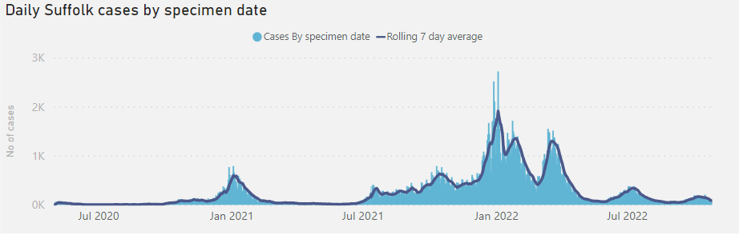
The Covid-19 pandemic began in early 2020 – and by the Spring, much of the world was in lockdown as we tried to work out how to combat the effects of the virus.
239,043 people tested positive for COVID-19 in Suffolk between May 2020 and Oct 2022
People from Suffolk’s more socio-economically deprived communities are more likely to catch COVID-19 - and are less likely to be vaccinated
In mid January 2021, COVID-19 patients in Suffolk were occupying 835 general hospital beds and 104 HDU/ITU beds
Over 55,000 people in Suffolk were on the Clinically Extremely Vulnerable list
While only 17.6% of cases have occurred in people aged over 60 in Suffolk, approximately 95% of deaths have occurred in this age group – and there are still deaths from Covid in Suffolk occurring every week. Please continue to get vaccinated and to support people you know to do the same!
2,303 people have died from COVID-19, 557 of whom lived in care homes (at 12 January 2023, deaths within 28 days of a positive test)
Source: Public Health Suffolk analysis
Notes:
Then Covid came…
- exacerbated the inequalities that already existed
- has caused at least 2500 deaths in Suffolk
- put enormous strain on health facilities and health and care workers
- identified people with particular risks, many of whom are still highly anxious about social mixing
And it hasn’t gone away – the deaths have occurred disproportionately in older people, and they are still occurring. If you have an older friend, neighbour, relative colleague who is not vaccinated please support them to get vaccinated!

Slide 5
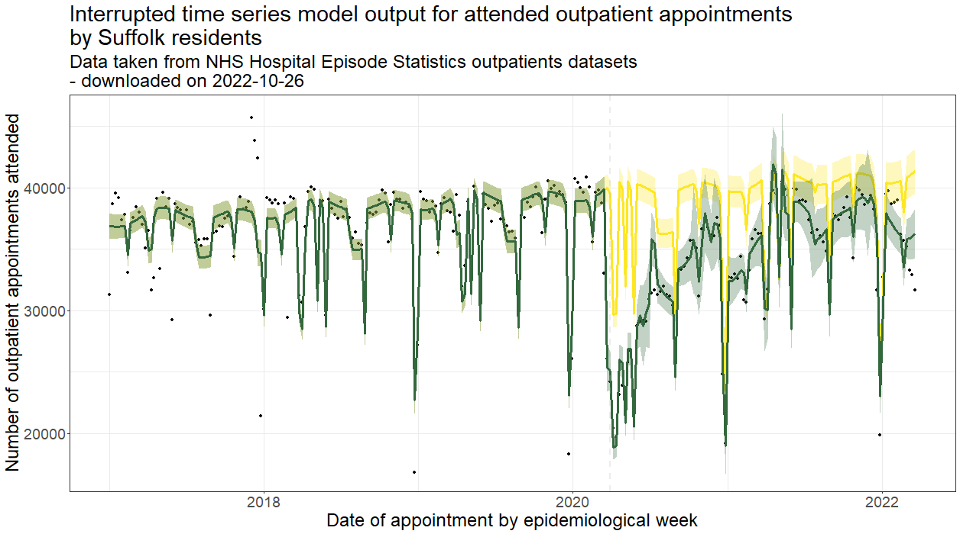
The direct and indirect impacts of COVID-19, particularly in relation to long COVID and because people could not access healthcare in a timely manner, are continuing.
Numbers of outpatient appointments attended by Suffolk residents (green line) were significantly lower than what would have been expected had there not been the pandemic (yellow line - counterfactual)
500,000 outpatient appointments that would have been expected to take place between March 2020 and March 2022 in Suffolk did not occur
These indirect impacts may continue to be felt for years to come
The lost care is equivalent to 13 weeks' worth of outpatient care in "normal times" – a significant outpatient care gap that is further multiplied by lost appointments in primary care, and lost hospital interventions
Ophthalmology, trauma & orthopaedics and ENT have among the highest care gaps by treatment specialty for Suffolk residents
At least 11,000 people in Suffolk may now be living with long COVID (self-reported; symptoms lasting longer than 12 weeks following infection)
Sources: Public Health Suffolk analysis of NHS Hospital Episode Statistics outpatient data
Notes:
And the impacts of Covid are ongoing
- half a million outpatient appointments did not happen – plus treatments, plus primary care consultations
- 11,000 now living with long covid

Slide 6
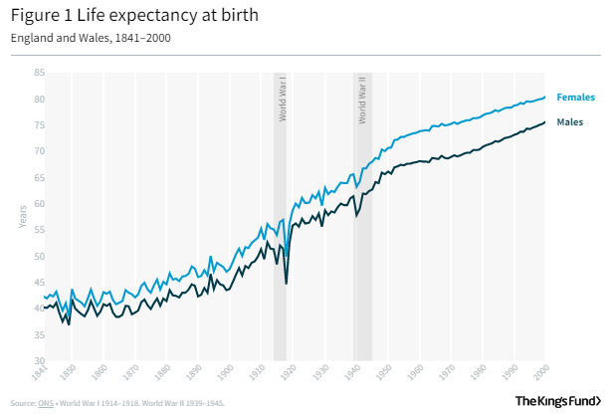
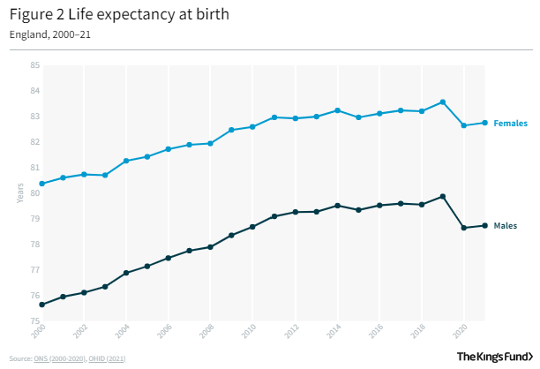
Previous projections suggested average life expectancy in Suffolk could be 89.1 years by 2030 – but the impact of covid has taken ten years off life expectancy gains
Source: Bennet J, Guangquan L, Foreman K, Best N, Kontis V, Pearson C, Hambly P, Ezzati M. ‘The future of life expectancy and life expectancy inequalities in England and Wales: Bayesian spatiotemporal forecasting’. Lancet 2015;386: 163-70; What is happening to life expectancy in England? | The King's Fund (kingsfund.org.uk)
Notes:
We can also look at the impact of covid on the most useful overarching indicator of health – life expectancy
These are data for England – the chart on the left goes all the way back to 1840 and you can see the trend of increasing life expectancy since around 1870, interrupted by the two world wars
if we look at bit more closely at the data since 2000 the impact of covid can be seen – broadly speaking for both men and women, Covid has removed the last ten years of life expectancy growth – we are back to the blue line, which is 2010

Slide 7
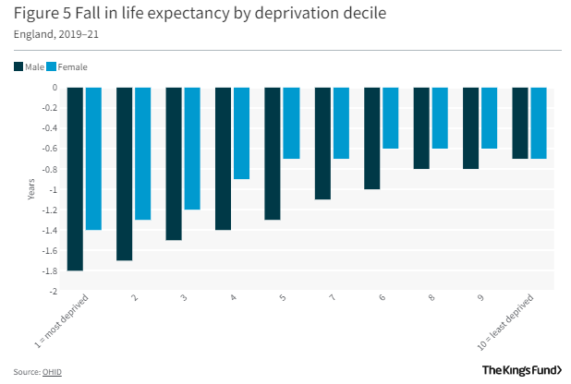
That reduction in life expectancy is not distributed equally across the population – and while the impact of the cost of living crisis is unclear, if it does reduce life expectancy, that effect will be magnified in more deprived communities, based on previous changes to life expectancy during austerity
Source: Health Equity in England: The Marmot Review 10 Years On - The Health Foundation; What is happening to life expectancy in England? | The King's Fund (kingsfund.org.uk)
Notes:
What’s also important to understand is that these falls in life expectancy are not distributed equally. The bar chart on the left shows the fall in life expectancy by deprivation decile
Two things
– life expectancy has fallen more in men than women in all deciles except the least deprived
- there is a clear socioeconomic gradient in the extent of life expectancy falls, with nearly 1.8 years in men in the most deprived decile, and only 0.7 in the least deprived
BUT
Look again at the recent life expectancy chart
What happened in the years prior to covid
LE flattened considerably in the wake of the financial crash in 2008/9 which brought in austerity and welfare reform.
Whether austerity contributed directly to the flattening of life expectancy is debated, and there are different opinions.
But I’m raising it now because it is possible that the current cost of living pressures may act in similar way
- we know their impact is unequally distributed in the population, with those on the lowest incomes most affected by price rises in food, energy, water and housing costs.
Combined with the ongoing health and wellbeing impacts we have already seen from Covid, which were also unequally distributed, this will be putting many people in our communities under severe pressure
it is too early to say yet what will happen to life expectancy as we move forwards – but we do need think and act in such a way that if it does start to recover, those benefits are shared by all, and if it remains static or even backwards, those burdens are not held by only a few

Slide 8
So what do we know about East Suffolk now?
Key findings from the 2021 Census
Physical and mental health in East Suffolk
Crime in East Suffolk
Deprivation and inequalities in East Suffolk
Education in East Suffolk
Skills in East Suffolk
Economy of East Suffolk
Summary messages

Slide 9
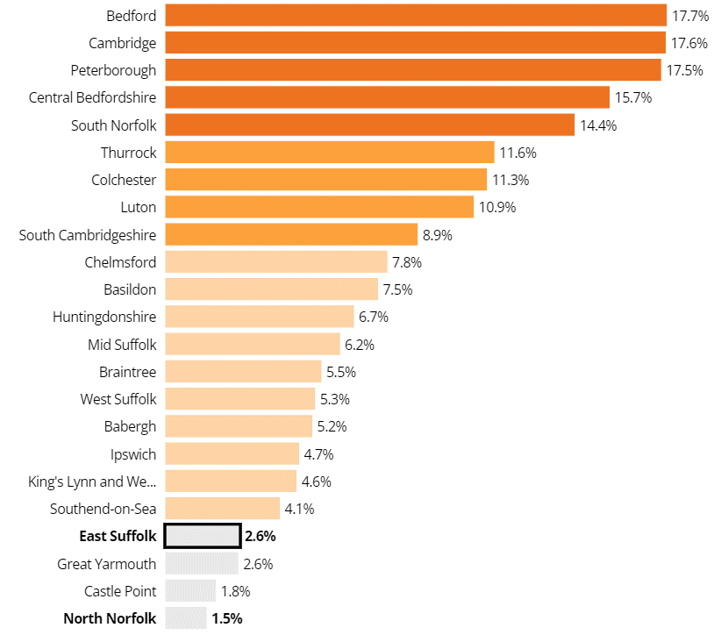
In the 2021 Census, 246,058 people were recorded as living in East Suffolk. East Suffolk’s population has increased by 2.6% in the last ten years – a lower increase than many other areas of the East of England
Population change in selected local authority areas in the East of England between 2011 and 2021
Source: How the population changed: Census 2021
Notes:
246058 increase of 2.6%
Low population increase. Some may be saying hooray – but does it have implications for workers and your economy?

Slide 10
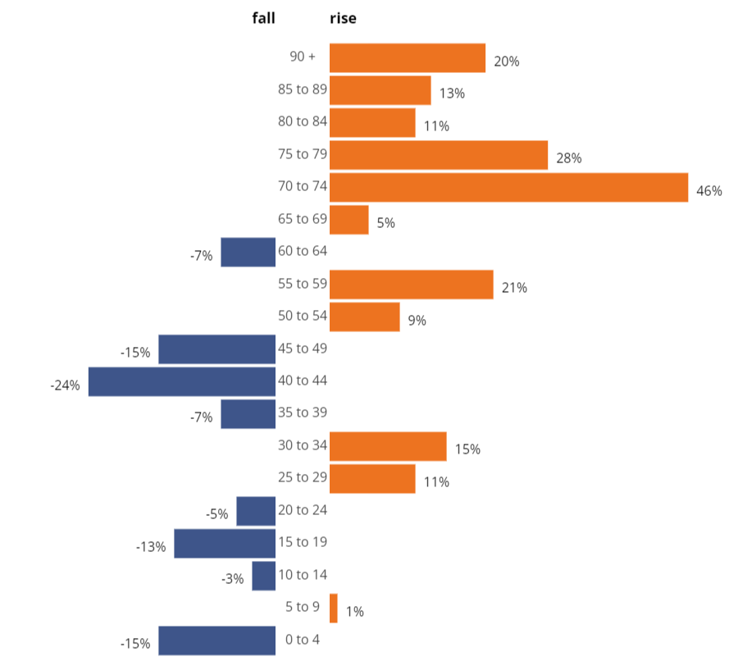
There have been increases in the number of older people in East Suffolk in the last ten years and decreases in the number of children and people of working age
East Suffolk population change by age group between 2011 and 2021
Over 65s have increased by 21.3% in the last ten years
There has been a 5.4% fall in the number of children aged under 15
People of working age (15-64) have decreased by 2.5%
Sources: Census 2021 Population change
Notes:
I think this is a worry for East Suffolk – older people are going to need care and support close to or at home. Where is this going to come from?

Slide 11
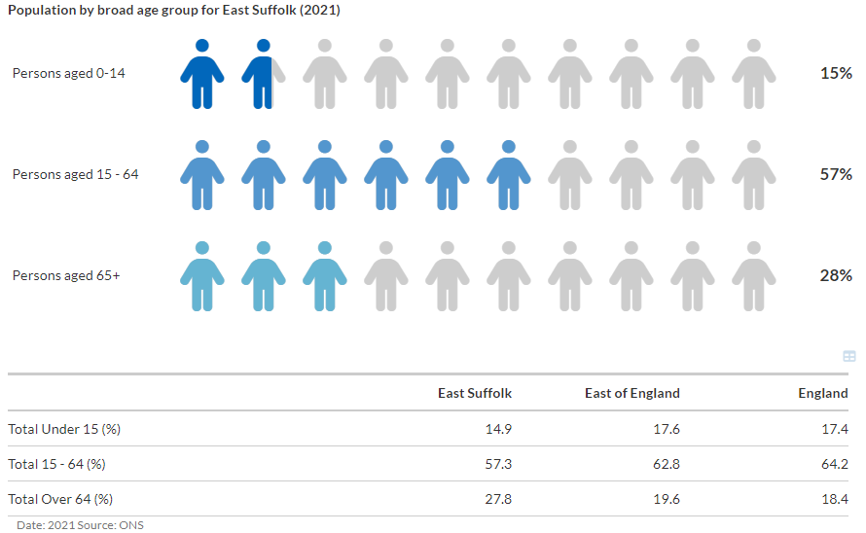
The overall population of East Suffolk, with a median age of 49, is now older than the East of England, England, and all other areas of Suffolk (except Babergh, also median age 49). More than 1 in 4 East Suffolk residents are now aged 64 and over.
Source: Population Report for East Suffolk (Suffolk Observatory)
Notes:
Overall impact of those trends – and note more than 1 in 4 are now aged 64 and over.

Slide 12
East Suffolk is less ethnically and racially diverse than Suffolk and England
Around 1 in 14 people in East Suffolk’s population are not White British in 2021 (6.9%, compared to 12.7% across Suffolk) and the White British population of the District grew by 2,023 between 2011 and 2021.
Sources: 2011 and 2021 Census
Notes:
Approximately half as diverse than Suffolk as a whole.

Slide 13
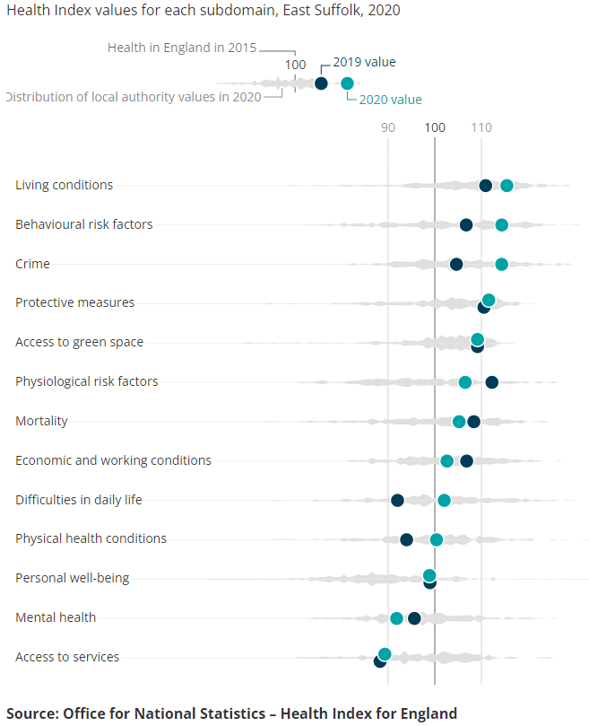
While many aspects of health in East Suffolk are good, levels of disability, children’s health, and access to services are worse than in the rest of Suffolk, and England
Data from the ONS Health Index compares a range of health indicators to England. East Suffolk's Health Index score improved in 2020 (from 2019). It scored highest (best) on living conditions and behavioural risk factors (among the best 25% authorities in England, fifth greatest improvement in this category).
Some of East Suffolk’s lowest scores are for indicators for mental health, access to services (linked to rurality), levels of disability, and high numbers of children with social, emotional and mental health needs.
Aggregated GP data for East Suffolk indicates a statistically significantly higher prevalence of depression in the registered population compared to England (13.8% vs 12.7%). Around 2,650 people registered with East Suffolk GPs have a dementia diagnosis.
Sources: The ONS Health Index , Fingertips
Notes:
Total pupils with social, emotional and mental health listed as their primary special eduational need (SEN) requirement
Weighted population aged 16-64 who are EA code or work-limiting disabled (NOMIS description)
living conditions looks at air pollution, household overcrowding, noise complaints, road safety, and rough sleeping.
"Behavioural risk factors" addresses alcohol misuse, drug misuse, healthy eating, physical activity, sedentary behaviour, smoking, and sexually transmitted infections.
There were 77 deaths by suicide in East Suffolk between 2019-2021, equating to a rate that was statistically significantly similar to England. 74.0% of these deaths were males.

Slide 14
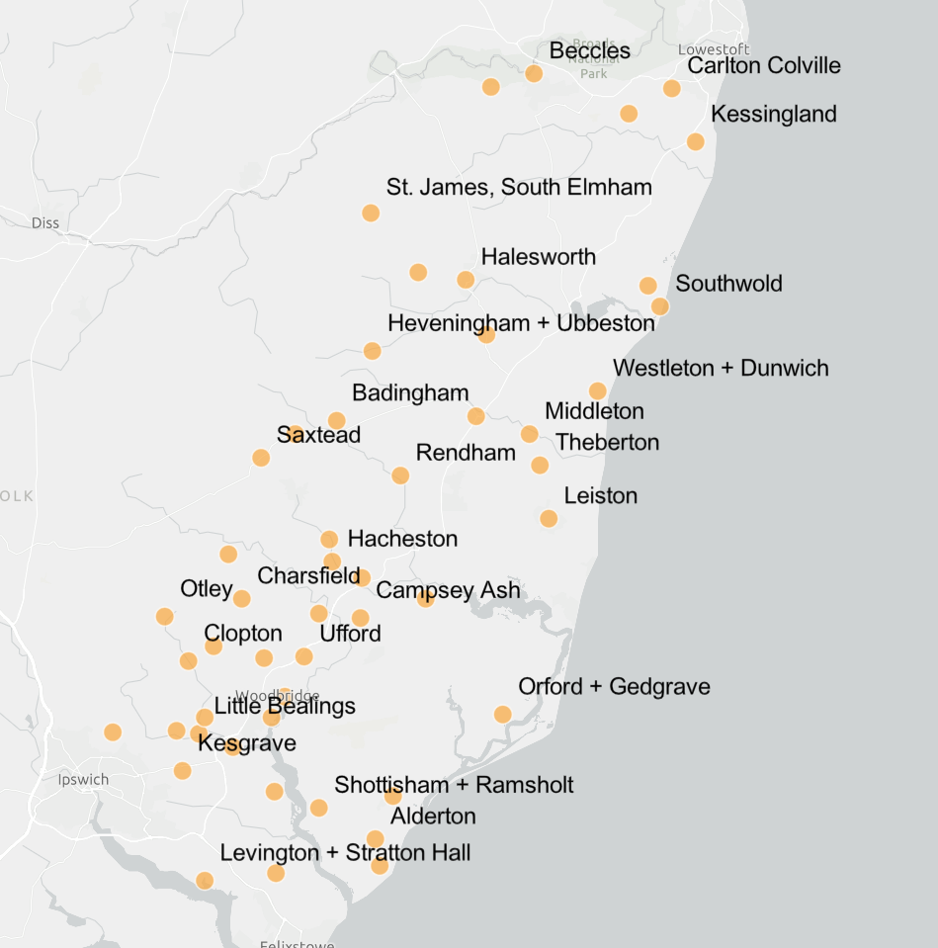

Transport East - Rural Access Survey
Responses
Thanks to Transport East for sharing their recent survey results for East Suffolk
143 Parishes responded
Good distribution of respondents
Out of 15 possible facilities, the average score within each Parish was 4.16
Notes:
Exploring the point about access to services in more detail
Across the East Suffolk area, the responses are well spread out with good representation across the district

Slide 15
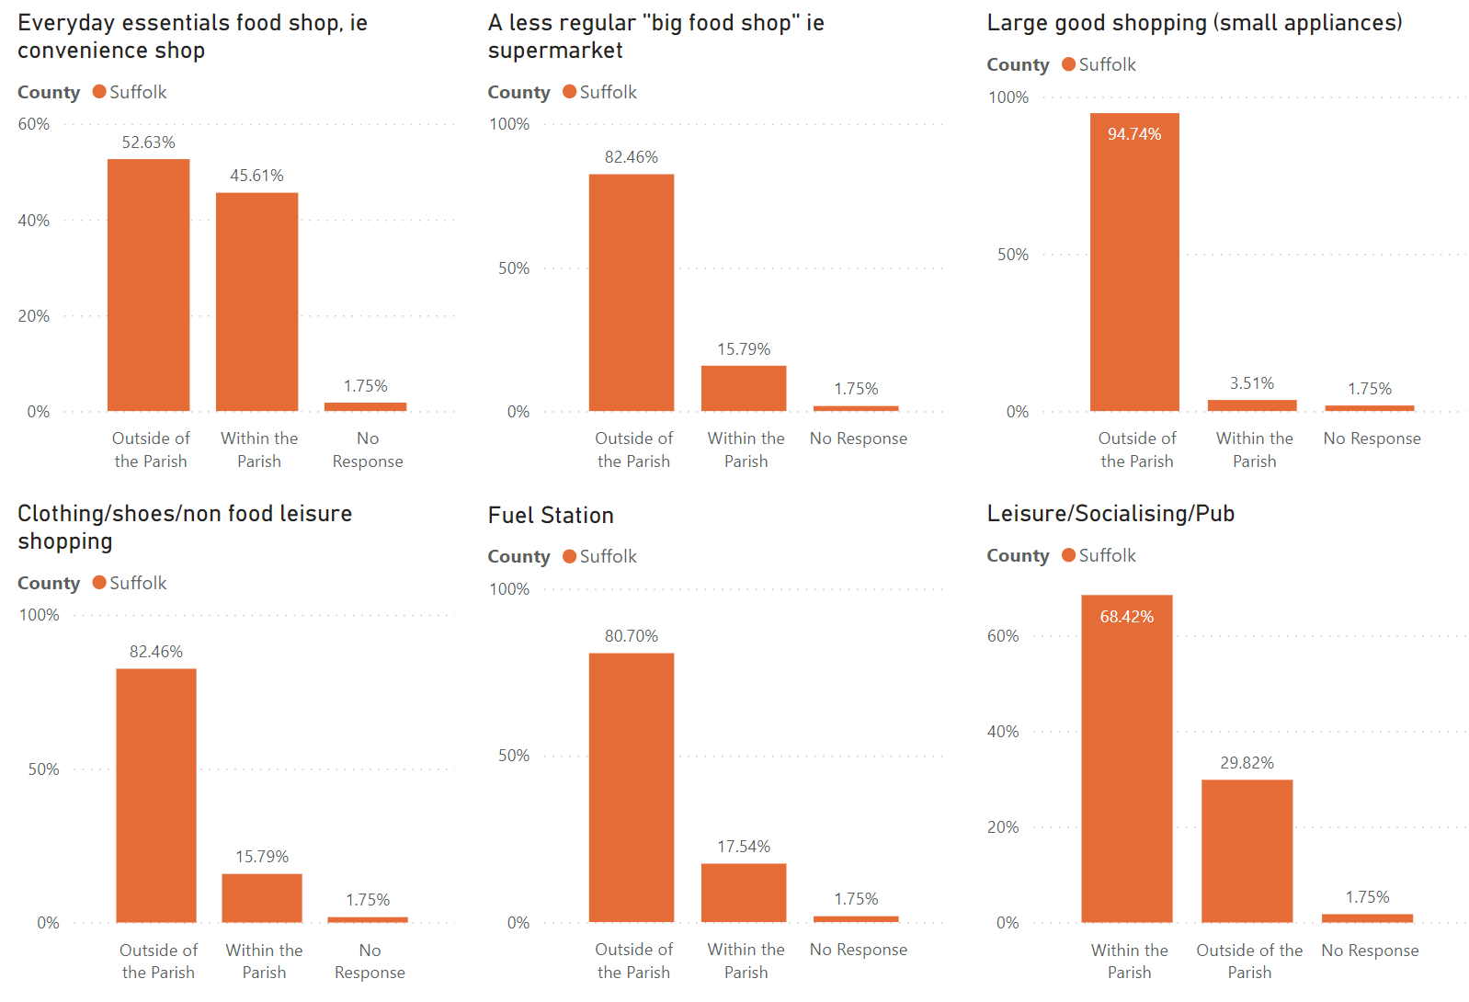
Rural Access Survey
Access to Facilities
- parishes reported
higher levels of access to
everyday essentials and
leisure/socialising/pub
facilities within their
parishes
- but for large goods,
large food shops, fuel
and clothing, the majority
of people are having to
leave their parish
Notes:
The survey asked a about a range of services that residents were likely to need to access and whether they existed within the parish or if travel was required
It’s clear that some residents are needing to travel elsewhere for a number of facilities or access them online where possible – such as for clothing, white goods or furniture
Other facilities included in the questions were health and medical services, primary, secondary and further education, sports including gym or leisure centre, libraries, banking and post office services .

Slide 16
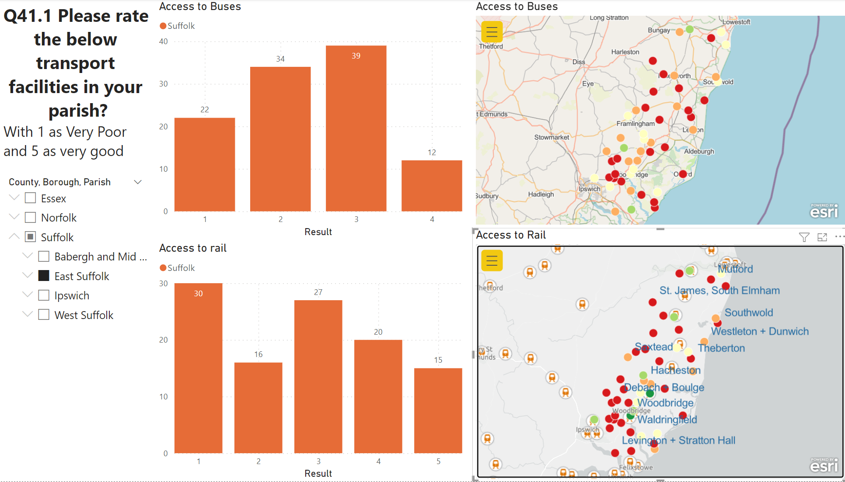
Rural Access Survey
Access to Bus and Rail
- no parish scored
access to buses as
‘very good’
- access to rail
services is valued
where it exists
Notes:
This slide shows the level of access to bus and rail services
With 1 as the lowest and 5 as the highest.
Rail scored lower across the whole of the region, apart from some Essex parishes where there are more stations and more frequent mainline services available.
The parishes that could access the East Suffolk line did indicate a higher score, indicating value in having rail services available locally

Slide 17
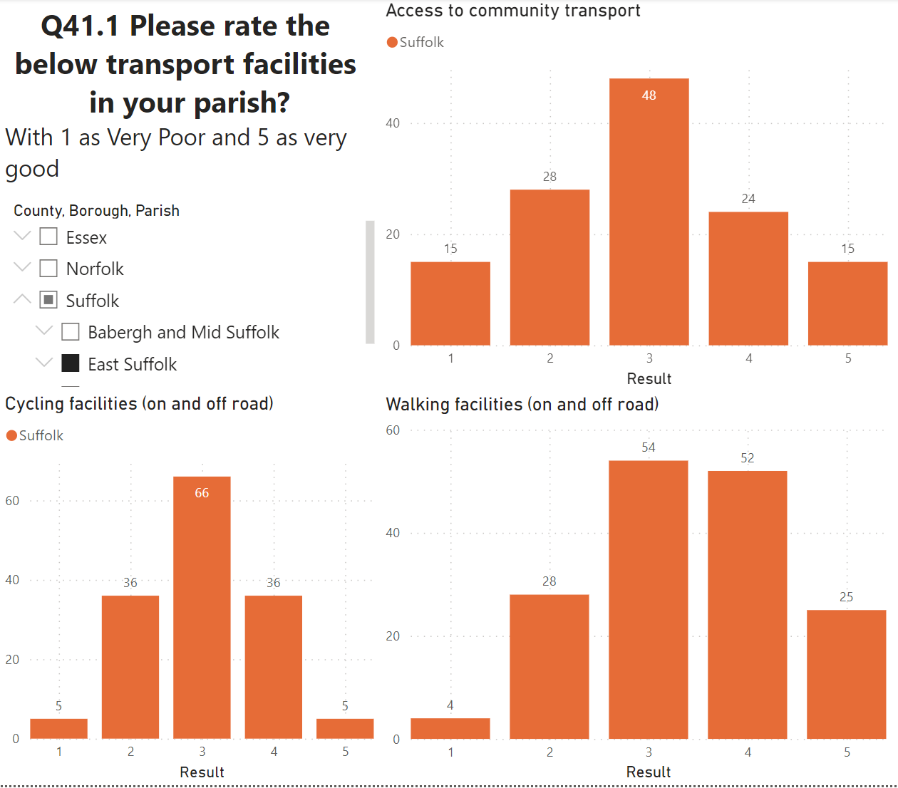
Rural Access Survey
Access to Walking, Cycling and Community Transport
- walking access scores well
- cycling and community transport scored more highly than bus or rail services
Notes:
This final slide shows the level of access to walking, cycling and community transport.
With scoring the same as the previous slide..
All of these scored higher than both bus and rail services, interestingly walking scores well if either on or off road. It might be interesting to perhaps look into this in more detail if possible.
(no map available for these results)

Slide 18


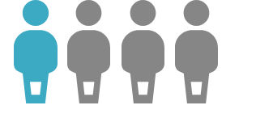

Looking at the health data in more detail suggests that key areas of concern include:
The rate of hospital admissions caused by unintentional and deliberate injuries in children and young people under the age of 5 (144.4 per 10,000) are statistically higher than England.
The rate of emergency hospital admissions for intentional self-harm (217.7 per 100,000) are statistically higher than England.
1 in 4 reception age children are overweight or obese (24.0%) - statistically higher than England (22.3%).
1 in 5 patients report a long-term musculoskeletal problem (such as arthritis) (24.0%) - statistically higher than England (22.3%).
East Suffolk performs statistically similar compared to England in relation to a range of health risk behaviours, alcohol use, smoking and physical activity
Rates of overall preventable mortality in East Suffolk are statistically better than England (under 75, 3 year ranges 2016-19). However, 1 year ranges for 2020 show East Suffolk is statistically similar to England, suggesting preventable mortality may have worsened during the COVID-19 pandemic.
Sources: Fingertips (2022)

Slide 19
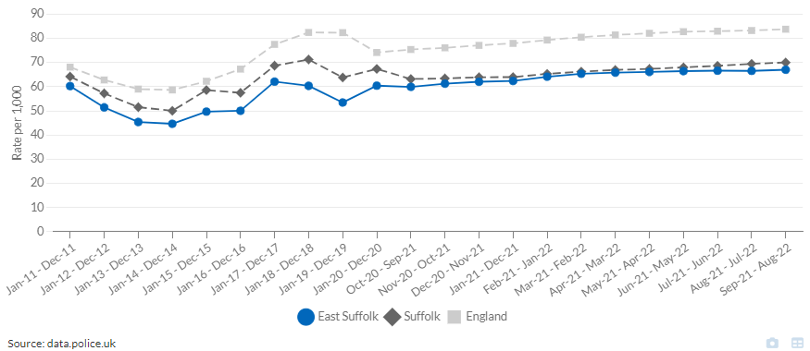
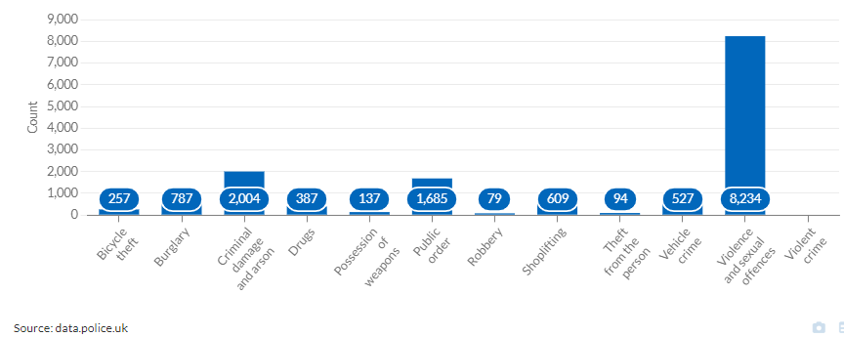
But crime rates are lower in East Suffolk than in Suffolk and England
All crime – 12 month rolling rates (Sep-21 - Aug-22)
The highest number of crimes (in the year ending Aug 2022) were violence and sexual offences (8,234), 33.0 per 1,000 population (34.2 Suffolk, 35.4 England)
Annual rates for each crime type in East Suffolk were lower than England.
The East Suffolk crime rate for criminal damage and arson (8.0) was higher than Suffolk (7.4), but East Suffolk has lower annual crime rates for other crime types each crime rate than Suffolk.
Crime count by type for East Suffolk (Sep-21 - Aug-22)
Sources: Suffolk Observatory crime report for East Suffolk (from data.police.uk)

Slide 20
East Suffolk has an unusually varied deprivation profile. A larger proportion of the population is in the least deprived quintile and in the most deprived quintile than in Suffolk as a whole. Relative deprivation is particularly high in Lowestoft.
More than a fifth of the population of East Suffolk (57,200 people) lives in neighbourhoods among the least deprived 20% of areas in England – the 2nd highest proportion of any of Suffolk’s LTLAs
East Suffolk also has the 2nd highest proportion of its population in the most deprived quintile (12.5%) of Suffolk LTLAs, albeit a long way behind Ipswich (33.5%)
Lowestoft accounts for the vast majority of the most deprived neighbourhoods in East Suffolk, though parts of Felixstowe and Beccles are also among the most 20% deprived of areas in England
The Kesgrave, Martlesham, Woodbridge and Framlingham areas in particular have very low levels of relative deprivation
 | East Suffolk |  | Suffolk
Decile | Population | % | %
1 = most deprived | 16,049 | 6.4% | 4.5%
2 | 15,140 | 6.0% | 6.0%
3 | 15,472 | 6.2% | 7.9%
4 | 34,975 | 14.0% | 9.2%
5 | 42,799 | 17.1% | 12.9%
6 | 28,802 | 11.5% | 18.3%
7 | 17,168 | 6.9% | 11.4%
8 | 22,768 | 9.1% | 11.4%
9 | 31,504 | 12.6% | 10.8%
10 = least deprived | 25,696 | 10.3% | 7.5%
Sources: Indices of Deprivation 2019, ONS 2020 mid-year population estimates
© Crown copyright and database rights 2023 Ordnance Survey 100023395
Sources: Indices of Deprivation 2019, ONS 2020 mid-year population estimates

Slide 21
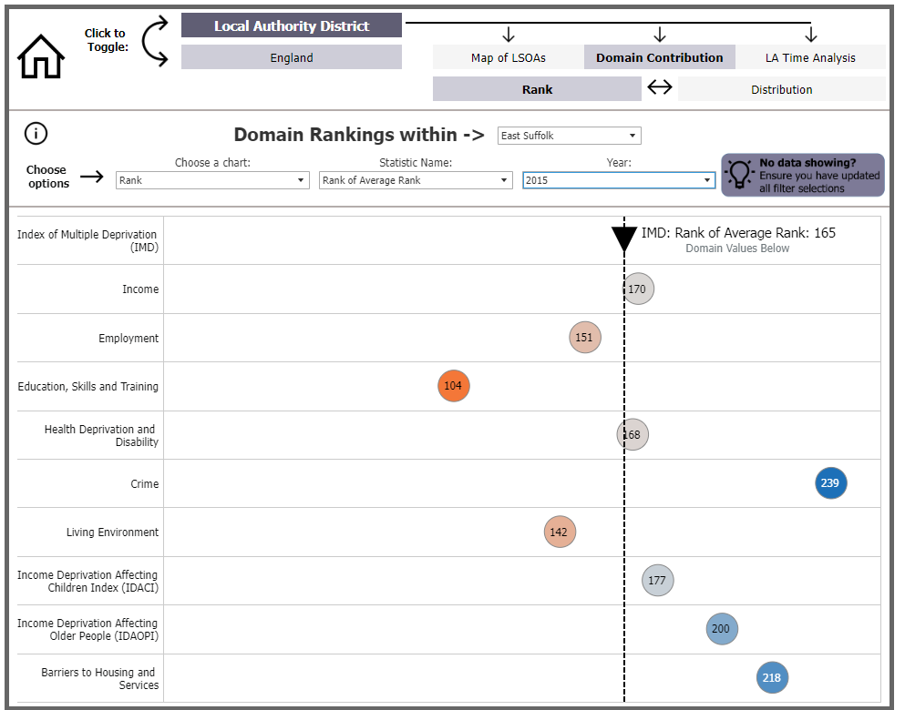
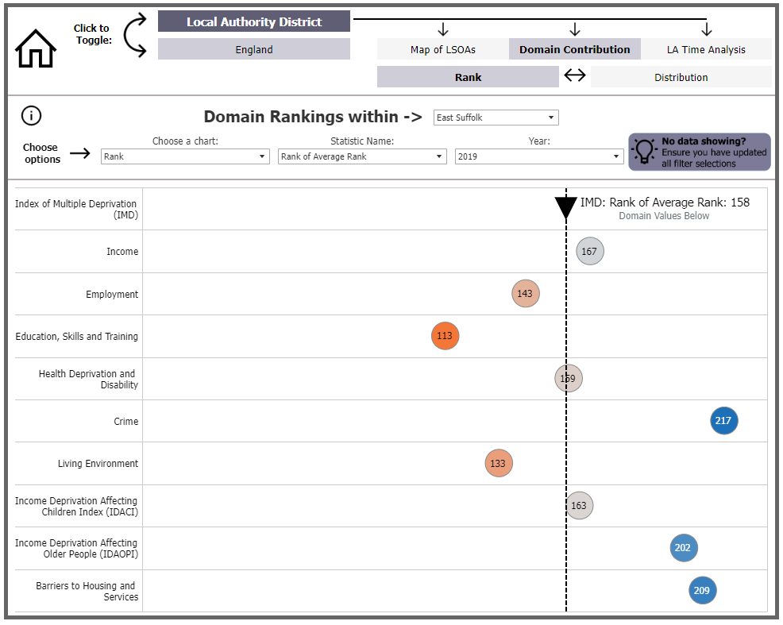
Relative deprivation in East Suffolk has not changed significantly in recent years. The 9 areas of Lowestoft which were in the 10% most deprived areas of England in 2015 all remained in the lowest 10% in 2019 - one area of Beccles also moved into the 10% most deprived areas.
While the education, skills and training domain improved between 2015 and 2019, it remains particularly low.
Ranking in the domains of Barriers to Housing and Services, Income Affecting Children (IDACI), and Living Environment worsened between 2015 and 2019 – again some of this reflects rurality
Source: Analysing the Indices of Deprivation

Slide 22
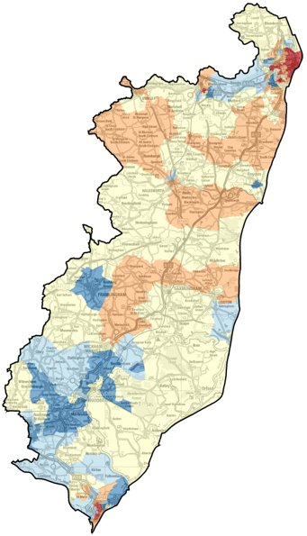
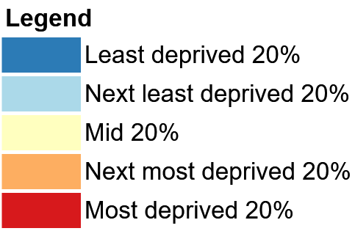
The 2019 Indices of Multiple Deprivation show this concentration of deprivation particularly in Lowestoft and Felixstowe. The domains of deprivation relating to income, employment and children all over-index compared to the rest of Suffolk
Index of Multiple Deprivation 2019: composite index
 | East Suffolk |  | Suffolk
 | Count | % | %
Income | 15,419 | 11.5% | 10.2%
Employment | 13,210 | 9.9% | 8.3%
IDACI | 6,352 | 15.2% | 13.6%
IDAOPI | 9,155 | 10.5% | 10.4%
Note – this data all predates the pandemic and the current cost of living crisis
© Crown copyright and database rights 2023 Ordnance Survey 100023395
Sources: Indices of Deprivation 2019, ONS 2020 mid-year population estimates

Slide 23
Parts of Lowestoft and Ipswich have the highest percentage of children eligible for free school meals in Suffolk…
IDACI measures the proportion of all children aged 0 to 15 living in income deprived families. The score, 15.0 for East Suffolk, represents the actual proportion (%) of children living in families who were income deprived.
East Suffolk is ranked 151 out of all 326 authorities in England for income deprivation among children (IDACI, 2019). East Suffolk is 5th in its CIPFA nearest neighbour group (Wyre is highest with 16.3%).
In March 2021, 7,419 children in East Suffolk were living in relative low income (data from DWP and HMRC), the highest count in a Suffolk LTLA.
However, in some areas of East Suffolk, Free School Meals data suggests many children will be living in absolute poverty. At least 40% of all children in Gunton West, Lowestoft Central, Pakefield North, and Lowestoft Harbour and Kirkley; between 30 – 34.9% of children in Felixstowe West and Normanston & Oulton Broad East; and 25-29.9% of children in Oulton and Southwold, Reydon & Wrentham 25-29.9 are in receipt of free school meals. As the income threshold for receiving free school meals is so low, these children are likely to be living in absolute poverty, not just relative deprivation.
Source: Healthy Suffolk Cost of Living dashboard, LGInform IDACI report; FSM Data SCC January 2022
Notes:
I want to talk particularly about children and young people
About 15% of children in East Suffolk are living in families who are income deprived – BUT this is reasonably old data, and the figure may quite possibly be higher than that now
In March 2021, nearly 7,500 children were living in relative low income – the largest number of children in a Suffolk LTLA
As well as RELATIVE poverty I think it is also import to talk about ABSOLUTE poverty
You are all likely to know about free school meals, and children in receipt of free school meals is often used as an indicator of poverty. I think it’s important to really understand that measure
Putting aside benefits what is annual household income threshold for children to receive FSM?
Adding in benefits house of commons library suggests most FSM families may be living on 16-18k per year in total. That is hard. But living in families where there is so little earned income, and presumably only experience of low paid, low status insecure jobs, may make it very hard for the children to break that cycle – if that is the norm, what are your chances of doing something different? And it is very much the norm in parts of east suffolk – at least 40% of children in central Lowestoft, over 30% of children in Felixstowe West and over 25% of children in Oulton, Southwold and Reydon are in this situation.

Slide 24
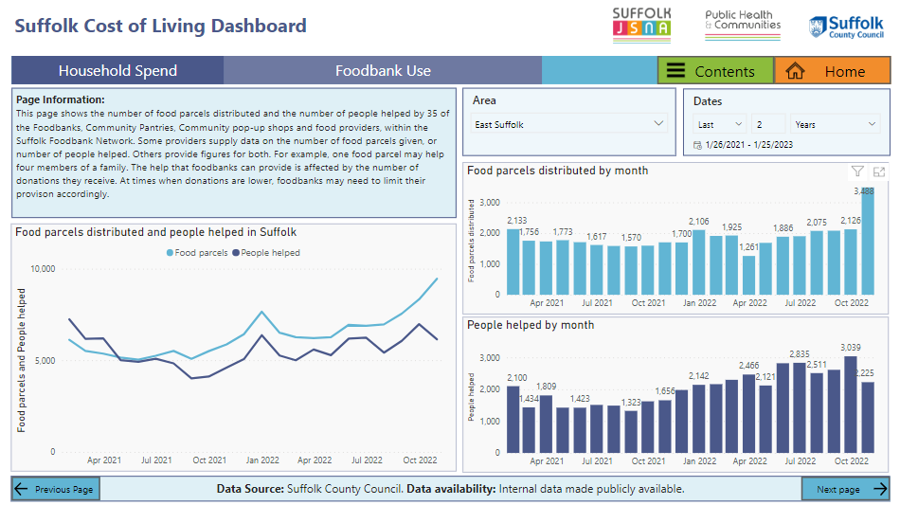
… and the number of East Suffolk residents helped by foodbanks has increased in recent months, with the number of food parcels distributed also increasing
Sources: Healthy Suffolk Cost of Living dashboard
Notes:
And of course the environment around these children is getting tougher. Food parcels from food banks rose sharply in East Suffolk in Oct, ANY MORE RECENT DATA?

Slide 25
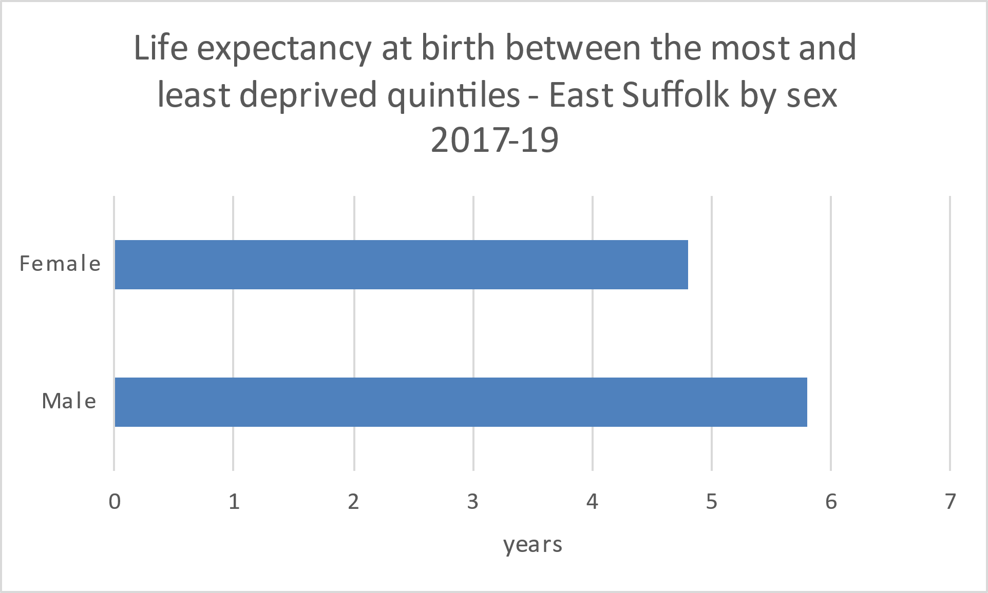
How does poverty influence health outcomes? Within East Suffolk, men in the least deprived communities live for 5.8 years more on average than in the most deprived communities; for women the gap is 4.8 years
Sources: OHID Fingertips
Notes:
We have talked a lot about the links between poverty and health outcomes – can we say more about the specific East Suffolk picture?
Yes - this is the life expectancy gap (averaged out by creation of East Suffolk council)

Slide 26
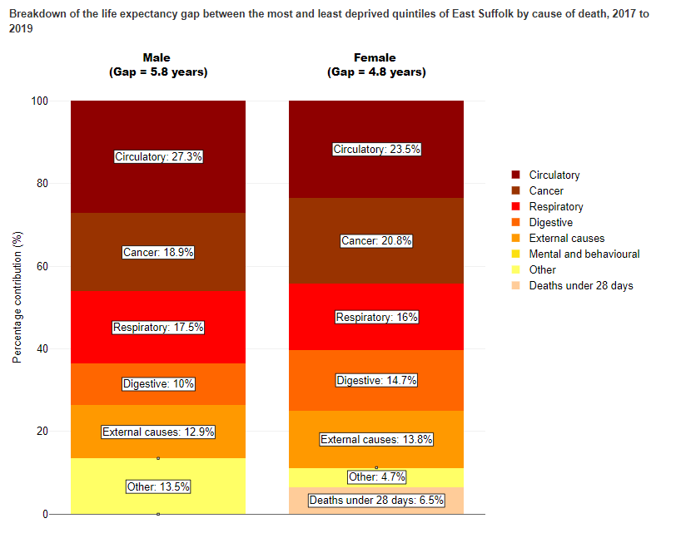
Circulatory disease is the main reason for the differences in life expectancy for men and for women in East Suffolk.
Do you know how many people smoke in Suffolk?
Or how long it would take for everyone in Suffolk to stop smoking at current rates? What could change this in your communities?
Source: Office for Health Improvement and Disparities based on ONS death registration data and mid year population estimates for the relevant years, and Department for Levelling Up, Housing and Communities Index of Multiple Deprivation, 2019
Footnote: Data are calculated using 2011 Census based mid-year population estimates. All data will be updated when 2021 Census based population data for small areas are released in late 2023. Circulatory includes heart disease and stroke. Respiratory includes flu, pneumonia, and chronic lower respiratory disease. Digestive includes alcohol-related conditions such as chronic liver disease and cirrhosis. External includes deaths from injury, poisoning and suicide. Mental and behavioural includes dementia and Alzheimer's disease. Percentages may not sum to 100 due to rounding.
Sources: OHID Fingertips, Segment tool
Notes:
And this is what is clinical terms are causing these early deaths – but remember there will be influences from housing, income, work etc as well
What is main risk factor still causing these early deaths from theses diseases?
How many smoke in Suffolk - 83000 – 109000 current smokers
How many quit each year - 1800 people quit in suffolk each year
Even if no-one else starts – it will take 46 years for everyone to stop at current rates – and again the distribution of smoking is not equal, rates in routine and manual workers three times higher than some other occupations.
What can you do to change this in your communities – this could have an immediate impact (cardiovascular disease risks start to fall in the immediate weeks following stopping smoking – and smoking costs thousands – and longer term health and wellbeing impacts

Slide 27
So what do we know about East Suffolk now?
Key findings from the 2021 Census
Health in East Suffolk
Crime in East Suffolk
Deprivation and inequalities in East Suffolk
Education in East Suffolk
Skills in East Suffolk
Economy of East Suffolk
Summary messages

Slide 28
Educational attainment levels in East Suffolk are similar to or slightly lower than Suffolk as a whole, but lower than the England average
In 2022, the % of children achieving a ‘good level of development’ at the end of reception was 1% higher in East Suffolk than the rest of Suffolk, and 2% lower compared to England.
In 2022, 54% of children in East Suffolk were working at least at the expected standard in reading, writing and maths, in line with 54% in Suffolk but below 59% in England (key stage 2).
In 2022, 45% of pupils in East Suffolk achieved GCSE grades 5-9 in English and Maths, compared to 46% in Suffolk and 50% nationally (key stage 4).
Rates of unauthorised absence from school are in line with Suffolk as a whole, but suspension rates from secondary school are 3% higher in East Suffolk than for Suffolk as a whole.
24% of primary pupils and 26% of secondary pupils in East Suffolk are disadvantaged – 2% and 4% higher than the proportions in the rest of Suffolk.
Notes:
All education indicators are lower than the England average.
Again, this will not be equally distributed – what more can we do to help our most disadvantaged learners
Higher rates of secondary school suspension – and higher proportions of disadvantaged pupils.

Slide 29
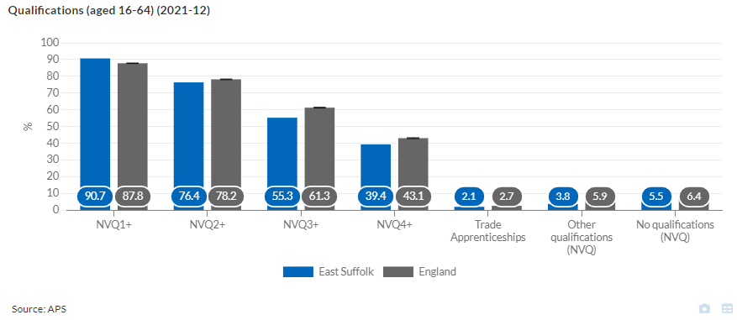
East Suffolk has lower levels of people with NVQ 3 & 4 qualifications than England as a whole….
Notes:
This is getting better over time – but East Suffolk still has lower rates of people with 3-4 equivalent qualifications

Slide 30
… and wages are also lower, particularly for women
Trend data is for Suffolk Coastal and Waveney district councils until 2018 when they were merged into East Suffolk Council.
Gaps in the data lines for female workers are where figures have been suppressed as statistically unreliable.
Note that the scale on the two graphs is different!
Sources: APS; ASHE; accessed via Suffolk Observatory and NOMIS

Slide 31
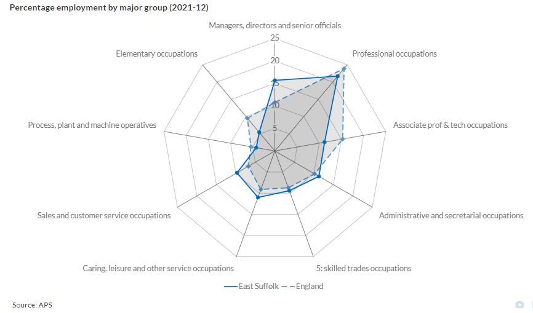
These lower skill and pay levels are only partially reflected in employment patterns – there are more people in sales and caring occupations, but fewer people in elementary occupations. ES has fewer people in professional occupations, and associated professional and technical roles, but more people in managerial roles, than the England average.
Sources: APS; accessed via Suffolk Observatory

Slide 32
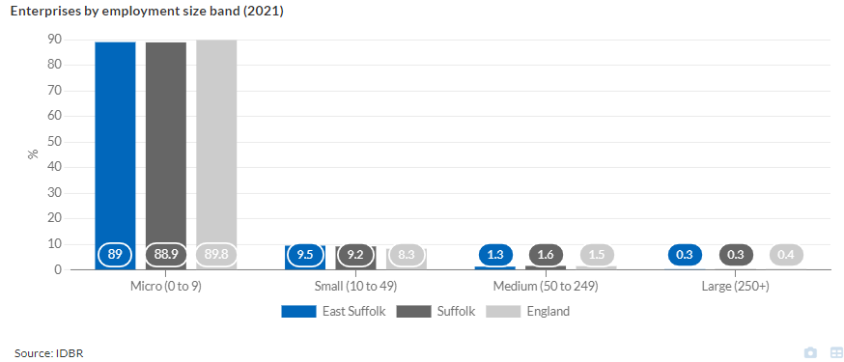
The economy of East Suffolk is similar to the rest of Suffolk. In 2020 East Suffolk had 9,650 active enterprises...
Sources: IDBR; accessed via Suffolk Observatory

Slide 33
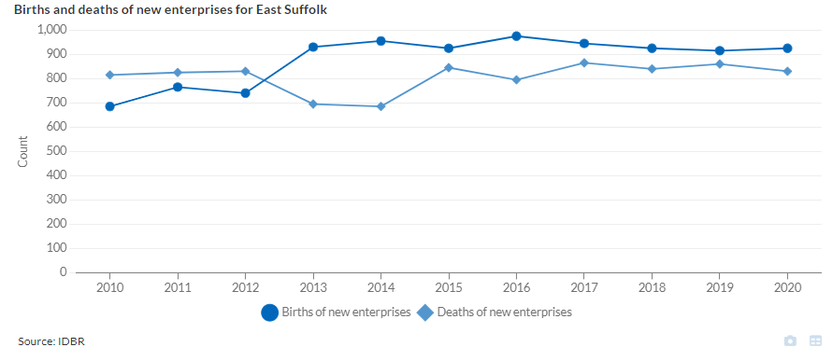
...and before the pandemic at least, more businesses were starting in East Suffolk each year than were closing
Sources: IDBR; accessed via Suffolk Observatory

Slide 34
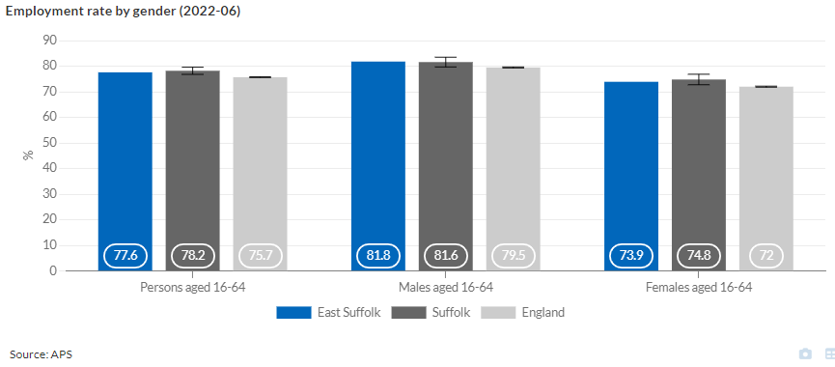
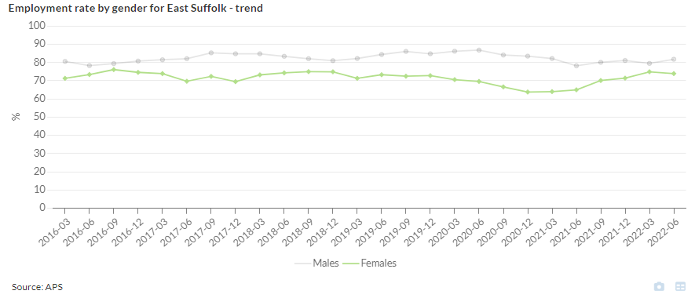
Employment rates in East Suffolk are significantly higher than for England – and have been resilient during the pandemic
Sources: APS; accessed via Suffolk Observatory
Notes:
Data from June 2022

Slide 35
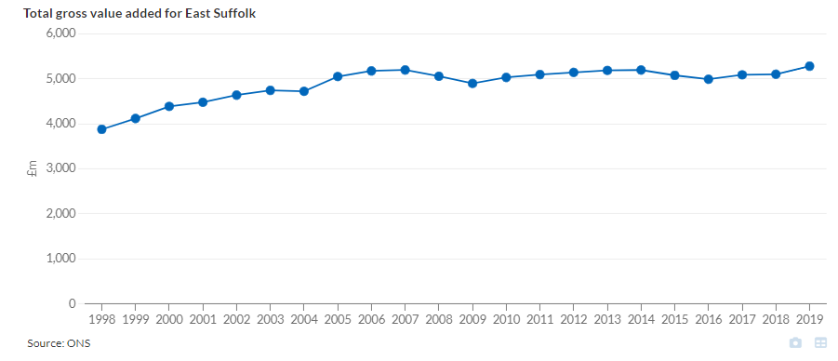
GVA (Gross value added) is a measure of the increase in the value of the economy due to the production of goods and services. In the years immediately prior to the pandemic, GVA in East Suffolk was increasing.
Sources: ONS; accessed via Suffolk Observatory
Notes:
Another positive economic indicator

Slide 36
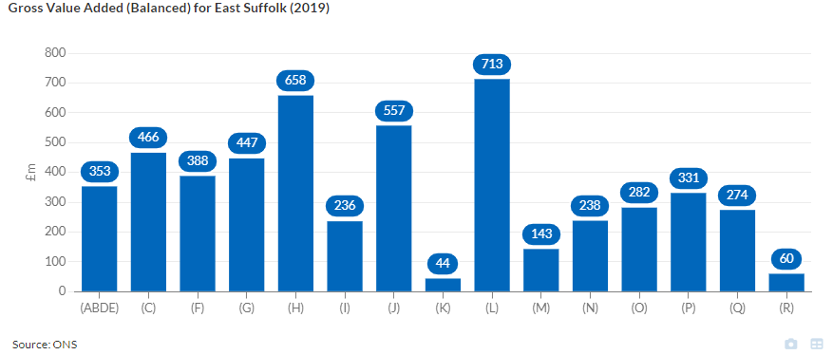
Different economic sectors make different contributions to East Suffolk’s GVA. This data predates the pandemic, which is likely to have strengthened some of these sectors (information and communication) and weakened others (?real estate)
The largest GVA contribution (L) is from real estate
Other significant sectors include transportation and storage (H), and Information and Communication (J)
Sources: ONS; accessed via Suffolk Observatory
Notes:
Agriculture, mining, electricity, gas, water and waste (ABDE)
Manufacturing (C)
Construction (F)
Wholesale and Retail Trade (G)
Transportation and Storage (H)
Accommodation and Food Service (I)
Information and Communication (J)
Financial and Insurance (K)
Real Estate (L)
Professional, Scientific, Technical (M)
Administrative and Support Services (N)
Public Administration and Defence (O)
Education (P)
Health and Social Work (Q)
Arts, Entertainment, Other Recreation (R)

Slide 37
So what does all this data tell us?
Population
Slow population growth and rapid population ageing is likely to bring challenges for the future
ES Less diverse than other areas
Deprivation & Inequalities
Inequalities remain deep and entrenched in some areas, and are likely to be exacerbated by the cost of living crisis
Deprivation affecting children is particularly high in some areas
Education, skills & Economy
Educational outcomes could be better; adult skill and wage levels remain relatively low, particularly for women
While there are lots of positive indicators relating to the economy, the combined shocks of the pandemic, Brexit, global inflation and national recession are likely to make economic conditions challenging
Many health outcomes remain good – but some indicators relating to children (mental health, obesity) are less good
East Suffolk has the widest socio-economic disparity within it of the five Districts and Boroughs within Suffolk – regional, national and international data suggests this can be associated with poor outcomes, lack of aspiration and the ‘politics of envy’

Slide 38
What do we need to do?
You will know better than I do! But my suggestions are:
Routinely and systematically take every opportunity we have to address inequalities - processes, funding decisions, local action – ideally in co-production with local communities, and with a sharper focus on particular groups in particular places (for example, children in Lowestoft; the particular challenges faced by coastal communities)
Renew our focus on the things which are causing early and preventable deaths – starting with smoking and managing blood pressure
Encourage people who may have missed healthcare interventions during the pandemic or not been vaccinated to take action – these missed interventions (for example, statins) will be increasing health risks for some people
Continue to support individuals, households and businesses as much as possible through very difficult economic conditions – and think about where the East Suffolk workers of tomorrow need to be skilled at, and in an area with an older and un-diverse population, where those workers are going to come from

