Slide 1
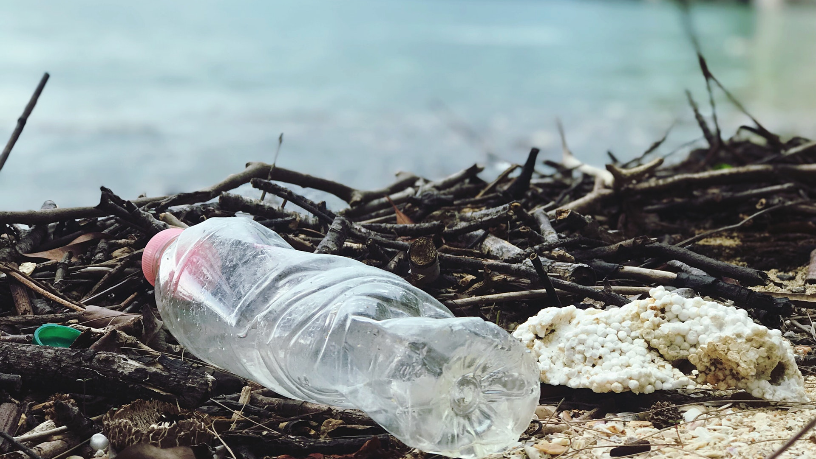


Plastic Pollution

Slide 2

Lesson Objectives
Understand what plastic is and what impact it can have on the environment
Understand what happens to waste in Suffolk
Plan activities which will help to raise awareness of plastic pollution

Slide 3
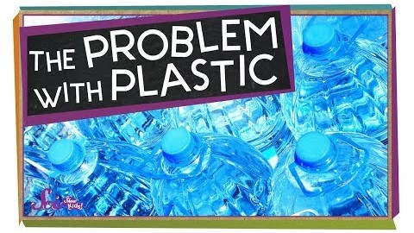
Notes:
https://www.youtube.com/watch?v=VUUUxOl715s

Slide 4
Questions from the video
What is plastic?
How do we use plastics?
Why do we use plastics?
Notes:
What is plastic?
Plastic is a material we use to make a variety of different objects we use in our lives.
There are many different types, shapes, colours and sizes of plastic. This is because we can add different chemicals to plastics to give it different properties.
How do we use plastic?
Plastic is used in almost everything we use in our everyday lives, such as phones, clothes and furniture.
Get the children to name something in the classroom made from plastic.
Why do we use plastic?
We use plastic because it is:
Easy to mould into a shape
Lightweight
Durable
Cheap

Slide 5
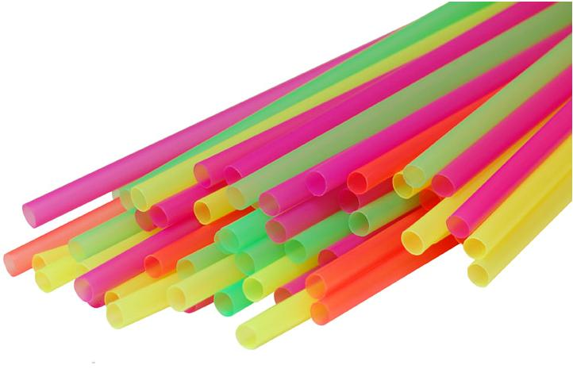
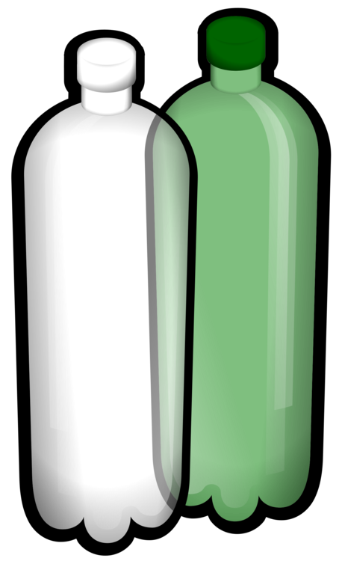
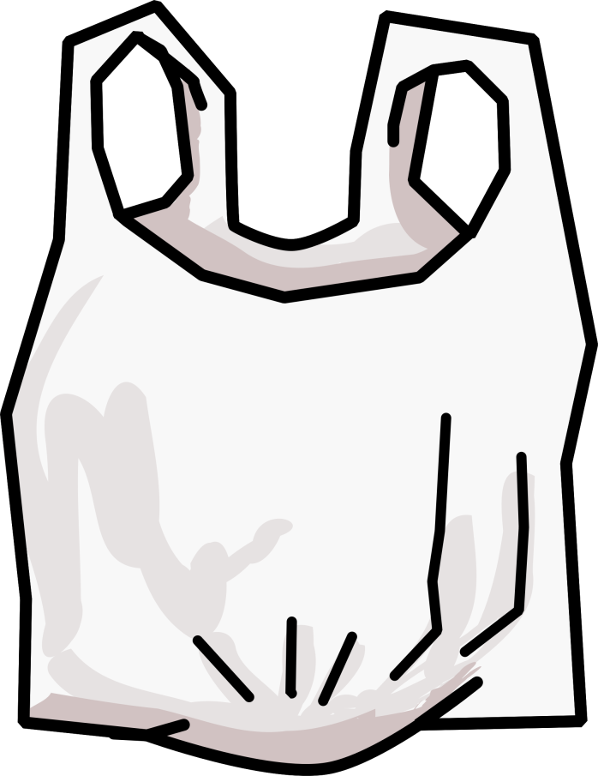

What are single-use plastics?
Why are they criticised?
Notes:
What are single-use plastics?
Some plastics are made to be thrown away after one use, whereas other plastics are designed to be used for a long time (for example the plastic in phones, computers and furniture).
Get children to name some common single-use plastic items they use, and when they last used it:
Common single-use plastics:
Plastic water bottles
Plastic carrier bags
Plastic straws
Plastic coffee cups
Why are disposable plastics criticised?
Because it is single-use, we consume and throw away a lot of this plastic.
40% of the plastics we make are used as packaging.

Slide 6
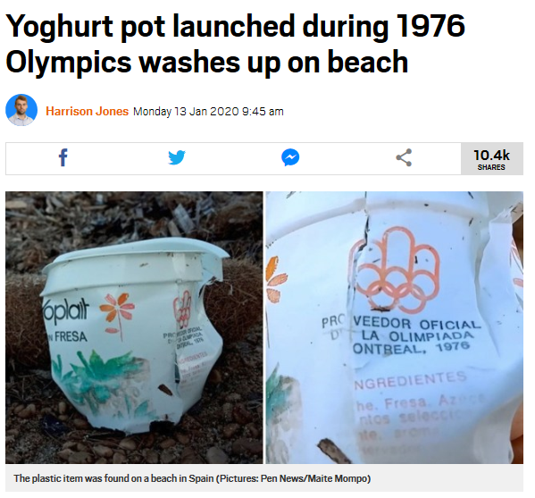
Questions from the video
What is the environmental impact of plastic?
Why does plastic cause these problems?
This yoghurt pot is at least 44 years old!
Notes:
What environmental impact does plastic pollution have?
Plastic pollution can harm wildlife, as they can become trapped in plastic or eat it.
90% of seabirds have eaten plastic.
8 million tonnes of plastic end up in the ocean each year and by 2050 the amount of plastic in the ocean will outweigh all the fish in the ocean.
Plastic pollution can also cause harm to us because of microplastics- microscopic pieces of plastic that are the result of plastic breaking down. Microplastics can make their way into the water we drink and the fish we eat. Their health effects are largely unknown.
Microplastics are much harder to get out of the water, because they are too small to collect.
Why does plastic cause these issues?
Plastic does not naturally break down in the environment (unlike things like food, which rots). This means when plastic escapes into the environment, it will remain there for a long time (on average, 450 years) and will break down into smaller and smaller pieces (microplastics), unless we go out and collect it.

Slide 7
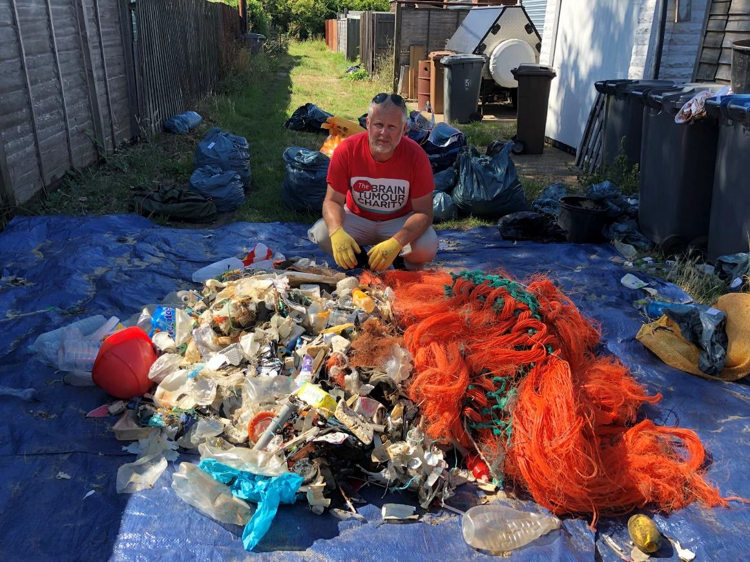
Local plastic pollution
Jason collected 136 Kg of rubbish from 11 Suffolk beaches!
Notes:
Plastic pollution is both a local and a global issue and has effects on both.
Explain photo:
Jason Alexander, works at an organisation called Rubbish Walks.
Did a beach litter pick at 11 beaches across Suffolk and collected 136kg of rubbish (the same weight as 49 bricks!)
The disposable single-use plastics we use can have an impact on our local environment- the most common forms of litter Jason found were: caps/lids, crisp and sweet packets, cotton buds, plastic cups.
A survey of Suffolk beaches found that 77% of beach litter is made from plastic.
The wildlife that live on the beaches in Suffolk will be eating this plastic pollution.

Slide 8
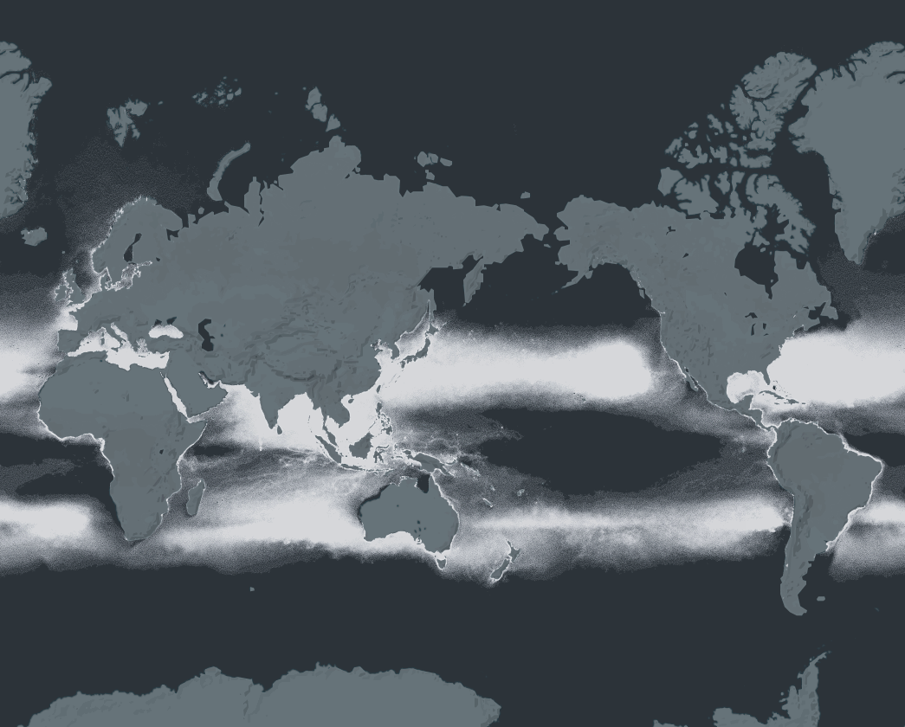
Global plastic pollution
Each white dot on this map represents 20 Kg of plastic in the ocean!
Notes:
Interactive map showing ocean plastic pollution across the world. One dot = 20kg of plastic
https://app.dumpark.com/seas-of-plastic-2/
This map shows how plastic pollution is a global issue.

Slide 9
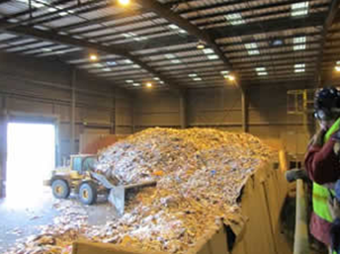
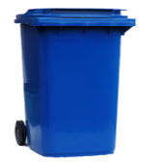
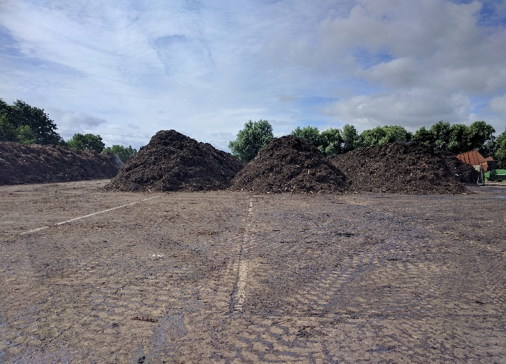
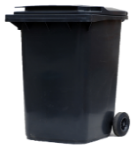
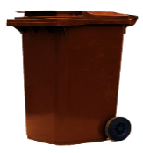
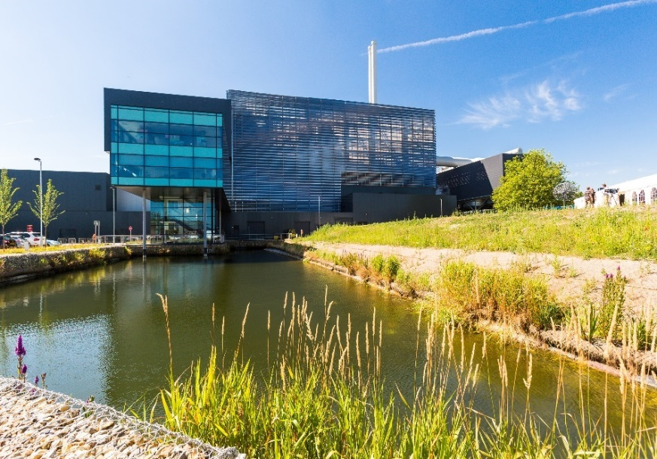
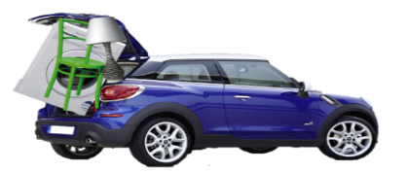
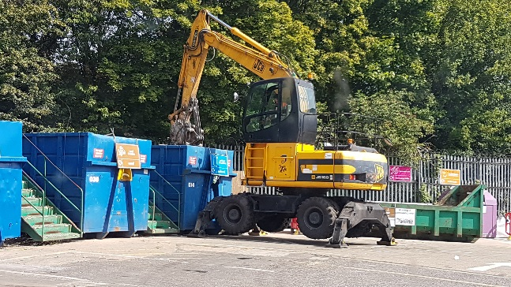
Where does our rubbish go?
Materials Recycling Facility
Composting Site
Recycling Centre
Energy from Waste
Notes:
Where does our rubbish go?
Recyclable rubbish (blue bin) goes to the Materials Recycling Facility. Nonrecyclable rubbish (black bin) goes to the Energy From Waste Plant. Food and garden waste (brown bin) goes to a composting site. Any waste that cannot fit in these bins is taken to a local recycling centre.

Slide 10
Recyclable waste
What is recycling?
In Suffolk, recyclable waste goes to the Materials Recycling Facility to be sorted
What are the benefits of recycling? What are the issues?
Notes:
What is recycling? What items can we recycle?
Recycling is the use of old items/ materials to make new items/ materials. For example we can recycle used paper in order to make new paper. This way we get rid of the old material and use fewer resources to make new material.
Optional: use A to Z of recycling at www.suffolkrecycling.org.uk to find out more about how to recycle certain objects.
In the UK, 45% of the plastic waste produced is recycled.
What are the advantages of recycling?
Do not need to send the materials to landfill
We do not need to use energy or resources to create new materials, we can instead use old materials
What are the disadvantages of recycling?
Recycling still requires energy and it costs money to operate
It can be difficult or impossible to sort certain materials (e.g. cardboard lined with plastic, like a coffee cup)

Slide 11
Non-recyclable waste
Any waste that cannot be recycled goes to the Energy From Waste facility
Here rubbish is burned to produce electricity
What are the benefits of burning rubbish? What are the issues?
Notes:
At the Energy From Waste facility, rubbish is burned to produce electricity. The burning rubbish turns water into steam, which then spins a turbine which produces the electricity.
What are the benefits of burning rubbish?
We do not need to send the material to landfill. The only byproduct that must be disposed of when burning waste is ash
We can recover the energy used to create the materials, by using it to produce electricity
What are the issues with burning rubbish?
The process is more expensive compared to recycling- it costs £56 per house to burn rubbish in Suffolk, compared to £19 for recycling
This process also produces carbon dioxide, which is a greenhouse gas and contributes to climate change

Slide 12
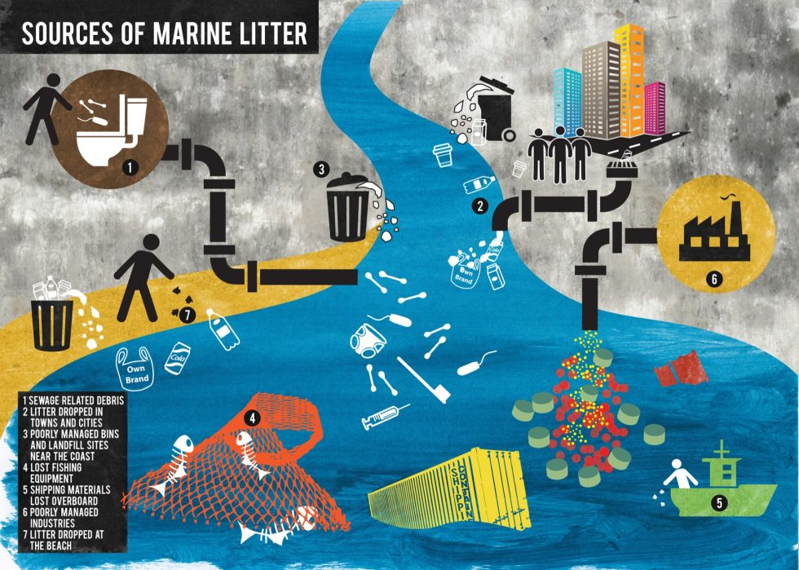
Why is plastic still a problem?
If we do not dispose of plastics properly, they pollute our environment!
Notes:
Why is plastic still be a problem even when we recycle it or burn it for energy?
Reasons: Plastic pollution at other stages when we produce and use plastics. If we do not dispose of plastics properly, they end up polluting the environment.

Slide 13
How can we tackle plastic pollution?
Waste hierarchy
Most preferred option
Reduce
Reuse
Why are the top options better than the bottom?
Recycle
Recover
Disposal
Least preferred option
Notes:
Introduce the waste hierarchy and the 4Rs
What does each part of the hierarchy mean?
Reduce- produce less waste, meaning there is less to throw away
Reuse- repair broken items, buy and sell second hand items or reuse something broken or disposable for another purpose
Recycle- send the material to be broken down to produce a new item. This is the Materials Recycling Facility
Recover- use the waste to produce energy. This is the Energy From Waste plant.
Disposal- the waste is thrown away into landfill
What is meant by the term “hierarchy”?
Hierarchy- lists our options for disposing waste from most preferable to least preferable, as the options at the top are better than the options at the bottom. We should try these options first before trying the option below.
Why are the options at the top better than the options at the bottom?
Reduce- when we make less waste in the first place, we do not need to worry about how to get rid of it. It also means we do not use energy and resources to create materials.
Reuse- when waste is reused, that means it does not have to yet be disposed and you do not need to buy a new item to replace it, which reduces waste, saves energy and resources.
Recycle- when waste is recycled, the materials can be used to make an item without needing to find another way to get rid of that old material. It also means we use fewer resources making materials.
Recover- this is our last preferred option before disposal, as we can still recover some of the energy used to make the waste in the first place and prevent the waste going to landfill;
Disposal- waste in landfill will take a long time to decompose, especially if it contains plastics. Decomposing waste in landfill also produces methane, which is a greenhouse gas which contributes to climate change. This is why it is our least preferred option.

Slide 14
What can we do?
How could we reduce, reuse or recycle plastic waste?
What more information could we try to find out the plastic waste we produce?
How could we raise awareness about plastic pollution and what people can do to tackle it?
Reduce
Remember the waste hierarchy!
Reuse
Recycle
Recover
Disposal
Notes:
20 minutes
Notes down the suggestions the children have made. These suggestions can be used to inform activity ideas such as:
Produce a school assembly
Design posters
Write an article for the school newsletter
Write a letter to the headteacher and school governors
Design a fun activity to reuse plastic waste or encourage recycling
Possible information to find out:
Find out what your school/ organisation currently does to reduce the amount of single-use plastic
Use a waste audit to find out how much waste is produced by your school/ organisation and how much of that is recycled

