Slide 1
Procurement Open Morning
14.08.25
Riverside Conference Rooms, Lowestoft

Slide 2


Plan for today
From 9.45am arrival and tea and coffee
9.55am welcome and introduction
10am-12pm 15-minute individual sessions with a member of the procurement team, make sure you have your ticket so we can call you in turn!
12.15pm event close

Slide 3





Topics to discuss in your 121
Social Value
Completing tender documents (examples available)
How to register on the government’s Central Digital Platform, Find a Tender Service
East Suffolk’s tendering system, In-tend, and how to create and manage your profile on the system.
How to submit clarifications on In-tend
Guidance on navigating the different procurement procedures under new procurement legislation
Open opportunities currently out to tender will not be discussed in detail.

Slide 4

About procurement in East Suffolk
We spend around £80-90 million each year.
We are a reliable source of work as we will always have requirements that will need to be supplied.
Our requirements are suitable for companies of all sizes.
The regulations that the Council are governed by mean that all suppliers in the process stand the same chance of winning.
procurement@eastsuffolk.gov.uk

Slide 5
Meet the team
Amy Moye, Procurement and Contracts Manager
Abiola Michael-Bucknor, Procurement Lead (Internals)
Richard Hill, Procurement Lead (Externals)
Iain Wilkinson, Procurement Business Partner (SNC)
Danielle Jubb, Procurement Business Partner (GYBC)
Zoe Archer, Procurement Business Partner (ESSL)
Deanne Davidson, Procurement Business Partner (Environmental Services & Port Health, Planning & Coastal Management)
Lynsey Hall, Procurement Business Partner (Housing)
Emma Akpan, Procurement Business Partner (Housing, Communities and Digital)
Samantha Cook, Procurement Business Partner (Property & Place)
Charlie Horne, Procurement Support Officer
Mia Owen, Procurement Apprentice

Slide 6
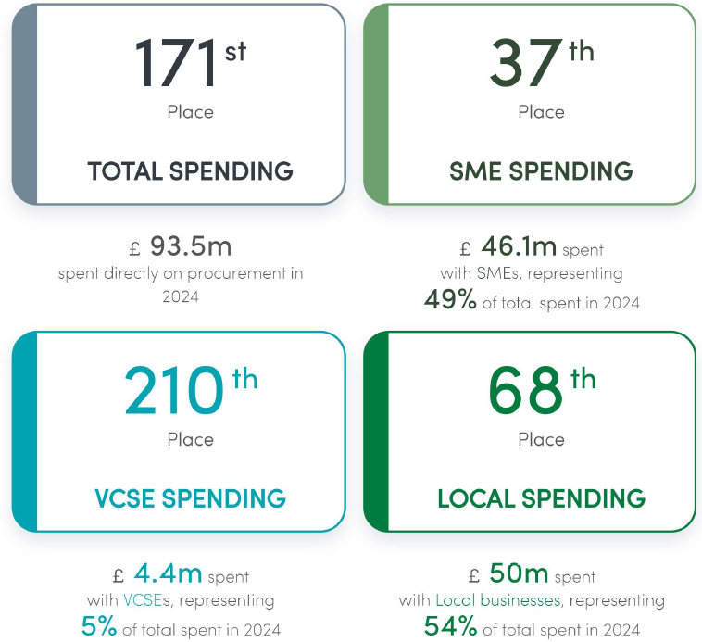
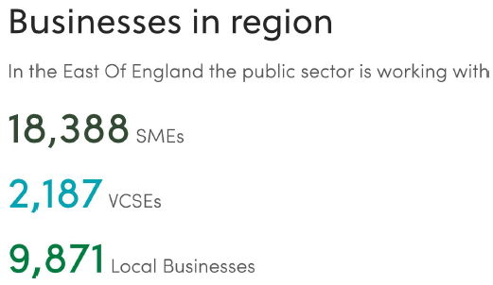
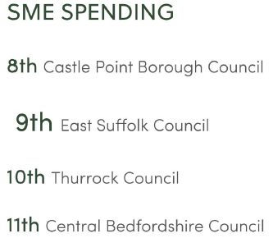
Out of 311 Councils East Suffolk Council procurement ranked as a “high performer”:
Out of 44 authorities in East of England:
Source: Tussell and Local Government, July 2025

Slide 7



90% PPT tenders 10% Social Value Weighting
Training and resources
Social Value contract schedule
East Suffolk Social Value Ask
Better monitoring
Software trial
Supplier training
Outcomes in ESC Social Value Ask
Added to procurement plan & tender documents
Questions on tax status
Updates to ESC Social Value Ask
Health & Safety requirements included
New Conflict of Interest procedure
Increased local spend (41%, £21.75m)
Additional training opportunities and resources
More Preliminary Market Engagement
Procurement Pipeline published
Revised contract and tender documents
New Contract Procedure Rules, contract and tender documents and Procurement Standard Operating Procedures
Exemption form for officers
More Spend data and SharePoint pages
Contract management resources
Training for team, officers and suppliers
Procurement Strategy Progress Report 2024-2025

Slide 8
Procurement rules
Procurement Act 2023
Procurement Regulations 2024
Case Law
Factors
Social Value Act 2012
Equality and Diversity act 2010
Case Law
Procurement Policy Notes
Modern Slavery Act 2015
The Procurement Opportunity
Data Protection
Contract Procedure Rules
TUPE
Council’s Constitution
Health and Safety
Climate Change Act

Slide 9






Partner organisations
The team delivers procurement services to:

Slide 10
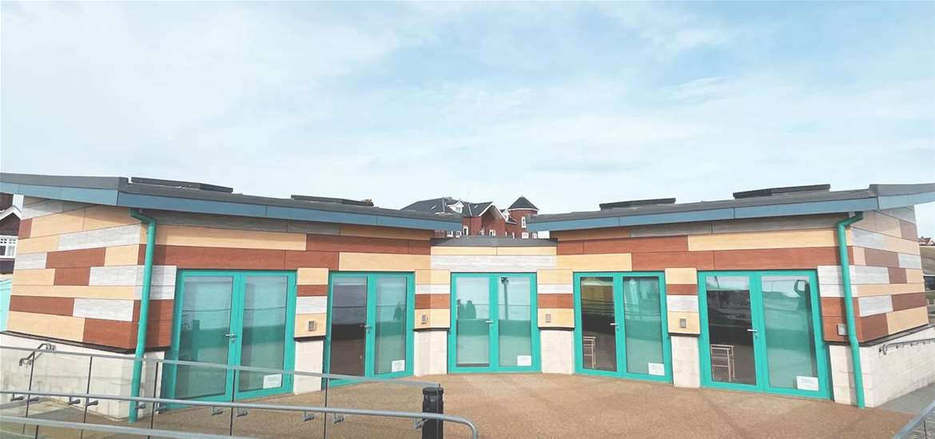
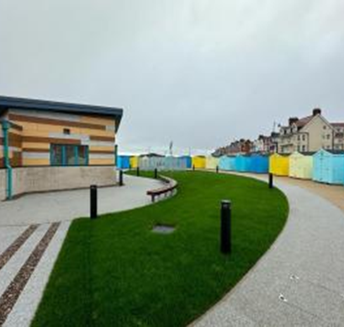
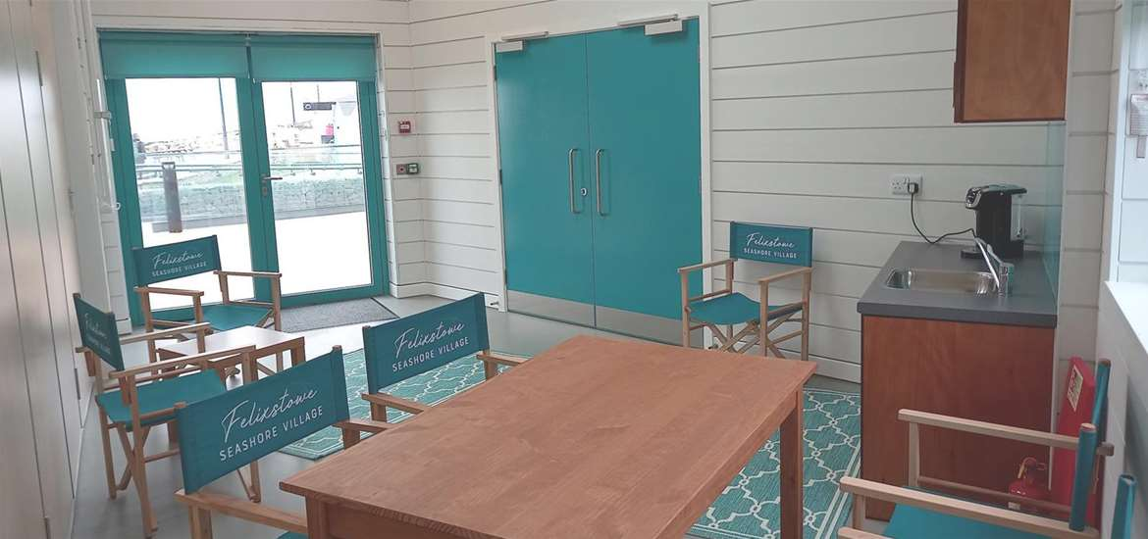
Seashore Village,
Felixstowe
Projects we have procured

Slide 11



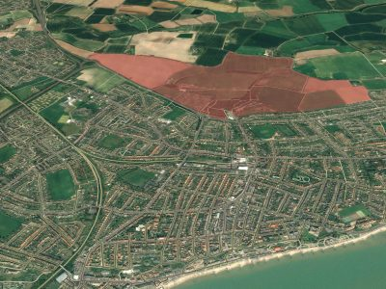
North Felixstowe Garden Neighbourhood,
Felixstowe
Projects we have procured

Slide 12


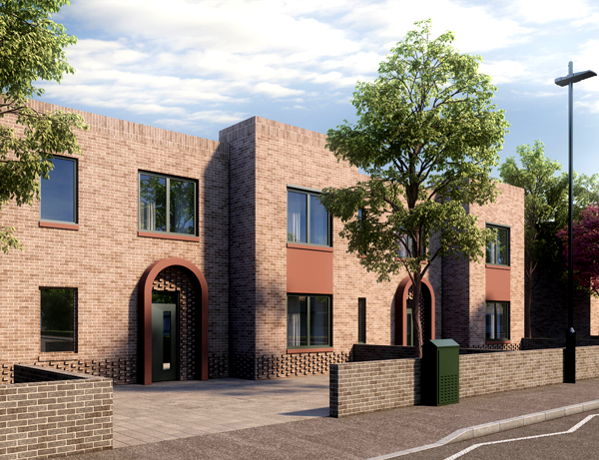
Deben Fields, Felixstowe
Projects we have procured

Slide 13
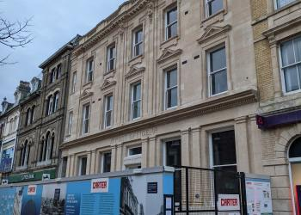
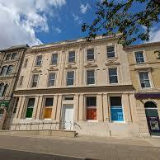


Post Office,
Lowestoft
Projects we have procured

Slide 14
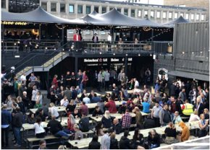

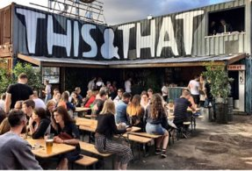


Cultural Quarter,
Lowestoft
Projects we have procured

Slide 15
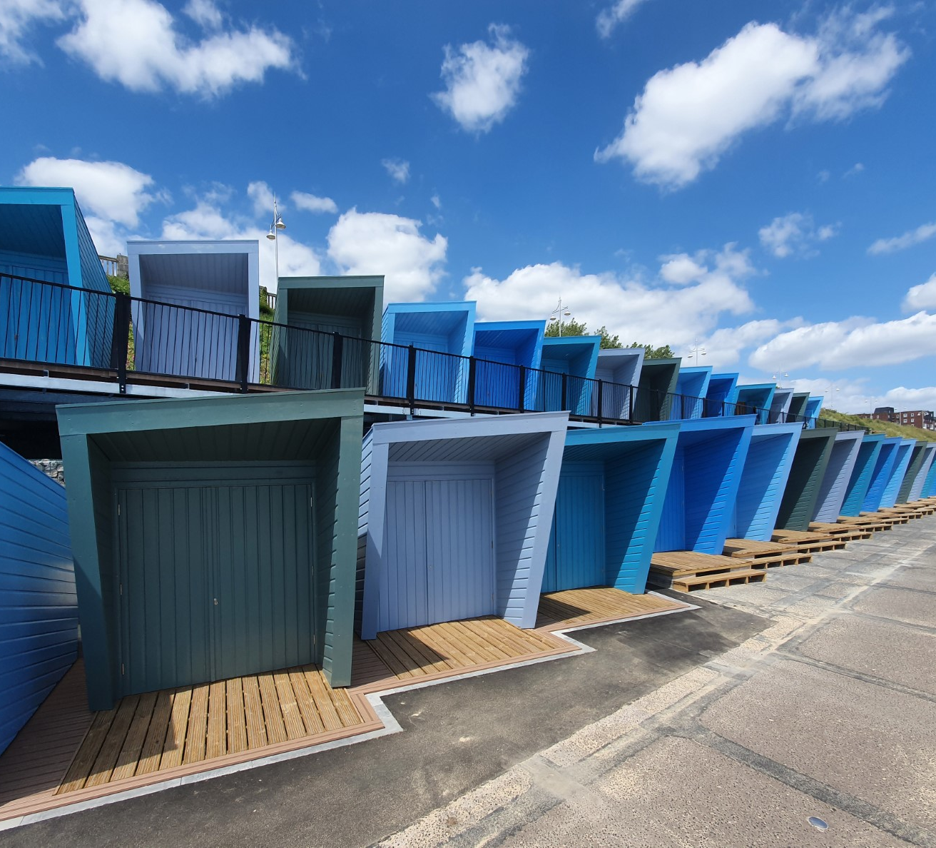
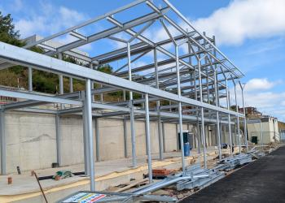

Jubilee Parade, Lowestoft
Projects we have procured

Slide 16



East Point Pavillion, Lowestoft
Projects we have procured

Slide 17
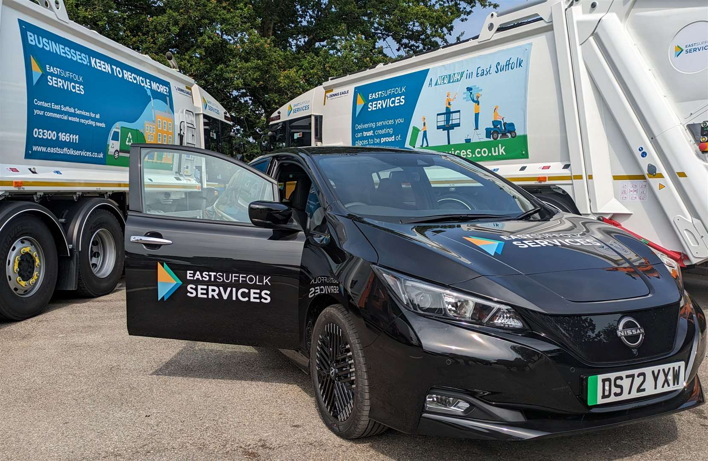
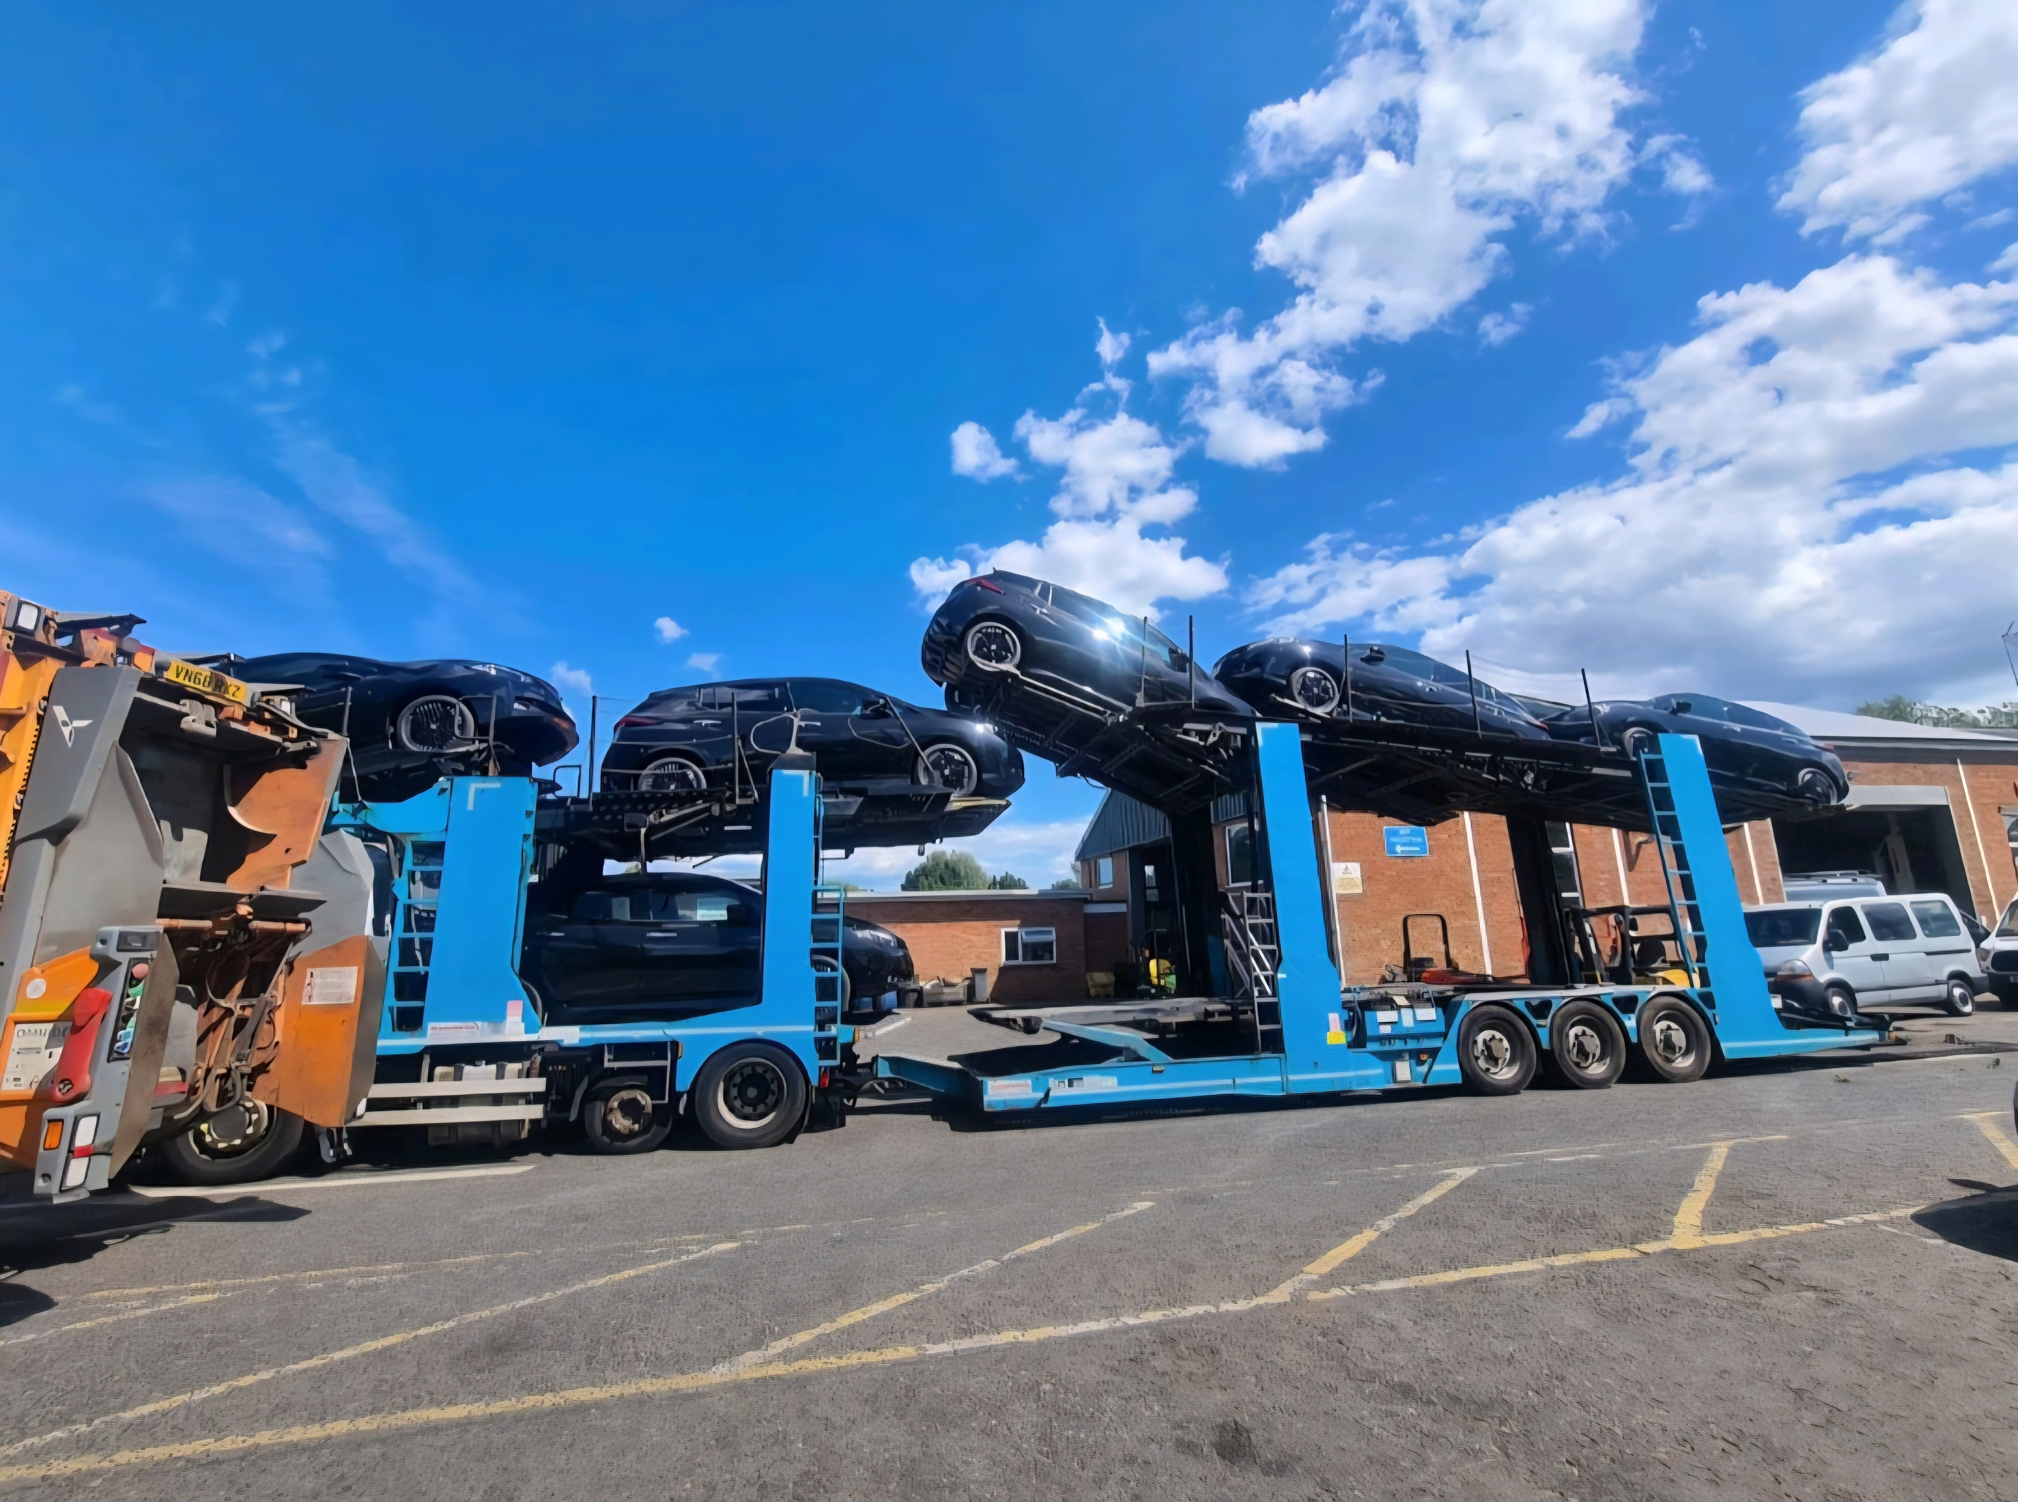
A fleet of new electric vehicles for East Suffolk Services Limited
Projects we have procured

Slide 18
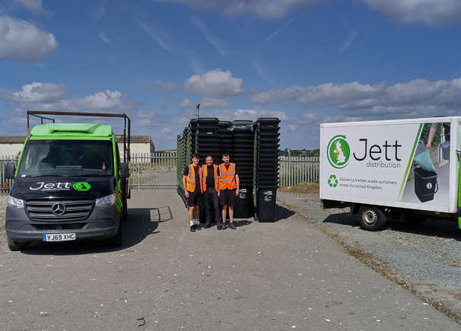
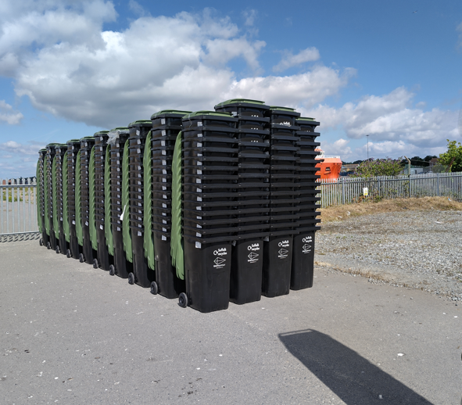
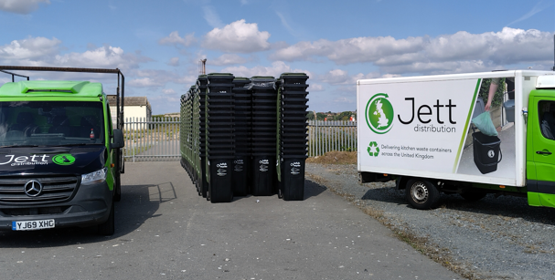
New waste bins and distribution contract for Better Recycling scheme
Projects we have procured

Slide 19
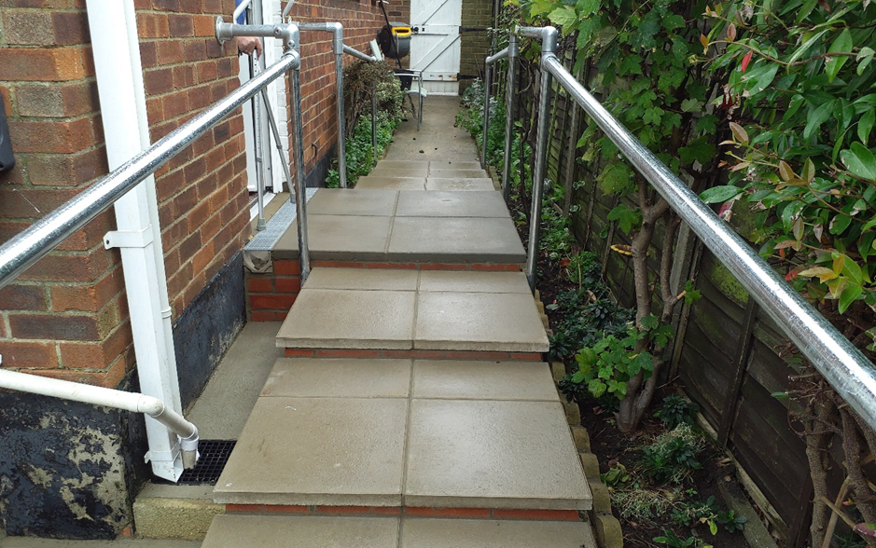
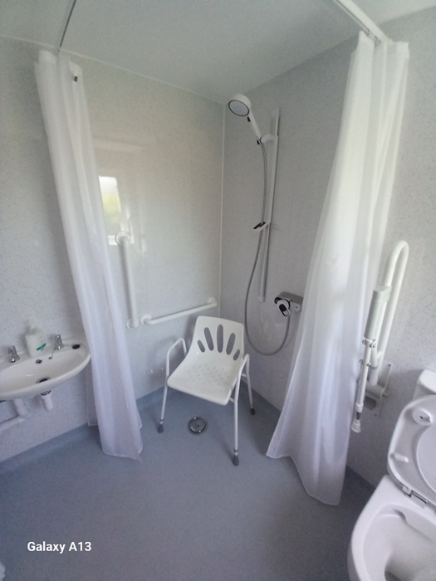
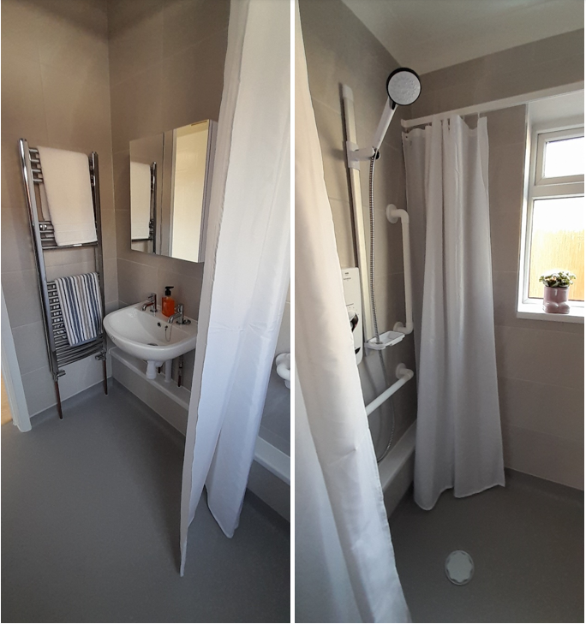
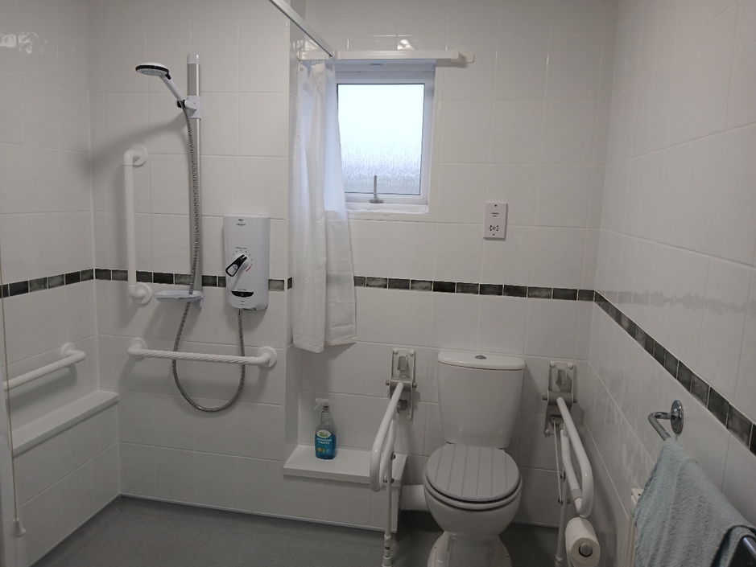
Adaptations for Independent Living Dynamic Purchasing System
Projects we have procured

Slide 20
Procurement Act 2023
Maximising public benefit
Transparency
Exclusion grounds
What?
The rules which govern public sector buys high value goods works and services
Why?
1.
Set of UK regulations
2.
Streamline regulations into one set
When?
24 February 2025 onwards
Anything started before then subject to previous regulations
Transforming Public Procurement - GOV.UK (www.gov.uk)
Find a Tender
Legislation to be aware of

Slide 21
Typical tender contents
Standard supplier
information
Exclusions
information
Clarifications
Timeline
Specification
Appendices
Procurement Specific
Questionnaire
Invitation to Tender
Part A
Central Digital Platform
(FTS)
Contract
Information
Tender Pack
Mandatory
Declaration
Form
Financial information
Invitation to Tender
Part B (or C)
Quality Questions
Pricing submission
Accreditations
Examples available on Supplying the Council page

Slide 22
Social Value
Social
Environment
Economic
East Suffolk Social Value Ask

Slide 23
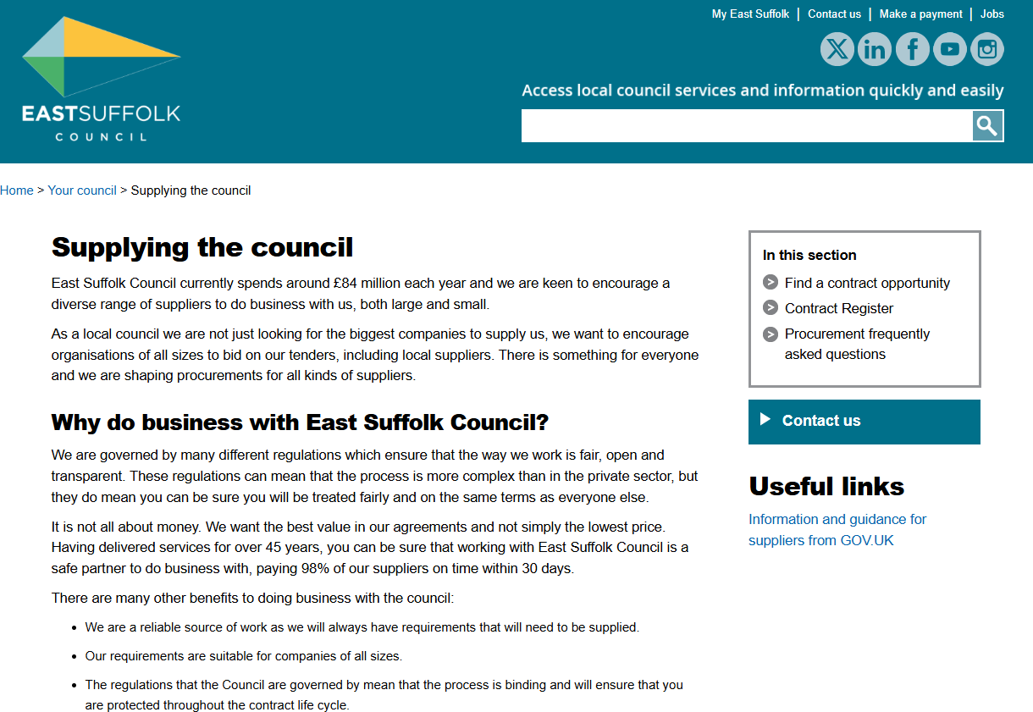
Supplying the council » East Suffolk Council
Useful links

Slide 24
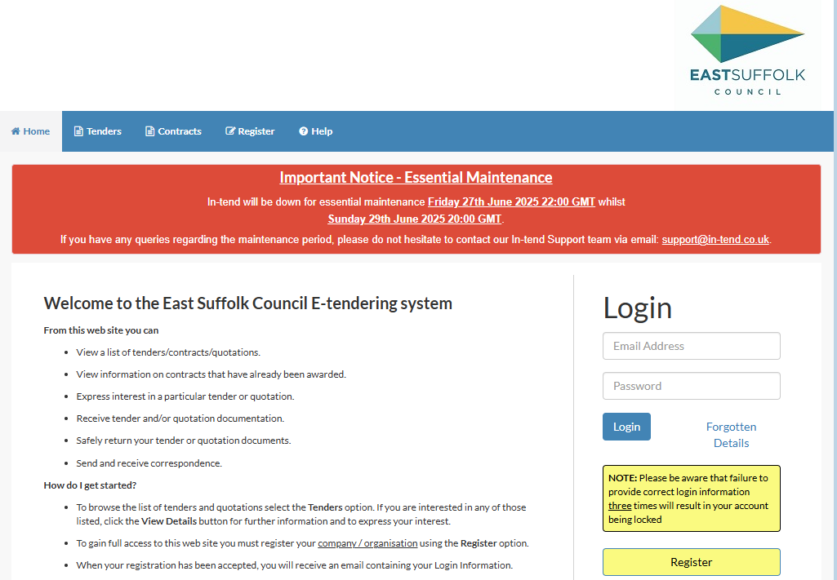
East Suffolk Council Electronic Tendering Site - Home
Useful links

Slide 25
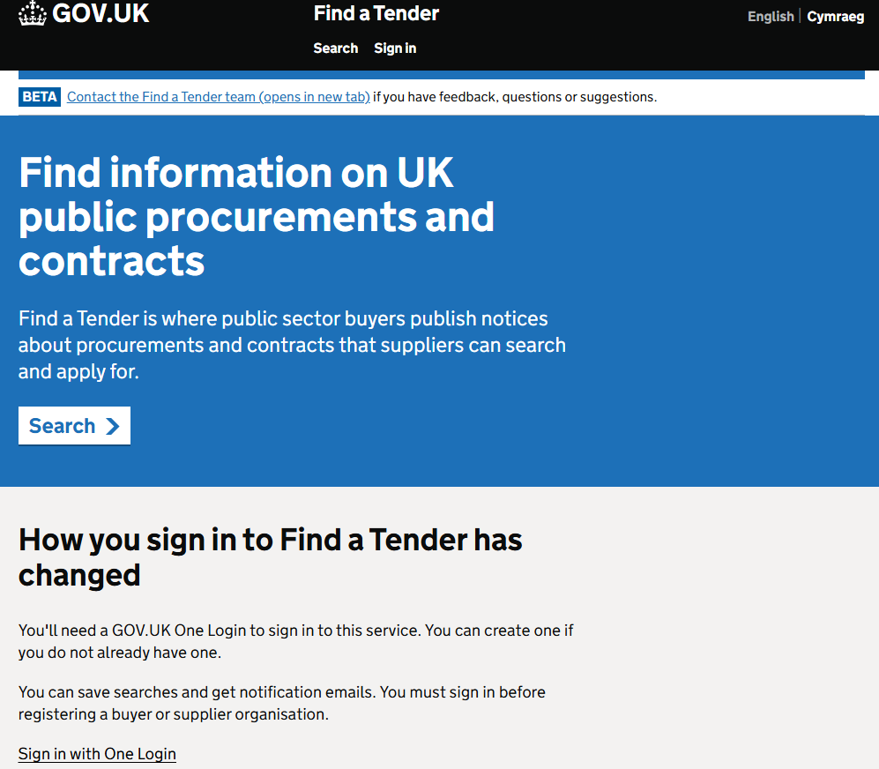
Find a Tender
Useful links

Slide 26
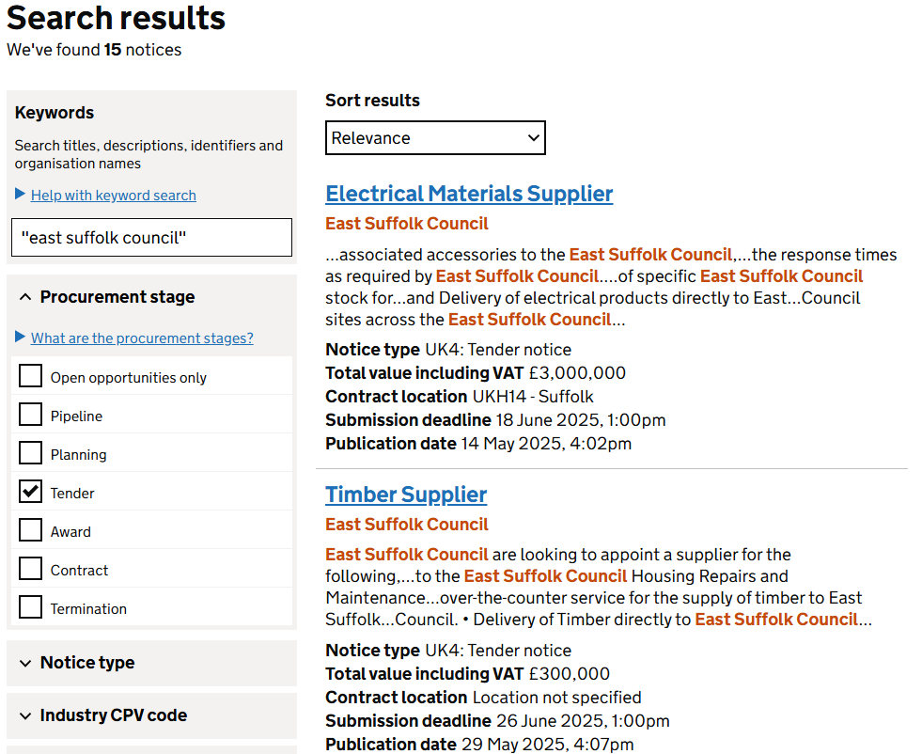
Find a Tender
Useful links

Slide 27
East Suffolk’s Contract Management Team
Our colleagues in Contract Management look after the Council’s contract with East Suffolk Services Limited
ESSL provide waste and recycling collection services, street cleansing, grounds and facilities maintenance and a host of other services
As ESC provide procurement services to ESSL the same rules and similar policies apply
Contract managers and contract monitoring officers drive continuous improvement and focus on performance of the contract delivery

Slide 28
New projects coming
Supplier welcome pack
Contract management handbook for officers
Further guidance on In-tend for suppliers

Slide 29

Further feedback?
Suggestions for the next Meet the Buyer event in January 2026?
Please contact:
Procurement@eastsuffolk.gov.uk

