Slide 1

Meet the Buyer Event
Thursday 23 January 2025
Riverside, Lowestoft

Slide 2
Welcome
9.45am arrival and coffee
10:00-10:30am Presentations:
Richard Hill, Procurement Lead - New Procurement Act for Suppliers
Abiola Michael-Bucknor, Procurement Lead- East Suffolk Social Value
Ian Currie, Sizewell C Supply Chain Business Manager, Suffolk Chamber of Commerce - Sizewell C supply chain engagement
10:30-11:00am 121 opportunities: including how to register on In-tend, future contract opportunities, East Suffolk’s Procurement Strategy
11.00am-12pm Workshop- How to complete tender responses: Group exercise to respond to a potential requirement and what you need to be aware of when filling out tender documentation.

Slide 3



Procurement Act 2023 for Suppliers
Richard Hill, Procurement Lead

Slide 4
What is changing and why?
Over £214,904 including VAT (for services or goods)*
Over £5,372,609 including VAT (for works)*
What?
The rules which govern public sector buys high value goods works and services
Why?
1.
Set UK regulations
2.
Streamline
regulations
When?
24 February 2025 onwards
Anything started before then subject to current regulations

Slide 5
What remains the same
Below threshold remains broadly the same
Basics of good bidding:
  Competitive pricing
  Good quality submissions
  Reading instructions/questions carefully
  Following rules set out in tender documents
  Raising clarifications
  Checking contract terms
  Strong social value offering
Frameworks and DPS will run until the end of their current term

Slide 6
Differences to be aware of
Procurement Specific Questionnaire
Debarment list – effects subcontractors, connected persons and associated persons
New: Competitive Flexible Procedure
New frameworks may operate differently
Higher value contracts (over £5m):
  KPIs & performance publicly rated
  Copy of contract published
  Unsuccessful bidders will be named

Slide 7
Central Digital Platform
An upgraded Find a Tender Service
One site to register on and provide key information
  Individual code
  Custom searches and alerts
  Should link with individual Council’s eProcurement sites
Greater transparency
  Data reporting
  Debarment list
  Performance information

Slide 8
Steps you can take to prepare
Understand how the regulations could affect your business:
  Take part in webinars offered by the Cabinet Office- next 24.1.25 11am
  Review guidance for suppliers on:
Transforming Public Procurement - GOV.UK (www.gov.uk)
Register on central digital platform from 24th February
Review local procurement pipelines once published
Consider Social Value and net zero offerings
Review supply chain for exclusion grounds

Slide 9
East Suffolk Social Value Ask
Abiola Michael-Bucknor, Procurement Lead

Slide 10
The East Suffolk Value Ask
Mandated by Public Procurement Policy especially those over PPT to allocate at least 10% to Social Value
The idea is to contribute to the Procurement strategy that aligns with East Suffolk Our direction Strategic goals
Thriving Economy
Tackling Inequalities
Environmental Impact

Slide 11
Social Value Ask Policy : ESC Social Value Ask Draft 1.xlsx
Increases chances of winning contracts depending on weightings
Supplier’s commitment to SV demonstrates reputation as a socially responsible organization which fits into ESC goals
Contributes to the long-term sustainability of the community
Encourages relationships with Local community
Aligns with the ESC strategic goals to meet the needs of its community

Slide 12
In response to Tenders: Do's and Don'ts's
DO'S | DON’TS'
Clearly state how your submission support strategic objectives using the Social Value Ask Policy | Try not to go out of the scope of the project , however responses should be tailored to the project outcomes
Be specific and ensure its proportionate to the Value of Contract , You can include the value worth of SV to be delivered ,Mention Tangible , measurable impacts/outcomes | Don't be ambiguous in your responses
Do some research and using the SV policy , identify areas where the SV can make impact stating previous examples and successes | do not state national or generic strategies , you can use the SV Ask measurement
Provide past successes and lessons learnt that can be imbedded in the project | Do not include unnecessary details but keep it concise and relevant (watch out for the word count!!!)
Demonstrate engagement and consultation with Local communities /stakeholders (Research is highly recommended) | Do not copy and paste from other projects

Slide 13
Examples of Social Value delivered in projects
 | Cultural Quarter |  |  | Total
 | Battery Green | Marina Centre | Jubilee Parade
Local supply Chain | 6 | 0 | 0 | 6
Number of Apprentices | 0 | 2 | 0 | 2
Volunteering days | 1 | 1 | 0 | 1
Financial Donations | £3600 | 0 | 0 | £3600
Recycled Building Material | 2600T | 0 | 160T | 2760T
Lowestoft Regeneration programme
(Combination of Cultural Quarter , Town Hall, Post Office, Port Gateway , Seafront Vision, Jubilee Parade- On going projects )

Slide 14
Name of Project | Contract Value | Social Value Achieved | Value of Social Value Achieved
South Lowestoft High Street Heritage Action Zone - Post Office Conservation Repairs 2022/2023 | £1,029,863.00 | Value of contract awarded in £ to SME | £99,817.53
 |  | Value of contract opportunities awarded to Local Suppliers | £517,658.26
 |  | Community Donations | £ 2560.00
 |  | Number of people hours spent on Education activities with Schools or higher education facilities (for use from 1 April, 2022) | £ 219.87
 |  | Number of people hours spent on direct community engagement activities (For use from 1 April, 2022 onwards) | £ 1790.37

Slide 15
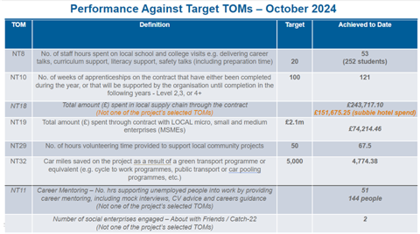
Cromer and Mundesley Coastal Management Projects (for North Norfolk District Council)

Slide 16
Cultural Quarter - The Demolition phase of Battery Green Car Park Lowestoft, Suffolk, NR32 1
Shared staff vehicles to reduce miles travelled
• Appointed 5 local staff
• Using local sub-contractors and local building merchants for materials
• Gifting £3,600 to 1 Local Food Bank and 4 local pantries
• Provided furniture to the Battery of Idea’s project, which was redundant from the Wilko store
• Crushed and graded concrete material on site for re use in the wider development
• Undertook a local litter pick

Slide 17
Examples of Good and Poor responses to Social Value Questions
Good responses | Poor Responses
-We are dedicated to creating local job opportunities through targeted recruitment strategies, apprenticeship programs, and partnerships with local employment agencies. - Additionally, We will create apprenticeship opportunities for young people and adults, particularly in construction and regeneration fields. By providing on-the-job training and mentoring, we aim to increase the skills base of the local workforce.. For example, we aim to generate X number of jobs within X local community, provide Y hours of training for skill development, and achieve Z% reduction in environmental waste. | "We plan to create jobs and support local businesses." Reasons: it does not quantify or qualify the impact of the proposed activities. The supplier's response presents a challenge for the evaluator to evaluate in terms of tangible benefits due to the absence of measurable outcomes.

Slide 18
Ensure Social Value Responses are related to the project to be delivered !!!

Slide 19










Sizewell C Opportunities
Ian Currie – Suffolk Chamber of Commerce, Supply Chain Business Manager, Local & Regional Supply Chain Engagement Team for Sizewell C
www.competefor.com/sizewellc/
www.sizewellcsupplychain.co.uk

Slide 20

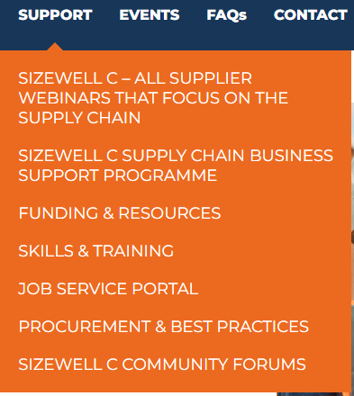
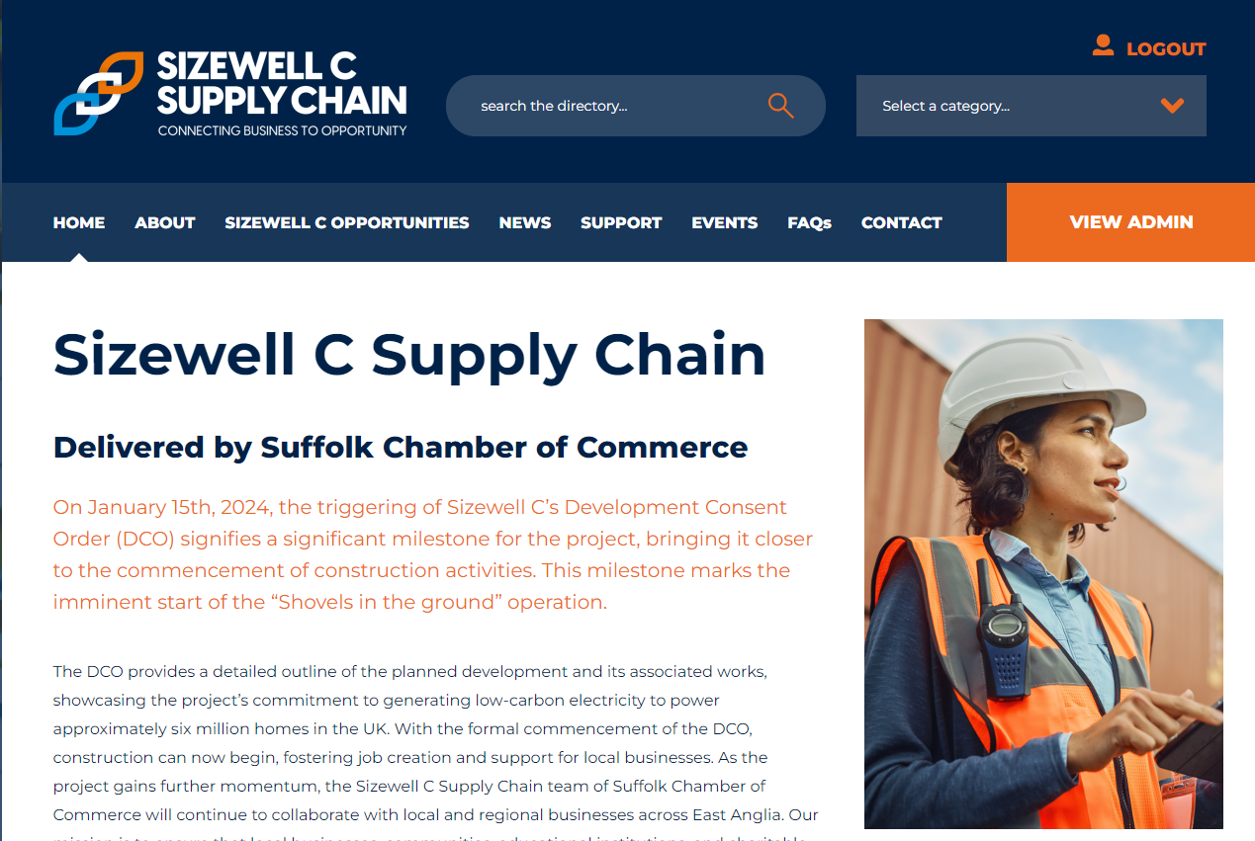
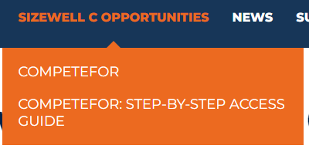
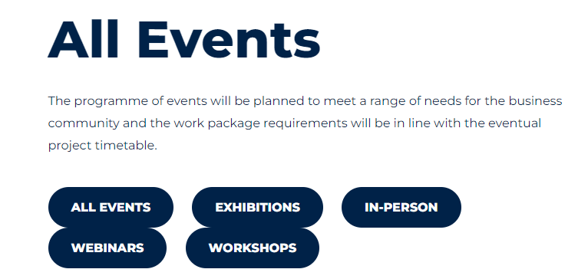
Supply Chain Guidance – Suffolk Chamber
https://sizewellcsupplychain.co.uk/
The Suffolk Chamber of Commerce provides a Local & Regional Supply Chain Engagement Team for Sizewell C to inform and mobilise companies to contribute and take advantage of the opportunity the Project offers our region

Slide 21

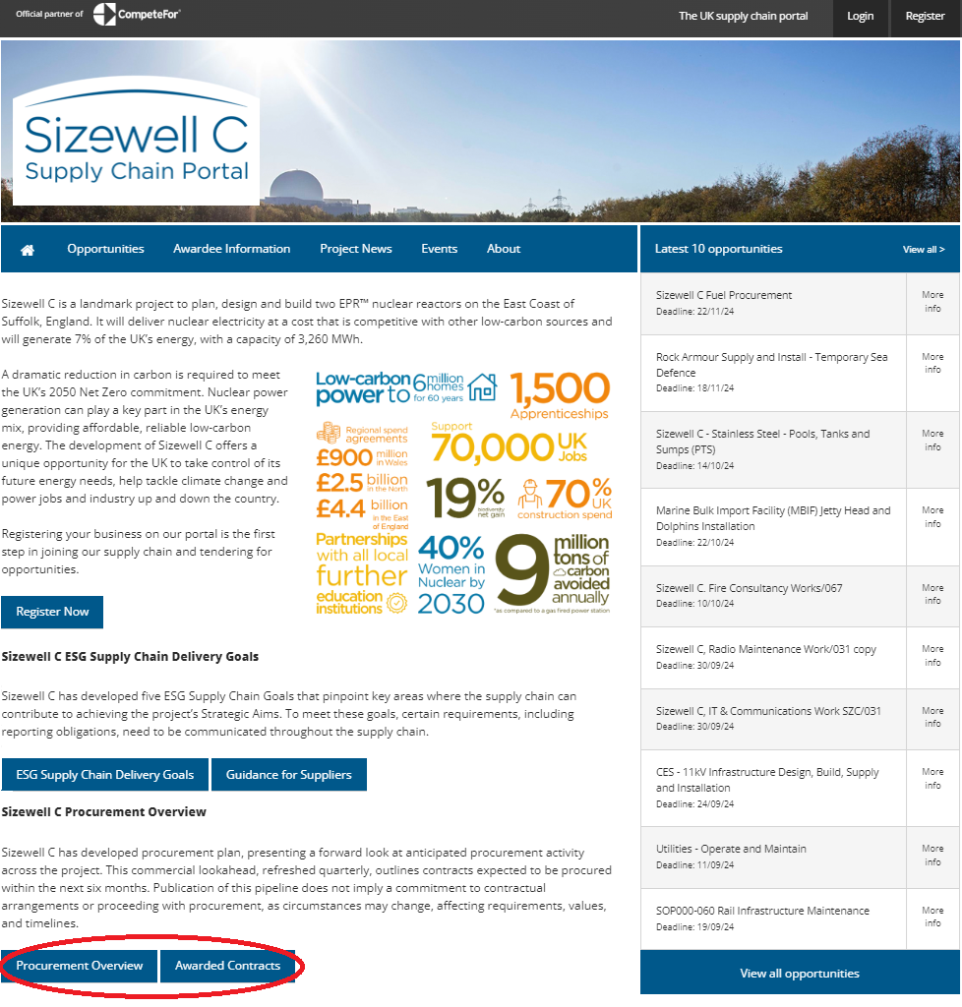
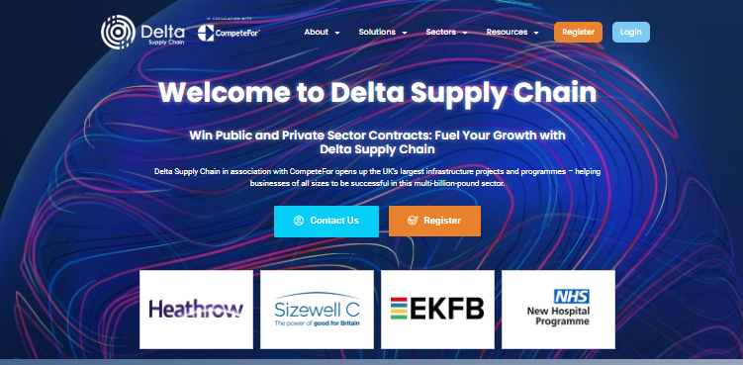
Sizewell C Opportunites Portal
https://www.competefor.com/sizewellc/
CompeteFor – Sizewell C Microsite
Sizewell C opportunities are now being advertised on CompeteFor; to respond you will need to register on CompeteFor. https://www.competefor.com/business/signup.html
Once registered on CompeteFor you will need to complete & publish your business profile for your organisation to be business ready and this will enable you to respond to opportunities.
It is important when logged in to CompeteFor to complete your email alert profile to keep up to date with opportunities that may be of interest to you. To find videos for setting up your business profile & email alerts, please visit https://www.competefor.com/video-guides/
Forward Look & Contract Awards

Slide 22
Key Themes
Procurement Process Overview
Make Sure You Bid Compliant

Slide 23
Key Themes
Sizewell C Supply Chain - ESG Social Value Goals
SZC has developed 5 Environmental and Social Governance (ESG) Goals to identify where the supply chain can help deliver the Strategic Aims of the Project
Goal 1:
Increase UK Content
By championing UK content in the supply chain, and prioritising local,
regional, and then national spend where possible
Goal 2:
Invest in education, employment and skills
By identifying job opportunities and skills training and apprenticeship
opportunities
Goal 3:
Reduce the environmental impact of construction
By identifying and acting on opportunities to leave a strong environmental
legacy as well as mitigating our impact on the environment.
Goal 4:
Tackle workforce inequality
By creating a diverse and inclusive workplace which employs local people,
engages young people, takes steps to engage hard-to-reach-groups and
promotes health and wellbeing
Goal 5:
Optimise opportunities for local communities
By providing opportunities in the region and supporting initiatives that
improve outcomes for local communities
Contact: Esg.team@sizewell.com

Slide 24



thank you
For any questions or more information, please:
email: sizewellcinfo@suffolkchamber.co.uk
call: 01473 694818
or visit: www.sizewellcsupplychain.co.uk

Slide 25

10:30-11:00am
121 opportunities & coffee break

Slide 26
11.00am-12pm Workshop: How to complete tender responses
Group exercise to respond to a potential requirement and what you need to be aware of when filling out tender documentation.
Part A- instructions and information
Part B- Procurement Specific Questionnaire
Part C- response pack
Guidance document
ESC Social Value Ask
Our Direction 2028
Procurement Strategy 2024-2028

