Slide 1

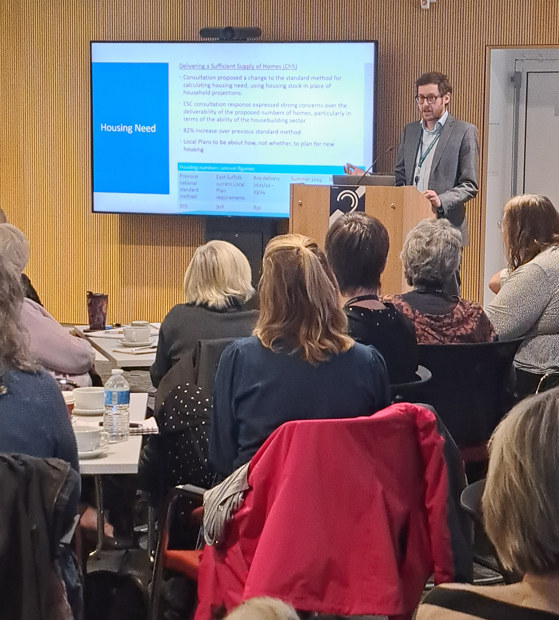

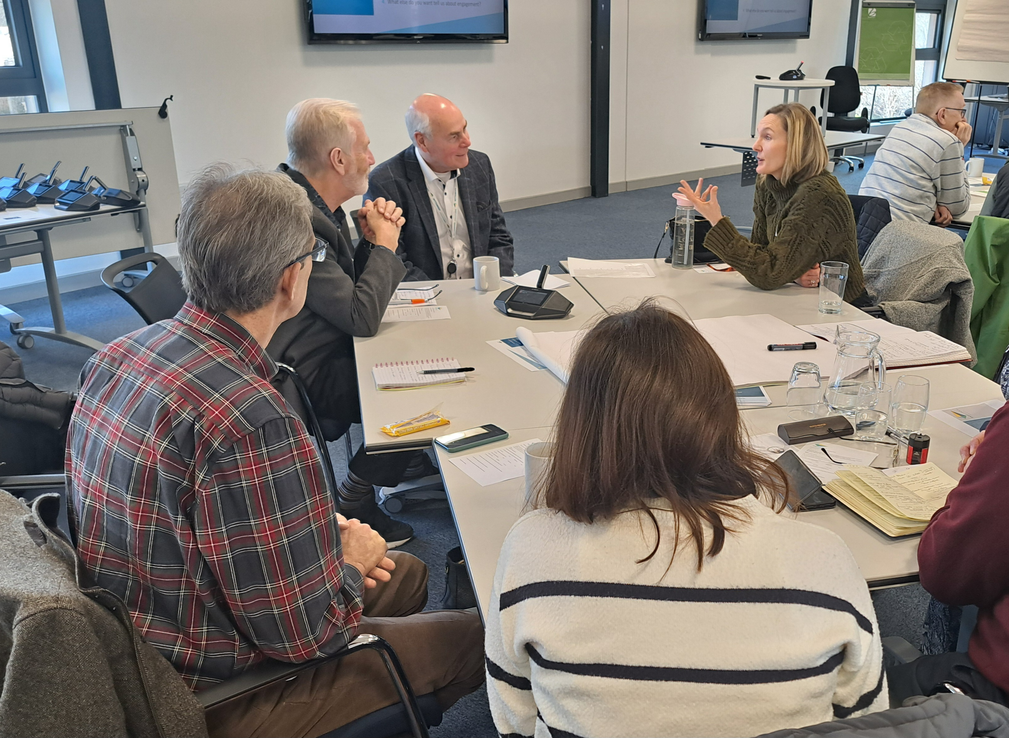
East Suffolk Council
Town & Parish Forum
July 2025

Slide 2
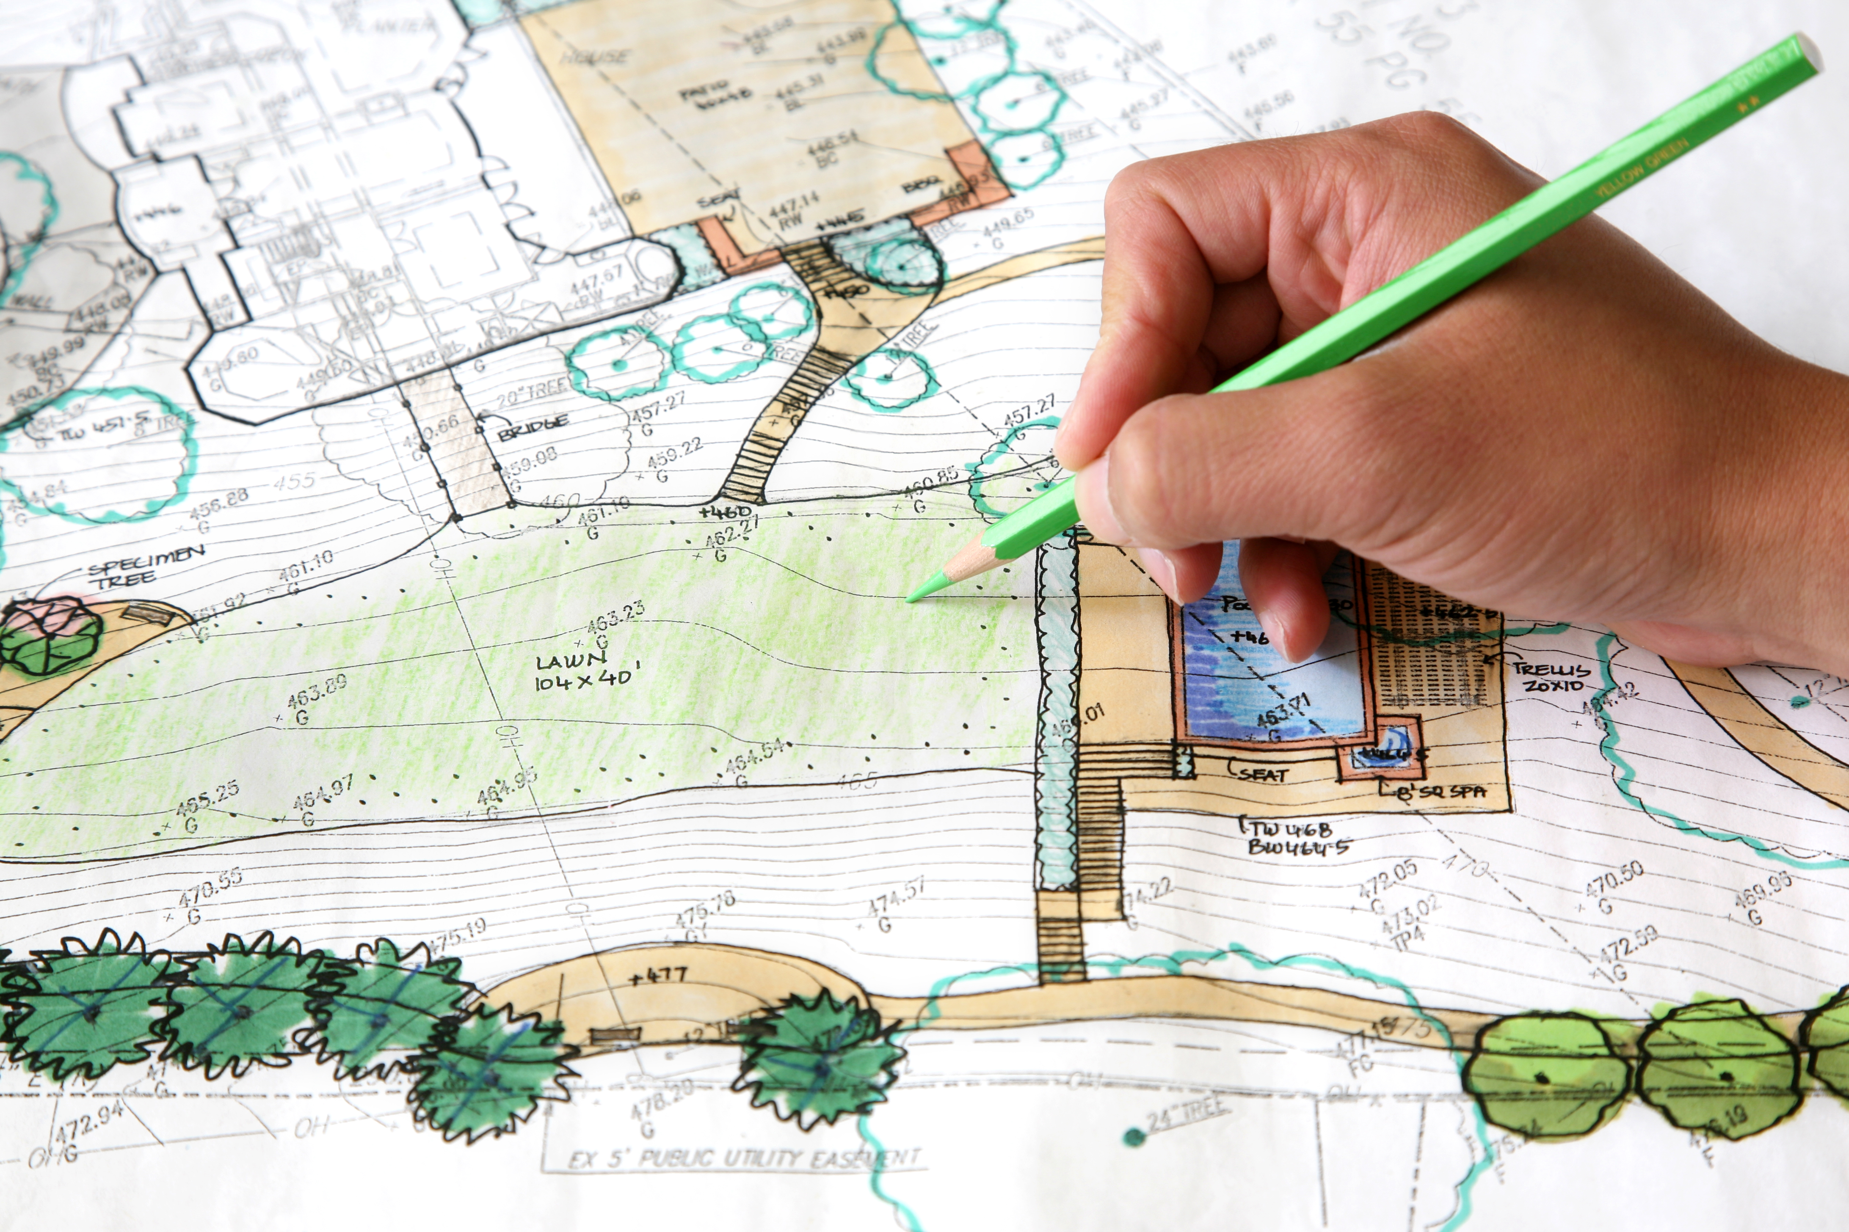


Town & Parish Council Forum Agenda - July 2025
9:30 - 9:50
Opening word from Cllr Mark Packard & Ben Woolnough
Cabinet Member for Planning & Building Control.
Head of Planning & Building Control.
9:50 - 11:15
East Suffolk Trees and Landscapes
Tree & Hedgerow Strategy, Tree wardens,
Landscape Audits & Tree conservation
Nicholas Newton, Principal Landscape and Arboriculture officer.
11:15 – 11:30
Coffee Break
11:30 - 12:00
An update from Development Management & Policy
Joe Blackmore, Planning Manager (Development Management). Andrea McMillan, Planning Policy Manager & Dickon Povey – Principal Planner.
12:00 - 12:20
An Update on Sizewell C & Energy Projects
Martyn Fulcher, Head of Energy Planning & Coastal Management.
Beth Rance, Energy Projects Manager.
12:20 - 12:45
Q&A

Slide 3
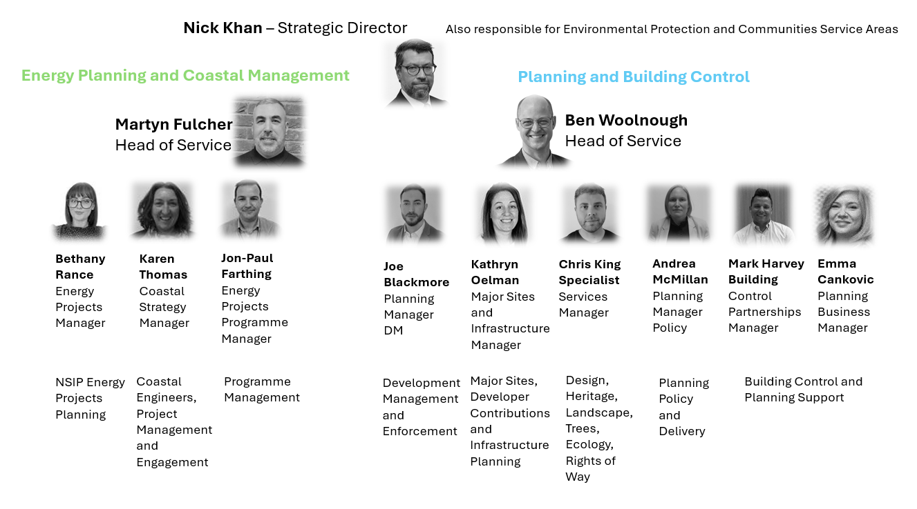

Slide 4
EAST SUFFOLK PLANNING AND BUILDING CONTROL IN NUMBERS 2024
1,648 planning applications received and 1906 decisions made
75 hours 22 minutes spent in planning committees, up from 52 hours in 2023, 38 hours in 2019
75% of appeals dismissed, the national average is 69%
£7.8 million CIL income
£1.3 million in Neighbourhood CIL distributed to Town and Parish Councils
29 CIL bids received this June
394 enforcement cases opened, 765 cases closed
2163 Building control applications
124 freedom of information requests
50 complaints, 13 upheld
28 Made neighbourhood plans so far with Five made in the past year
22 Planners have been created by our team since 2019 through Level 7 RTPI apprenticeships.

Slide 5
EAST SUFFOLK TOWN AND PARISH FORUM JULY 2025
TREES AND LANDSCAPE

Slide 6
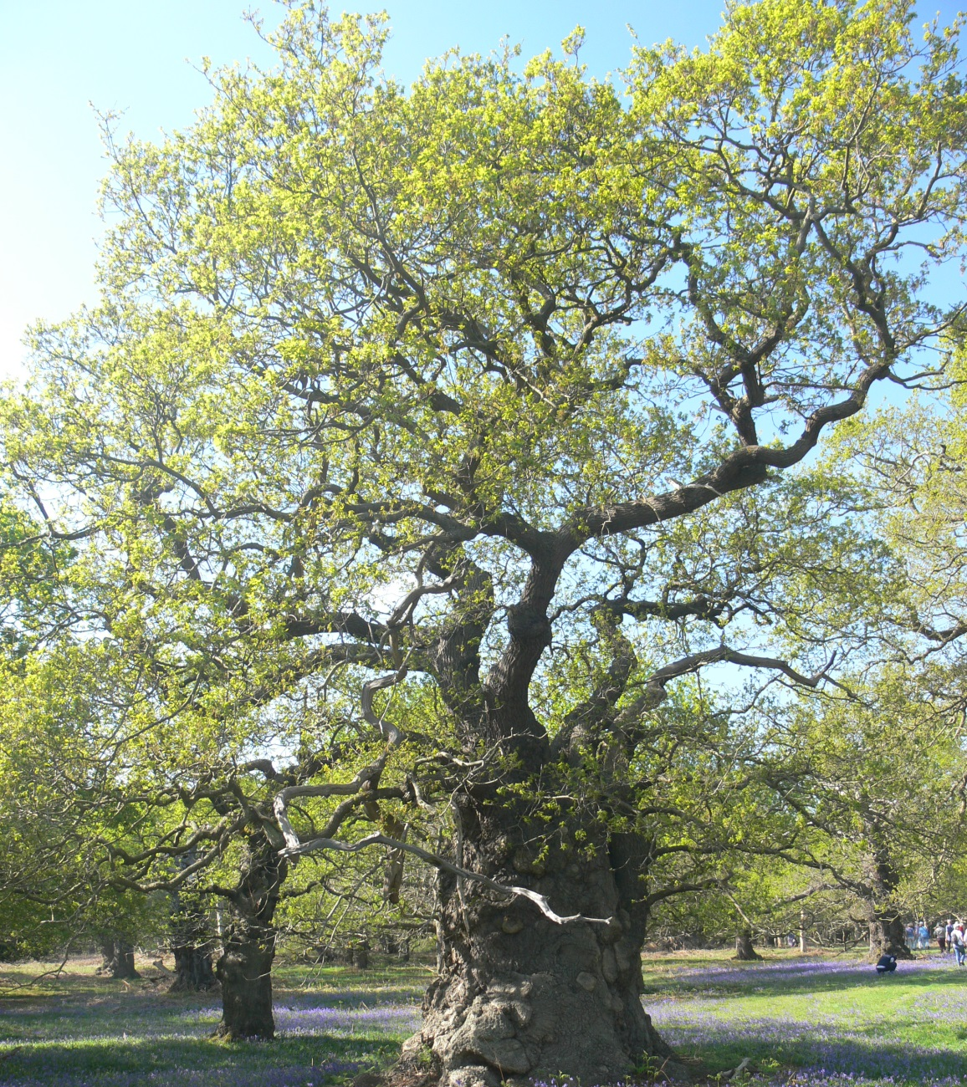
An update and discussion on matters relating to trees and landscape in East Suffolk…

Slide 7
Team Structure-
Principal Arboriculture and Landscape – Nicholas Newton
Senior Landscape Officer – Ruth Chittock
Arboriculture Officer North- Rik Fox (currently also covers Woodbridge and Melton)
Arboriculture Officer South – Falcon Saunders
Landscape Management Officer – Hamish Liddle
Also
Rights of Way Delivery Officer – Sarah Potter

Slide 8
TREE PRESERVATION ORDERS
A local planning authority can serve a TPO on tree(s) when it is expedient to do so.
Such trees need to:
  Have a reasonable degree of future longevity
  Be under threat to a greater or lesser extent
  Be of notable public amenity value
TPOs can be served on individual trees, groups of trees, woodlands or areas of trees.
It is a criminal offence to lop, top, fell or otherwise destroy a tree protected by a TPO without first applying for and receiving consent from the local planning authority.
A local authority can permit, partially permit, or refuse an application.

Slide 9
A refused application can be appealed to the Planning Inspectorate.
The local planning authority can be held liable for any costs directly arising from a refusal of consent for tree works.
Exemptions from need to apply:
If the tree is dead, or has deadwood (only dead wood may be removed)
If the tree is diseased.
If the tree is imminently dangerous.
To mitigate a legal nuisance.
For these only 5 days written notice is required.
There is a District wide review of all TPOs currently underway.
All TPOs can be viewed on our GIS mapping webpage and this is always live and up to date.

Slide 10
TREES IN CONSERVATION AREAS
Applies to all trees with a stem diameter greater than 75mm measured 1.4m. above ground level.
Essentially imposes all the same restrictions/requirements as a TPO tree…
Except……..
The applicant is no longer applying for permission, but giving Notice (S211) of intention to carry out works.
The local authority has 6 weeks to decide whether to raise no objection, or to allow 6 weeks to lapse, in which case the work may go ahead, or to serve a TPO.
A TPO has to be served to prevent the notified work because a notification cannot simply be refused (it’s a notification not an application).
Therefore the tree must show same qualifying TPO criteria as before.
Exemptions are same as TPOs.

Slide 11

Other legislation-
1997 Hedgerow Regulations
Felling Licence under the Forestry Act
High Hedges legislation

Slide 12
TREE STRATEGY
The Council is currently preparing a tree strategy partly focussed on seeing the planting of 250,000 trees.
To achieve this, we will be making a call for sites from any organisation that wishes to take part in meeting this ambition and that can include Town and Parish Councils.

Slide 13
TREE WARDENS
The Suffolk Tree Wardens have recently celebrated their 30th anniversary.
They are now a self –governing charitable organisation.
Full details of who they are, what they do, and why your community needs one if you haven’t got one can be found at:
www.suffolktreewardens.org.uk

Slide 14

LANDSCAPE CHARACTER

Slide 15

The District is currently covered by 2 Landscape Character Assessments; one Waveney, one Suffolk Coastal.
These are currently under review to be amalgamated into an up-to-date East Suffolk format and digitized so that they can be viewed as a layer on our GIS mapping.
This is of relevance to Neighbourhood Plans and it will help you with your planning consultation responses in respect of maintaining your local landscape distinctiveness.

Slide 16
LANDSCAPE MONITORING
With our current team numbers we are now able to embark on a programme of monitoring of new landscape works associated with new developments.
We aim to have a comprehensive Districtwide programme to ensure better quality delivery of new planting.
There is potential for Tree Wardens to have a role in this as local ‘eyes on the ground’.

Slide 17
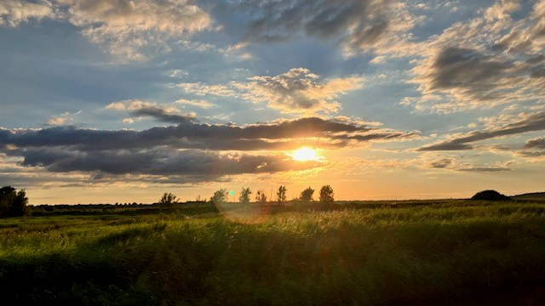

Slide 18
Development Management
Joe Blackmore – Planning Manager

Slide 19
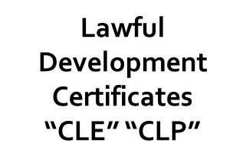
What are the Various Application Types?
Permitted Development Notifications and Prior Approvals
“PNH”
“P3Q”
“AGO”
Variation of Conditions “VOC”
Removal of Conditions
“ROC”
Non-Material Amendment
“AME”
Discharge of Conditions
“DRC”
Planning Application Types
Applications Made by The Council as Developer
“RG3”
Advertisement Consent Apps
“ADI” “ADN”
Listed Building Consent
“LBC”
Outline Planning Application
“Out”
Reserved Matters Application
“ARM
Full Planning Application
“FUL”

Slide 20
Which Application Types are Most Important for Towns and Parishes to Comment on?
FUL – full application
OUT – outline application
ARM – reserved matters
LBC – listed building consent
VOC – variation of condition
ROC – removal of condition
ADI/ADN – advertisement consent
RG3 – council-led development

Slide 21
What are the Application Types Where the LPA Cannot Generally Consider Comments from TC/PCs?
Permitted Development Prior Notifications and Approvals
Discharge of Conditions
Non-Material Amendments
Lawful Development Certificates
*EIA Screening and Scoping Opinions

Slide 22
What are the Various Application Types?
Permitted Development Notifications and Prior Approvals
“PNH”
“P3Q”
“AGO”
“AGO2”
Variation of Conditions “VOC”
Removal of Conditions
“ROC”
Non-Material Amendment
“AME”
Discharge of Conditions
“DRC”
Lawful Development Certificates
“CLE” “CLP”
Planning Application Types
Applications Made by The Council as Developer
“RG3”
Advertisement Consent Apps
“ADI” “ADN”
Listed Building Consent
“LBC”
Outline Planning Application
“Out”
Reserved Matters Application
“ARM
Full Planning Application
“FUL”

Slide 23
Questions for the DM Team?

Slide 24
Planning Policy update
Town and Parish Forums
16th / 23rd July 2025
Andrea McMillan (Planning Manager – Policy & Delivery) and Dickon Povey (Principal Planner)

Slide 25
Local Plan update
Interim timeline for preparation of East Suffolk Local Plan set out in Local Development Scheme (March 2025)
The timeline anticipates beginning work in 2025, with adoption in 2029
Dependent on introduction of new plan-making system by Government – now anticipated ‘later this year’, and with a period of familiarisation
Reforms introduce ‘30 month’ timetable for plan preparation
Local Plan will plan for significantly higher levels of housing (new standard method figure 1,667 dwellings per year, compared to 916 planned for in Local Plans)
We are getting prepared in advance of the new system and formal stages – e.g. scoping of evidence

Slide 26
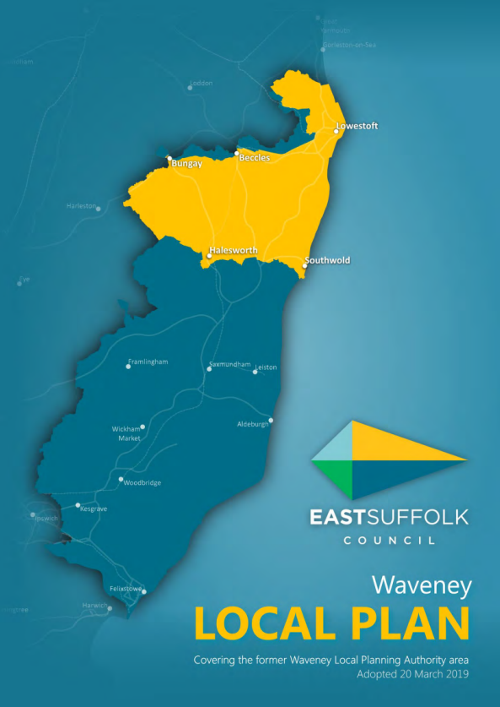
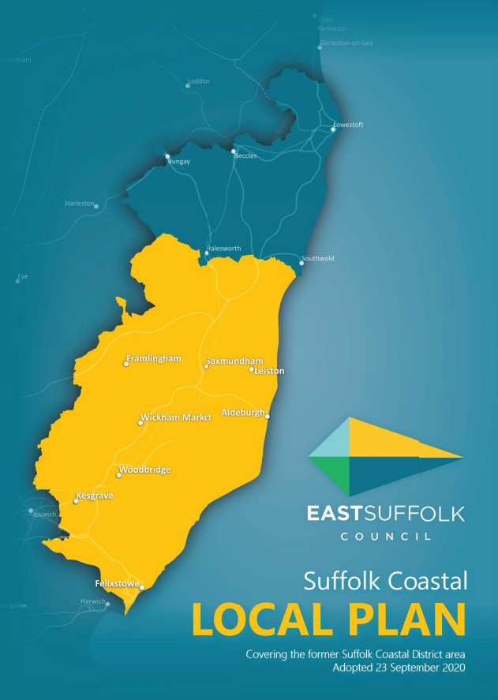
Housing Land Supply
Waveney Local Plan area – following the introduction of higher housing need figure, due to the Local Plan being over five years old housing land supply position was re-visited in March 2025. Land Supply = 3.33 years
‘Presumption in favour of sustainable development’ applies in Waveney Local Plan area currently (Note – doesn’t apply in Bungay until Nov 2027 as Neighbourhood Plan plans to meet it housing requirement)
Interim Housing Position Statement published in March 2025 – explains how the ‘presumption’ applies
Suffolk Coastal Local Plan is five years old on 23rd September. ‘Review assessment’ required to be undertaken before then. Housing land supply fully expected to be below five years. Report to Cabinet in September including update to Interim Housing Position Statement

Slide 27
Statement of Community Involvement review / questionnaire
The Statement of Community Involvement (SCI) explains steps ESC will take around consultation and engagement for planning
It covers Local Plans, Neighbourhood Plans, Planning applications and appeals, CIL charging schedule, and more
Needs to be reviewed every 5 years
  (note: SCI’s may be removed!)
We want to understand how communities would like to be engaged in preparing new planning policy documents
Questionnaire has launched!
  Open until 3rd September

Slide 28
Neighbourhood Planning update
28 made plans in total. Carlton Colville, Westerfield and Ufford plans most recently made
Otley NP has recently completed Examination. Aldringham-cum-Thorpe and Lowestoft are commencing Examination
Little Bealings completed the pre-submission consultation in June
Two guidance documents to help Neighbourhood Plans address Housing and Climate Change matters were published in May.
The 'How to go About it' guidance is being reviewed and updated.
Preparation of new guidance on Neighbourhood Plan implementation and monitoring and planning for Infrastructure is currently being prepared.
Locality have announced that Gov grant funding and technical support has ended

Slide 29
Energy Projects
Town and Parish Forum
Martyn Fulcher, Head of Energy Planning and Coastal Management &
Beth Rance, Energy Projects Manager
16 and 23 July 2025

Slide 30
ESC Energy Planning
Team
What is their role?
ESC (as the Local Planning Authority) is not the decision-maker for NSIPs. ESC has an important role to play in the consenting process from pre-application engagement, consenting, delivery, and throughout the lifetime of these projects
The grant of a Development Consent Order is not the end of the planning process for NSIPs. Officers have significant responsibilities post DCO ​
Discharge of requirements (akin to planning conditions) and obligations to be undertaken and delivered in accordance with the Development Consent Order and Deed of Obligation
Working closely with internal and external stakeholders, promoters, statutory bodies, and communities
Outside project work, the service regularly engages with central government, responding to consultations on planning reform, community benefits, policy changes, and more.
Recent establishment of a programme management function within the service, to provide strategic oversight and programme management across all East Suffolk’s NSIPs

Slide 31
Energy Projects Overview
Pre-Application
Acceptance
Pre-Examination
Examination
Recommendation and Decision
Post Decision
 | Project | Stage | Project Headlines
New Nuclear | Sizewell C |  | DCO granted 2022. Formally commenced January 2024. Discharges of requirements are ongoing.
Offshore Wind | East Anglia One |  | DCO granted 2014. Operational
 | East Anglia One North |  | DCO granted 2022. Pre-commencement
 | East Anglia Two |  | DCO granted 2022. Pre-commencement
 | East Anglia Three |  | DCO granted 2017. Commenced works on the cable route 2025
 | Five Estuaries (Galloper extension) |  | Examination closed 17th March 2025. Examining Authority’s recommendation sent to the Secretary of State, decision expected September 2025.
 | North Falls (Greater Gabbard extension) |  | DCO application accepted 22 August 2024 – examination ongoing.
Interconnectors | LionLink |  | Statutory Consultation expected late 2025. DCO application expected to be submitted late 2026.
Reinforcement Projects | Sea Link |  | In pre-examination phase, examination expected to start summer 2025.
Out of District Network Reinforcements | Bramford to Twinstead |  | DCO granted by the Secretary of State 12 September 2024. Pre-commencement
 | Norwich to Tilbury |  | DCO application expected to be submitted in 2025. Statutory consultation finished 26 July 2024. Additional targeted consultation held February-April 2025
Post Decision
Post Decision
Post Decision
Post Decision
Post Decision
Decision
Examination
Pre-Application
Pre-Examination
Post Decision
Pre-Application

Slide 32
Projects Overview
Lion Link: multi-purpose interconnector between the UK and Netherlands, connecting to a Dutch offshore wind farm, and connecting the GB and Dutch electricity grids. Currently in the pre-application phase. Statutory consultation expected autumn 2025
East Anglia One North: offshore wind farm, granted consent in 2022 and construction has not yet formally commenced.
East Anglia Two: offshore wind farm, granted consent in 2022 and construction has not yet formally commenced.

Slide 33
Sea Link, National Grid Electricity Transmission (NGET)
Pre-Examination
Project Description
High Voltage Direct Current (HVDC) subsea network reinforcement link between Suffolk and Kent.
HVDC underground cables from the coast at Aldeburgh to a new converter station at Saxmundham, connected via High Voltage Alternating Current (HVAC) underground cables to the proposed Friston substation.
Project Update
NGET submitted application for DCO to PINS on 27th March 2025.
ESC submitted its Adequacy of Consultation Representation to PINS on 9 April 2025 – accepted that NGET had met the statutory requirements, but noted disappointment in Applicant’s consultation and failure to take the Council’s meaningful contributions on board
PINS accepted the application for examination on 23 April 2025
ESC submitted its Relevant Representation (see next slide for further details) to PINS on 20 June 2025
Next Steps
Officers are preparing Local Impact Report, which will be submitted at an early stage in the Examination
Rule 6 Letter, setting out the draft Examination timetable, expected to be published by PINS imminently
Examination expected to commence in Q3 2025

Slide 34
Sea Link
ESC
Relevant Representation
Pre-Examination
ESC submitted its Relevant Representation to PINS on 20 June 2025
Designed to provide the Examining Authority (who will be examining the application during the six-month Examination commencing later this year) with a summary of the Council’s principal concerns, together with supporting context
  ESC maintained its objection to the project in light of the lack of engagement by the Applicant and the unacceptable harm the project will cause to the local communities, environment and economy of East Suffolk, both in isolation and cumulatively with the numerous other projects in the area
  In the event that the project is consented, ESC remains fully committed to working with the Applicant to secure the best outcomes possible, in the interests of our local communities and environment.
This Representation will be expanded on in greater detail within ESC’s Local Impact Report, which will be submitted during the Examination.
ESC organised engagement events with the Town and Parish Councils proposed to host the project should it be granted development consent by the Secretary of State for Energy Security and Net Zero, helping to ensure that their views and local knowledge informed ESC’s response.
ESC’s Relevant Representation can be viewed here.

Slide 35
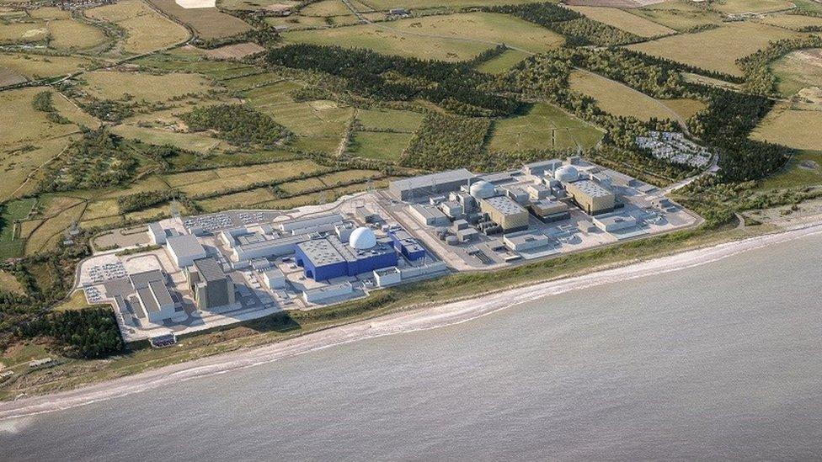
Sizewell C Project Overview
2 European Pressured Reactor Units, with an expected overall output of 3.2GW
Once operational, will supply 6m homes for an operational life of around 60 years
Two temporary park and ride sites; one at Darsham (the ‘northern park and ride’), and one at Wickham Market (the ‘southern park and ride’)
Two Village Bypass: a permanent road to bypass Stratford St Andrew and Farnham
Sizewell Link Road: permanent road linking the A12 to west of the Sizewell C main development site
Yoxford Roundabout: permanent highway improvements at the junction of the A12 and B1122 east of Yoxford
Green Rail Route: a temporary extension of the existing Saxmundham to Leiston branch line into the main development site
Rail: Other permanent rail improvements on the Saxmundham to Leiston branch line
2,400 temporary accommodation campus

Slide 36
Sizewell C
Overview
Post Decision
Formal commencement occurred 15 January 2024, project is now in its second year of construction, of an anticipated 9–12-year construction period.
ESC has responsibilities as host authority, the local planning authority, the enforcement authority, and as a signatory to the Deed of Obligation
  Governance groups are meeting regularly as required by the Deed of Obligation. ESC engages with all required working groups – including planning group, transport review group, accommodation working group, ecology working group and many others
  Discharge of requirements ongoing (akin to planning conditions); working closely with stakeholders including Suffolk County Council, Environment Agency, Natural England, and others
Officers continue to engage with regulators and associated permits/licensing requirements, including the Environment Agency, Natural England, Marine Management Organisation
Officers are also considering several planning applications in relation to the Sizewell C project

Slide 37

Funding – Final Investment Decision, 22 July 2025
Post Decision
In the News - June
£14.2bn confirmed by the Department for Energy Security and Net Zero as part of government’s June Spending Review
EDF confirmed 12.5% stake as part of Anglo-French summit in early July
Final Investment Decision (FID)
FID confirmed by government 22 July, through the Secretary of State for Energy Security and Net Zero
The final investment decision follows the conclusion of government approvals processes, and negotiations with potential investors as part of the capital raise process started in September 2023.
Estimated construction cost of £38bn, including an estimated saving of 20% compared to Hinkley Point C as a virtual replica project
The government will become the largest shareholder with an initial stake of 44.9% alongside private investors
New Sizewell C shareholders: La Caisse with 20%, Centrica with 15%, Amber Infrastructure with initial 7.6%, EDF 12.5%
Sizewell C gets green light with final investment decision - GOV.UK

Slide 38
Sizewell C
Site Updates
Northern Park and Ride, Darsham: Site preparation, including construction compounds and welfare facilities, ecology and archaeology mitigations, continues. Construction of the roundabout next to the A12 and Willow Marsh Lane has started.
Southern Park and Ride, Wickham Market: archaeology ongoing, scheduled to conclude this summer. As areas become clear of archaeology work, construction will begin in a phased manner from the summer.
Orwell Logistics Park, Freight Management Facility: now operational, replacing the site consented under the DCO at Seven Hills. HGVs are checked in, security checked, and directed for onward travel via approved routes
Green Rail Route: Work starting soon on the new junction of Lover’s Lane and Abbey Road as part of the realignment work to allow SZC to install a new level crossing for the Green Rail Route.

Slide 39
Sizewell C
Site Updates
Two Village Bypass: Welfare facilities being installed at the Friday Street Roundabout compound ahead of main works starting later in the summer. All the site accesses have now been established, and construction will begin once archaeological surveys are complete.
Sizewell Link Road: All the site accesses have now been completed. Archaeology and ecology works continue across the sites, and main construction will begin in a phased manner once this work has completed.
Yoxford Roundabout: Construction began in early July with earthworks to bring the level of the site close to the current level of the A12. During this phase SZC will transport surplus material to the site on the A12 which will be used for the construction of the Sizewell Link Road. The roundabout will be completed in early 2026, with the majority of work taking place offline before the final connections to the A12 are made.

Slide 40
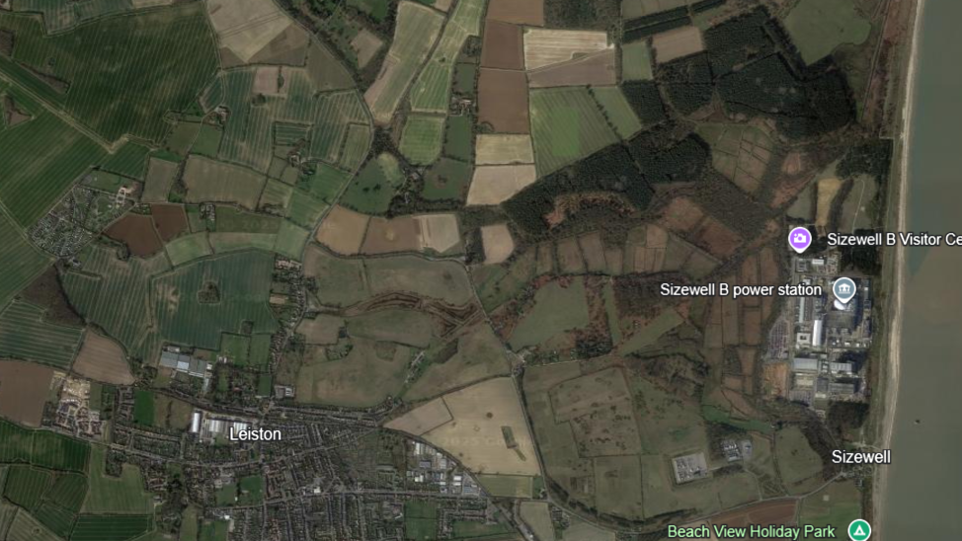
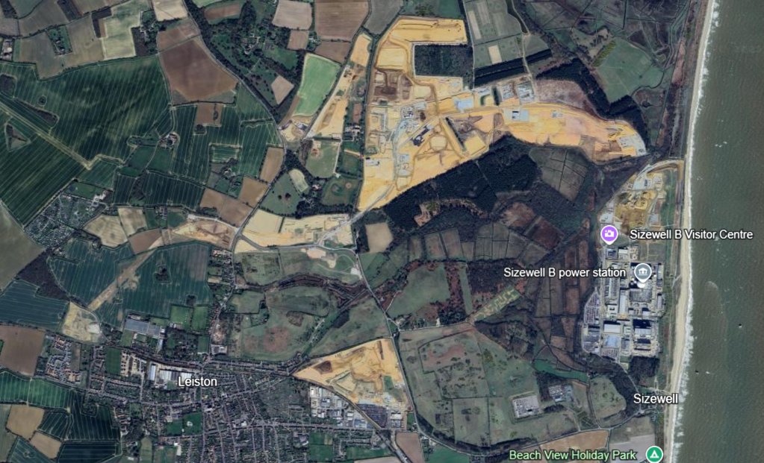
Main Development Site
Sizewell C | Aerial images and official updates reveal construction progress | New Civil Engineer
2022
2025
TCA
MCA
ACA
Temporary Construction Area (TCA): preparation for desalination plant ongoing, construction of the northern haul road required to move materials around site during main civils works ongoing, SSSI crossing works well underway (works to the northern side of the bridge include finishing the installation of the sheet pile environmental barrier, and on the southern side of the bridge works are underway to begin installing the sheet piles.)
Ancillary Construction Area (ACA): Earthworks progressing. Delivery taken of some ballast and pre-assembled track sections in preparation for construction of the rail head
Sizewell Beach and Harbour: Construction of the northern section of the temporary sea defence has started with the first sheet piles being installed. The works will take place within the Sizewell C fence line and the public footpath will remain open. Works will soon commence on installing a temporary outfall on the beach

Slide 41
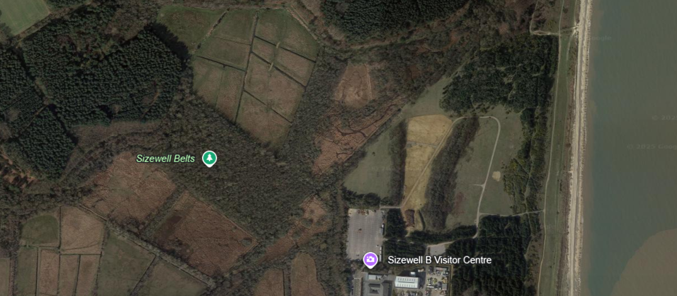
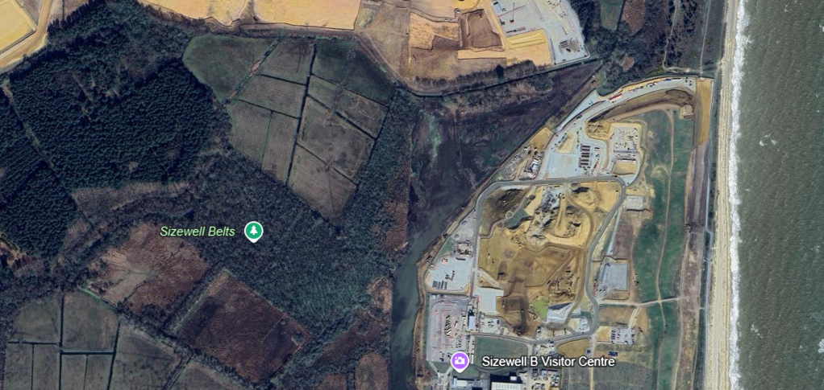
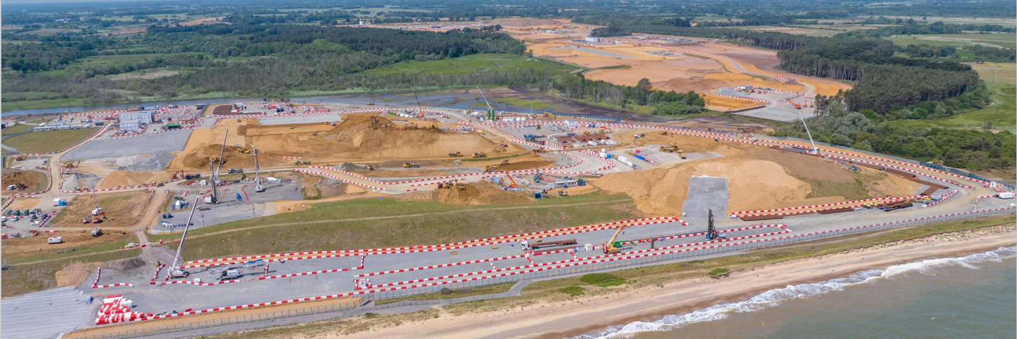
Main Construction Area
MDSF SZC 16 July 2024
Sizewell C | Aerial images and official updates reveal construction progress | New Civil Engineer
2022
2025
SSSI Crossing
TCA
MCA
SSSI Crossing

Slide 42
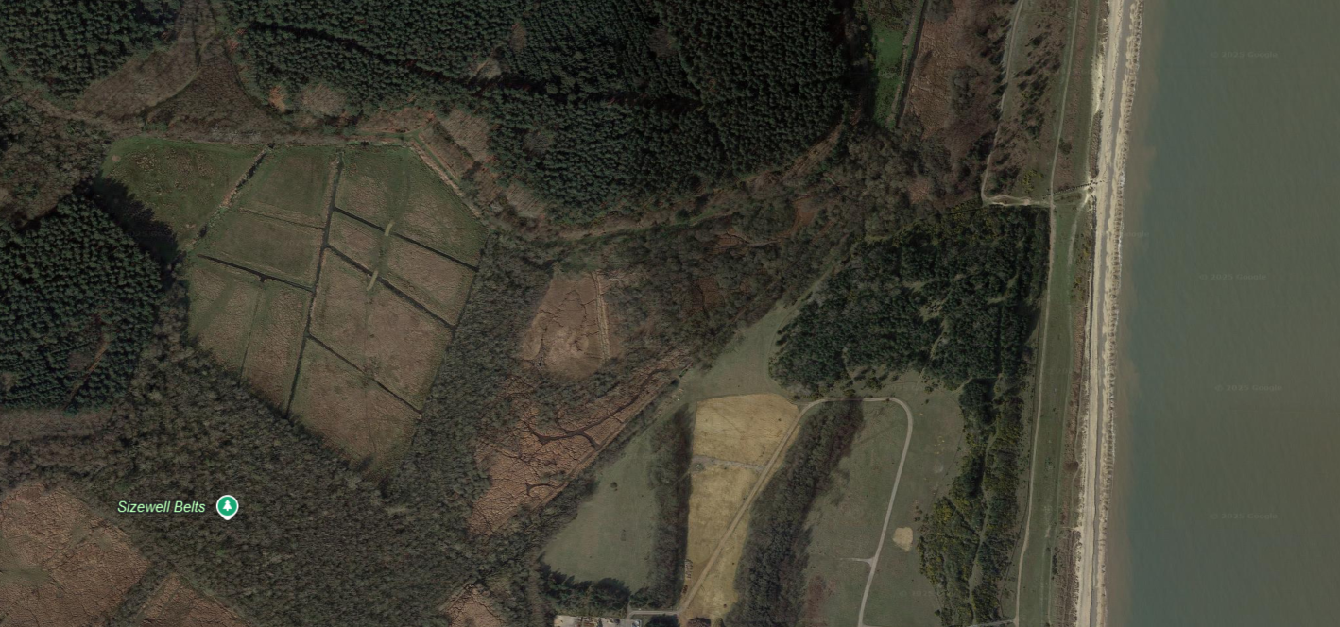
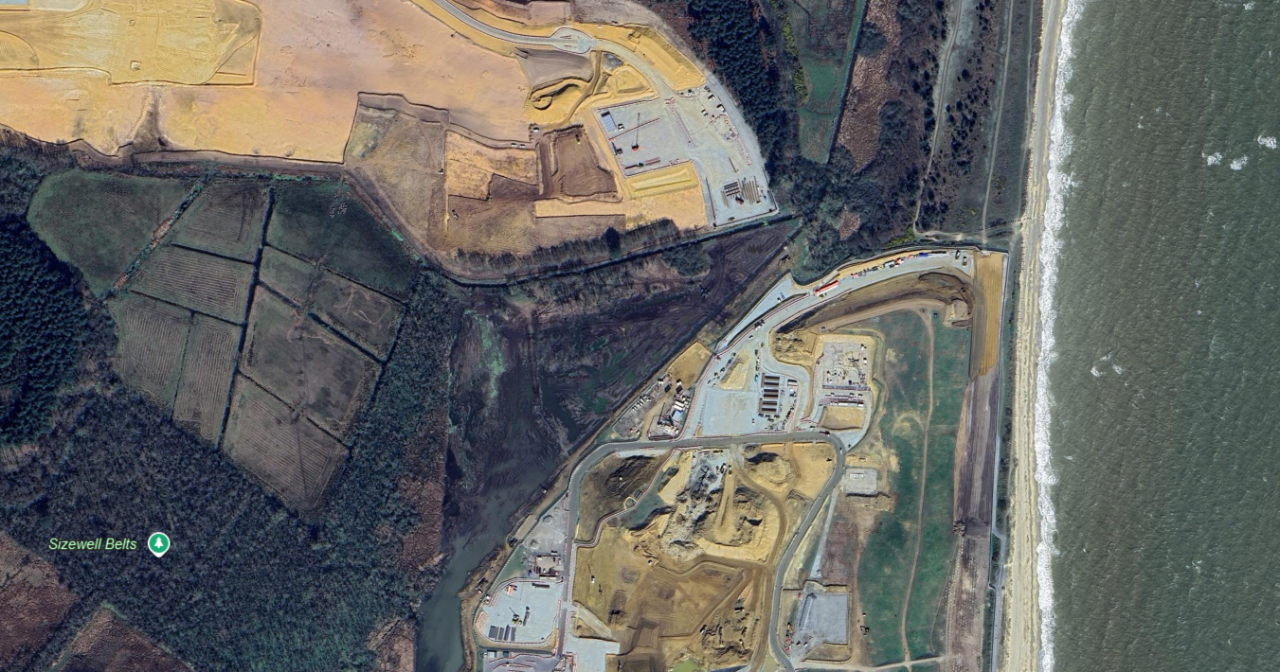
SSSI Crossing
2022
2025
Sizewell C | Aerial images and official updates reveal construction progress | New Civil Engineer

Slide 43
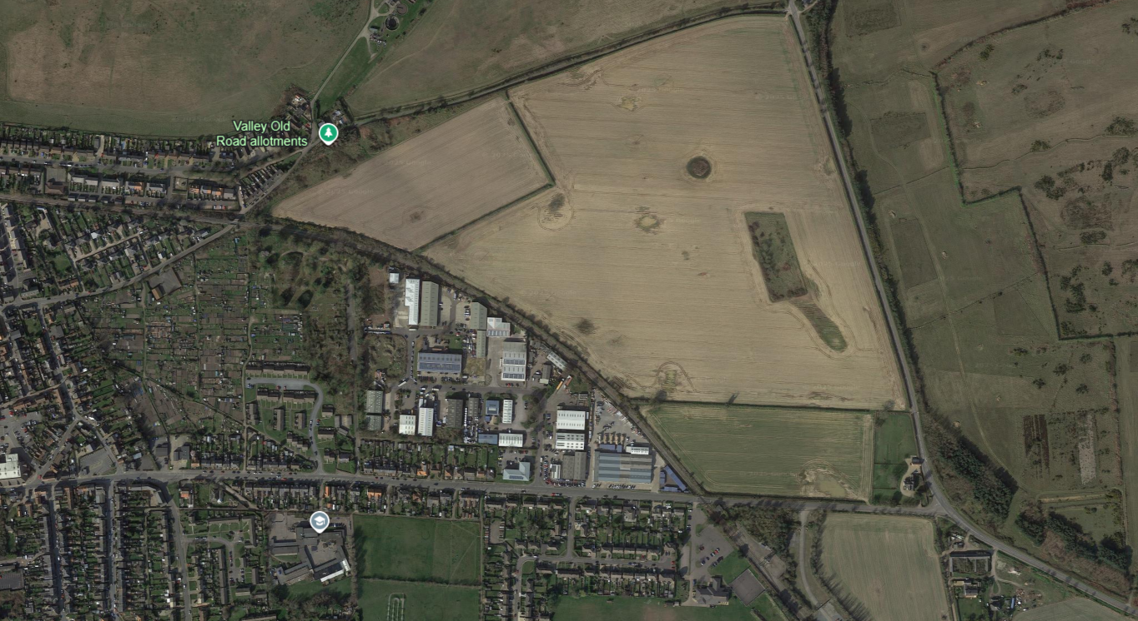
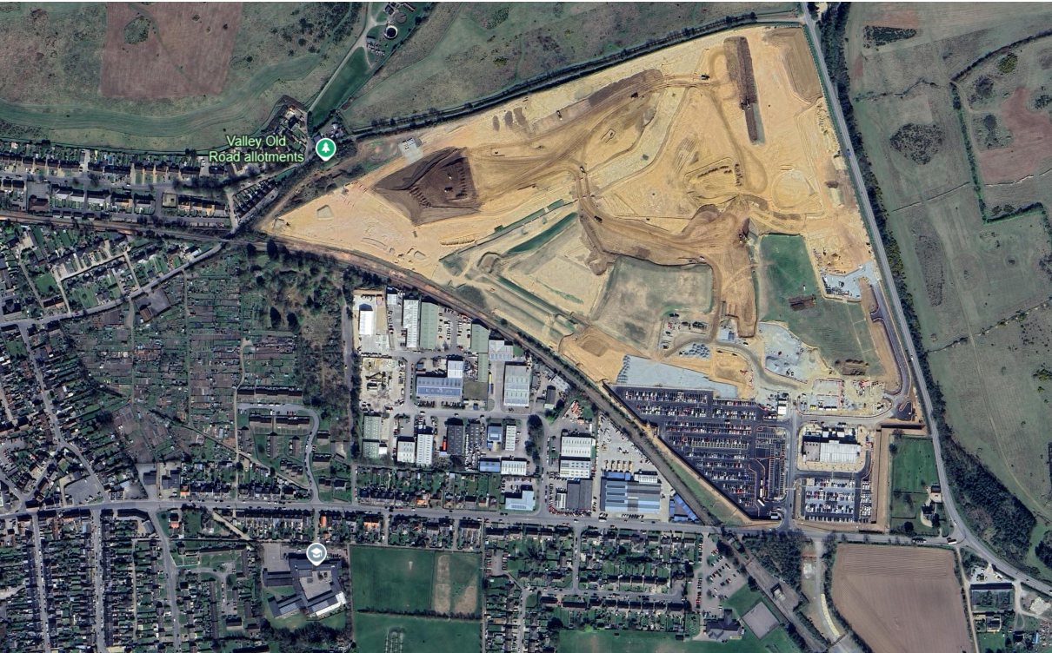
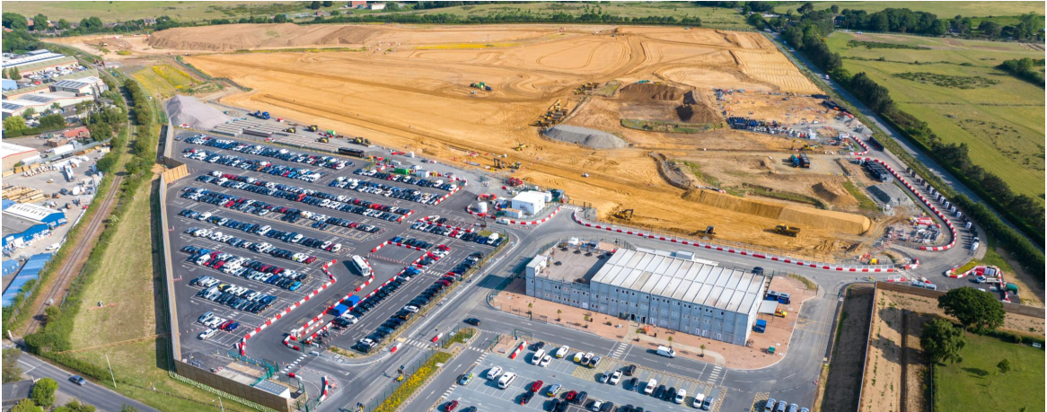
Ancillary Construction Area (ACA)
2022
2025
Sizewell C | Aerial images and official updates reveal construction progress | New Civil Engineer
MDSF SZC 16 July 2024

Slide 44
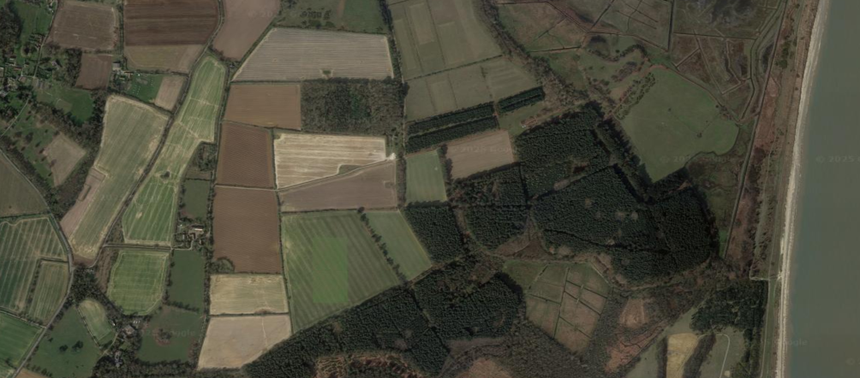
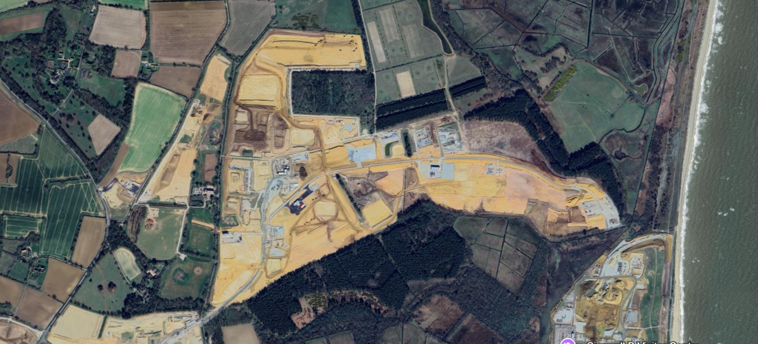
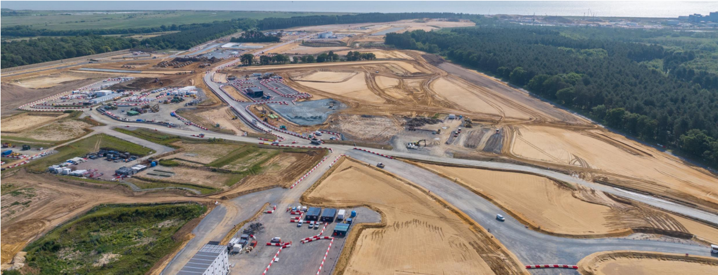
Temporary Construction Area (TCA)
2022
2025
Sizewell C | Aerial images and official updates reveal construction progress | New Civil Engineer
MDSF SZC 16 July 2024

Slide 45
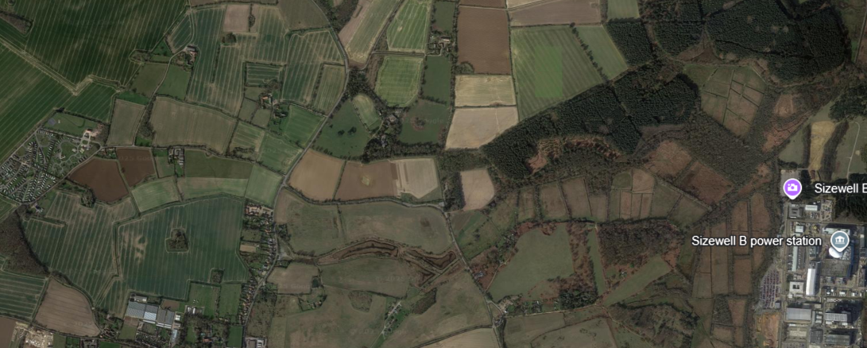
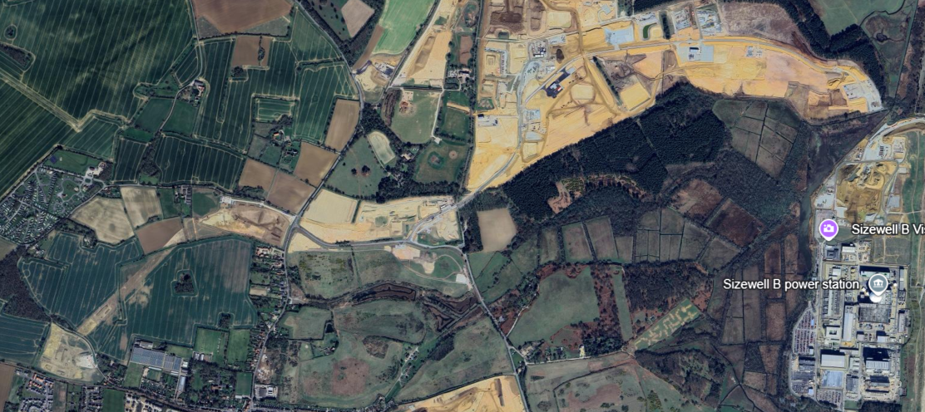
Sizewell C | Aerial images and official updates reveal construction progress | New Civil Engineer
Green Rail Route
2022
2025
Rail: Track replacement works started w/c 7 July on the Leiston Branch Line. Leiston airfield compound (welfare and parking) programmed to be open from 7 July, with the Buckleswood Road compound to be used for logistics only. Level crossing improvement works by SZC and Network Rail programmed into 2026
Green Rail Route: Work starting soon on the new junction of Lover’s Lane and Abbey Road as part of the realignment work to allow SZC to install a new level crossing for the Green Rail Route.

Slide 46

Other Updates
Working Paper, Community Benefits and Shared Ownership for Low Carbon Energy Infrastructure (DESNZ). Officers drafted response, to be published on our website
National Policy Statements EN-1, EN-3, and EN-5 (Consultation, DESNZ). Officer responses available on ESC website
Biodiversity Net Gain for NSIPs (Consultation, DEFRA). Officers drafting response - will be published on our website
Planning and Infrastructure Bill
Officers monitoring amendments and progress as the Bill moves through Parliament, engaging with government

Slide 47
Energy Projects Links
Sizewell C:
More information on Development Consent Order obligations and governance can be found here: Governance groups » East Suffolk Council
More information on discharge of requirement applications can be found here: Requirement discharge information and applications » East Suffolk Council
Sizewell C Works Tracker: Home - Sizewell C Works Tracker (szcworkstracker.co.uk)
Sea Link:
All ESC responses can be found here: Sea Link » East Suffolk Council
Further information can be found on the project website: Sea Link | About the project | National Grid Group
Planning Inspectorate project page, with application documentation: Sea Link - Project information
Consultations
All responses to consultations can be found on ESC's Strategic Engagement webpage: Strategic engagement » East Suffolk Council

Slide 48



Any Questions?

